Slide 1
Statistics and Public Policy
The Flawed Data Problem
Immigration and Overseas Students
Wealth Inequality and Wealth taxation
Is the World Nominal or Real?
Not just the UK

Slide 2
The Flawed Data Problem
Data Source | Public Policy
LFS (Labour Force) – suspended | Interest rates Welfare (health; labour inactivity) Minimum wage Labour market regulation (eg zero hours) Immigration impact on wages/jobs Employment policy (youth; long term jobless）
WAS (Wealth and Assets) -suspended | Inequality measures Wealth tax impact Savings behaviour Regional wealth inequalities
Annual Population Survey- suspended | Population by nationality: immigration Regional income disparities
Long Term Migration- revised | Immigration HE policy
Crime: Household Survey decertified | Police resources and priorities
Digital Sector – suspended | Economic growth Digital taxation

Slide 3
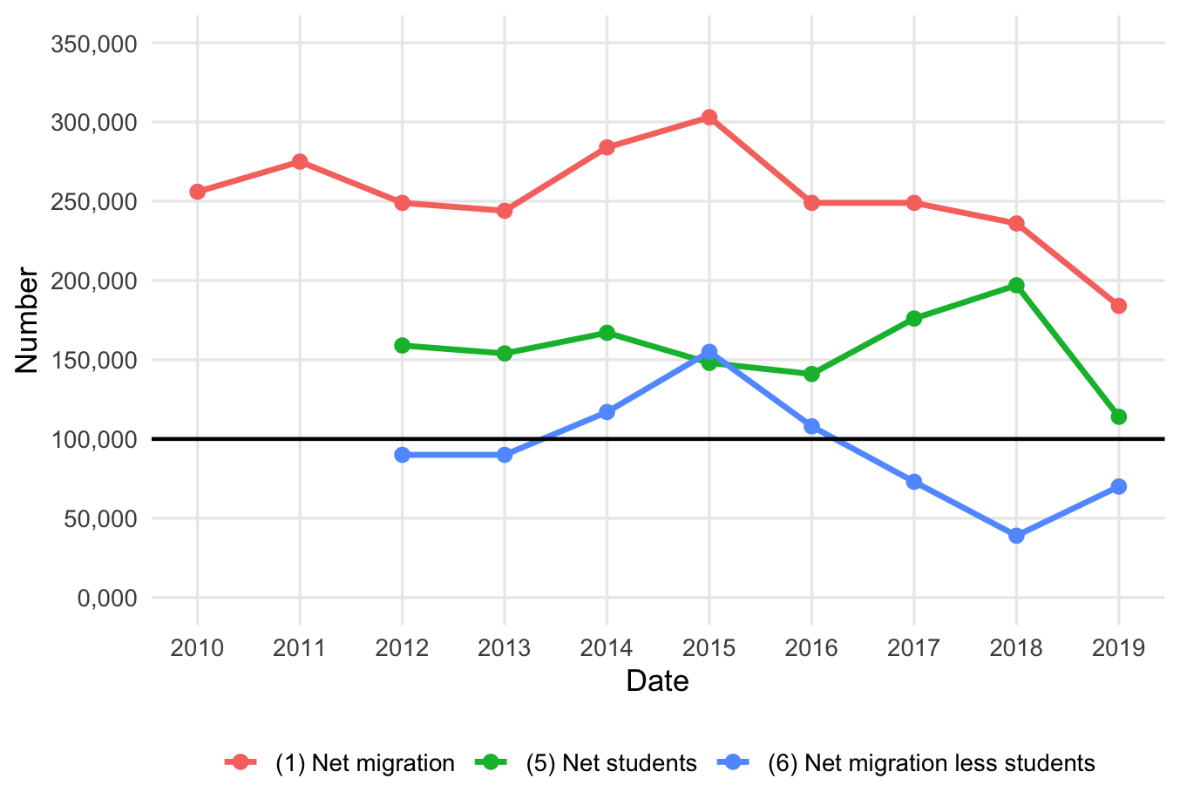
Overseas Students and the Immigration Numbers
Source of data: Provisional Estimate of Long Term International Migration, 2012-25

Slide 4
British Wealth
 | Share | Gini Coefficient
Net Financial | 14 | 0.87
Private Pension | 35 | 0.68
Net property | 40 | 0.66
Physical | 10 | 0.47
Total | 100 | 0.59
(disposable income) | (100) | (0.36)

Slide 5
International Measures of Net Wealth (WID)
Country | Top 1% | Top 10% | Quality of Data | Welath Tax
Netherlands | 14.0 | 45.5 | 3 | Dropped (now tax wealth returns)
Belgium | 15.5 | 52.6 | 1 | Only on financial accounts
UK | 21.3 | 57.1 | 3 | High value property only
Denmark | 21.6 | 50.3 | 3 | Dropped
Italy | 22.0 | 56.1 | 1 | Only on overseas assets
Norway | 23.3 | 52.7 | 2 | YES. 1% on all incl. overseas
Asutralia | 23.7 | 57.7 | 0 | None
Spain | 23.8 | 57.4 | 3 | YES. Complex
Sweden | 27.5 | 68.2 | 2 | Dropped.
France | 27.7 | 59.9 | 2 | Dropped. Only property now
Germany | 27.9 | 58.5 | 1 | Dropped.
China | 30.4 | 68.0 | 2 | None
Swiss | 31.1 | 62.8 | 3 | YES. Low and cantonal.
USA | 34.8 | 69.5 | 4 | None
World | 36.4 | 74.0 | - | -
Brazil | 39.3 | 71.9 | 0 | None
South Africa | 54.9 | 85.7 | 3 | None

Slide 6
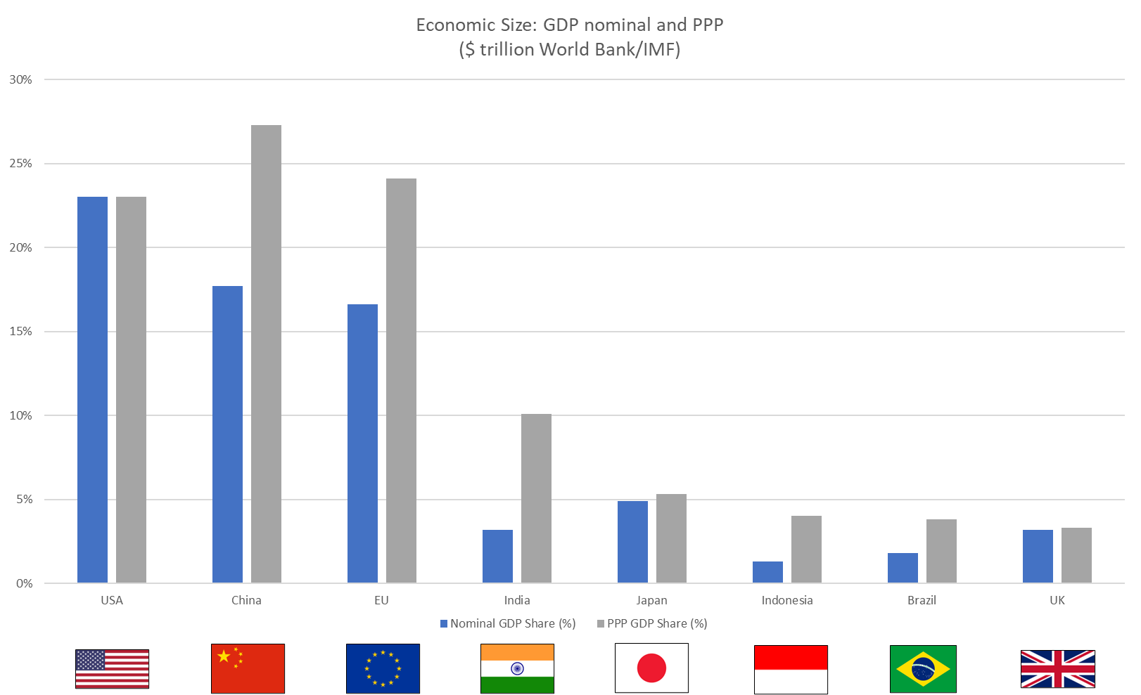

Economic size: GDP nominal and PPP ($Trillion world bank/IMF)

