Slide 1
‘View from the factory floor’
Geoff Tily, 23 May 2024

Slide 2
Motion 19 RPI – save the rate
Congress believes the planned abolition of RPI represents an attack on millions of workers and pensioners’ living standards and a permanent deepening of the cost- of-living crisis.
Congress notes that:
i. trade unions have always fought for an inflation measure that reflects working people’s cost of living as a foundation of collective bargaining
ii. the government plans to effectively abolish the RPI rate of inflation from 2030
iii. the Royal Statistical Society has said that alternative CPI/CPIH indices are ‘an unsatisfactory measure of inflation as it affects British households.’
iv. the government’s neglect of RPI since 2010 has raised the cost of borrowing, putting further strain on public services.

Slide 3
Motion 19 RPI – save the rate
Congress condemns:
a. the withdrawal of the RPI link for public sector pay and pensions, which disproportionately lowered the incomes of women, ethnic minority, and disabled workers and pensioners.
b. the suspension of RPI’s routine methodological updates since 2010
c. the Treasury and the UK Statistics Authority’s refusal to hold a full consultation on scrapping RPI.

Slide 4
Motion 19 RPI – save the rate
Congress calls upon the TUC to:
1. establish a priority campaign and working group that brings together interested affiliates and other appropriate organisations through to 2030
2. lobby Labour and the government to preserve an independent RPI, or otherwise create and agree with unions a new rate suitable for collective bargaining
3. create resources that affiliates can use to defend the link
4. hold a conference during the lifetime of the working group to discuss the campaign and the importance of RPI for pay and pensions.

Slide 5
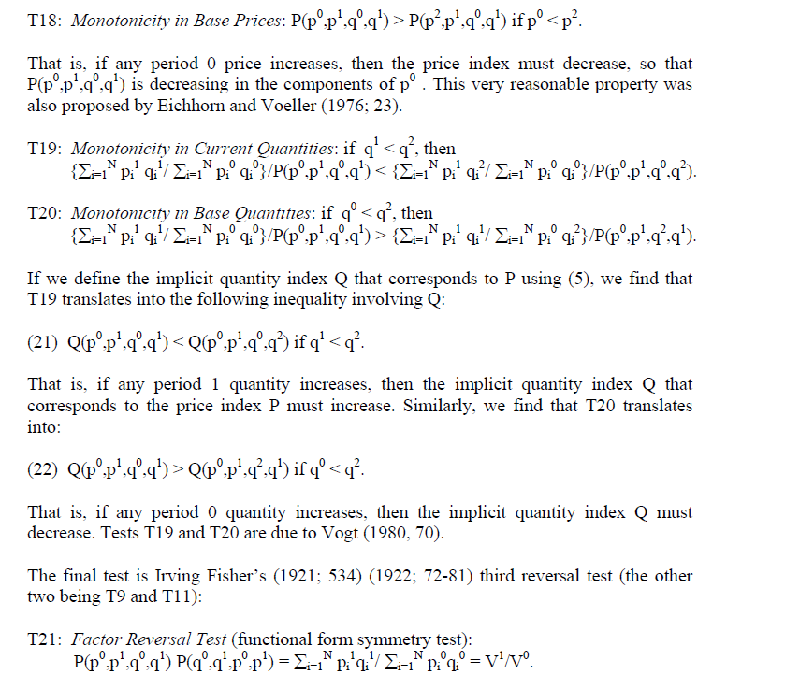
Access is restricted: algebra, complex definitions, and technical jargon.
W. Erwin Diewert (2012) Consumer Price Statistics in the UK

Slide 6
Arguments can change form very abruptly.
W. Erwin Diewert (2012) Consumer Price Statistics in the UK
However, as Pierson [1895;332] observed 100 years ago, consumers do purchase less in response to higher prices; i.e., substitution effects do exist. The existing theory of cost of living indexes can be viewed as a way of incorporating these substitution effects into the measurement of price change… (Diewert, 1995, p. 31)
Arguments that attempt to justify the use of the Carli index on the basis of the economic approach to elementary indexes that are presented on pages 364-369 of the Consumer Price Index Manual cannot be used to justify the use of the Carli index. (Diewert, 2012, p. 87)

Slide 7

Not subtle, repetition the norm.
House of Lords (2019) Measuring Inflation
80.Chris Giles, the [former] economics editor of the Financial Times, told us that the Carli index had “known biases”. He said ‘price bounces’—where prices go up but revert back again—exacerbated these biases
81.Professor Martin Weale, a former member of the Monetary Policy Committee of the Bank of England, gave an example of the Carli formula’s “upward bias”. [two shirts costing £20, one up to £30 and then back down to 20]
82.Dr Ben Broadbent, Deputy Governor of Monetary Policy at the Bank of England, said the problem described in Box 5 [Weale’s example] was “worse the greater the dispersion of the inflation rates.” …
83.Dr Broadbent said that the failings of the Carli index “have been evident for a century, citing a pamphlet by the American economist Irving Fisher from 1922. Referring to Irving Fisher's work in a November 2018 letter to the Royal Statistical Society, Dr Broadbent said that “almost a century later there is virtually no other statistical agency in an advanced economy that uses it.”

Slide 8
84. Robert Hill, Professor of Macroeconomics at the University of Graz, also cited Irving Fisher’s work and concluded that the use of the Carli formula was “indefensible“:
“Irving Fisher warned against the Carli formula in his 1922 book on index numbers. Carli fails the time reversal test, and suffers from a systematic upward bias. For example, if prices change from periods 1 to 2, but then in period 3 return to their original period 1 levels, a chained Carli [etc …]
85.When reaching their conclusions, both Professor Diewert’s 2012 report and Paul Johnson’s 2015 review gave weight to the fact that the Carli formula failed this so-called ‘time reversal’ test when coming to their conclusions. …
86.This feature of the Carli formula was identified by William Stanley Jevons in 1863.

Slide 9
Irving Fisher
Theoretical justifications for state-sanctioned sterilization of individuals provided by Irving Fisher rationalized its racialization on grounds that certain non-white racial groups, particularly blacks due to their dysgenic biological and behavioral traits, retarded economic growth and should be bred out of existence (Price and Darity, 2010)

Slide 10

Not given the full story. Other authorities omitted. Simone Weil (1942-43) ‘Human Personality’
Scientists of the same class are equally enslaved by fashion, which rules over science even more despotically than over the shape of hats. For these men the collective opinion of specialists is practically a dictatorship.
(reprinted in The Power of Words, p. 36)

