Slide 1
OSR: Current regulatory issues in prices
Office for Statistics Regulation
May 2024

Slide 2
The Office for Statistics Regulation (OSR)
The regulatory arm of the UK statistics system
Focused on the public good of statistics and data
Separate from the Office for National Statistics (ONS) and Government Departments
  Not a statistics producer
  Reporting to a non-Ministerial Board
  Budget, governance and reporting is separate from the ONS

Slide 3
Our vision is that statistics serve the public good
In a world of abundant data, we want people to have confidence in statistics produced by the public sector

Slide 4
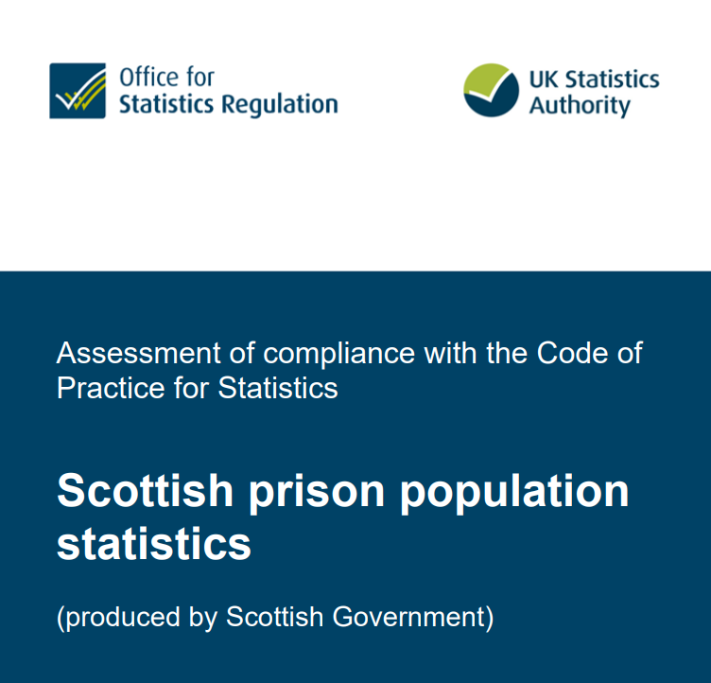

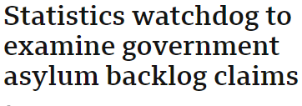
We uphold the trustworthiness, quality and value of statistics and data used as evidence
Code Compliance
Casework
Reactive work
Code Guidance
Reviews and reports
Research
Blogs (our views)
Oversight, engagement, horizon scanning
How statistics are produced
How statistics are used
How statistics are valued
We develop a better understanding of the public good of statistics
We protect the role of statistics in public debate

Slide 5
Economic statistics: OSR work
Since UK left the Eurostat system, we have increased our focus on the quality of economic statistics
Quality review of:
  Producer price indices
  Gross operating surplus and profitability
  GDP revisions
De-accreditation of LFS-based labour market statistics
Forthcoming:
  Business Enterprise Research and Development
  Business investment
  Classifications
  Overview of ONS economic statistics
  And… Regulatory issues in prices (see remaining slides)

Slide 6
Prices statistics: Purpose
With any area of statistics, we start by understanding the purpose of the statistics
For prices, we focus on the “three family” approach (endorsed by Tony Cox in his letter to OSR of 12 November 2019):
  Price indices for understanding macroeconomic dynamics
  Price indices for understanding household cost experiences
  A price index for inflation-linked bonds

Slide 7
Current landscape
Purpose | Current indices
Price indices for understanding macroeconomic dynamics | CPI CPIH
Price indices for understanding household cost experiences | HCIs
A price index for inflation-linked bonds | RPI

Slide 8
Regulatory issues
Purpose | Current indices
Price indices for understanding macroeconomic dynamics | CPI CPIH
  Estimation of private rental prices: how is ONS developing its new index?
  Scanner data: how is ONS incorporating high volume datasets from supermarkets etc?

Slide 9
Regulatory issues: private rental prices
  ONS is replacing two series – Index of Private Housing Rental Prices and Private rental summary statistics – with a new Price Index of Private Rents
  This involves more comprehensive micro data on rents from the Valuation Office Agency and equivalents in other parts of GB/UK
  Addresses coverage and methodological weaknesses in current approach: uses all available data for the latest month and stratifies at a lower geographical level
  Crucially, feeds into the H in CPIH:
    OOH weight between 16-18.5 % over 2018-2024.
    ‘Actual rents for housing’ has a 6.4-7.4% weight in its own right over the same period
  We are currently scoping an assessment of PIPR
  Key point: we want to get user reaction to the new statistics – so please speak to me or contact my team via regulation@statistics.gov.uk
Notes:
more comprehensive micro data on rents from the Valuation Office Agency and equivalents in other parts of GB/UK [currently for GB, UK from Mar 25]
The new private rents price statistics are used to measure both actual rentals for housing, and owner occupiers’ housing costs. The weight for owner occupiers’ housing costs ranged between 16.0% and 18.5% of CPIH (Table 1) while for actual rentals for housing, the weights ranged from 6.4% to 7.4% of CPIH, note that private rents only feed into a part of actual rentals for housing (for 2023 this was 63%, previous years are between 58% and 67%). https://www.ons.gov.uk/economy/inflationandpriceindices/articles/impactanalysisontransformationofukconsumerpricestatisticsrailfaresandsecondhandcars/privaterentsandsecondhandcarsdecember2023
Consumer price inflation, updating weights: Annex A, Tables W1 to W3
https://www.ons.gov.uk/economy/inflationandpriceindices/datasets/consumerpriceinflationupdatingweightsannexatablesw1tow3

Slide 10
Regulatory issues: scanner data
  ONS has incorporated new datasets to its CPI/CPIH series in recent years
    Used cars
    Rail tickets
  These are significant, but are dwarfed by the plans in 2025 to introduce scanner data
  While this will allow much more granular and real-time picture, there are questions:
    Does it move away from the easy-to-explain “fixed basket” concept of inflation measurement?
    How easy is the GEKS-T window methodology to explain to the public?
    The index will use a 25 month window. Are there any consequences that flow from this design?

Slide 11
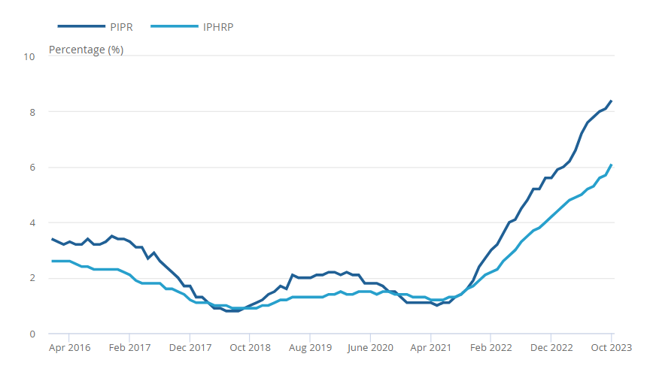
Impact
Private rental price annual percentage change using the new methodology showed similar trends but is generally higher
Private rental price annual change for the UK, January 2016 to October 2023
Source: ONS impact analysis on transformation of UK consumer price statistics: private rents and second-hand cars
Notes:
ONS impact analysis published in December comparing old IPHRP rents series with PIPR:
https://www.ons.gov.uk/peoplepopulationandcommunity/housing/articles/redevelopmentofprivaterentalpricesstatisticsimpactanalysisuk/latest

Slide 12
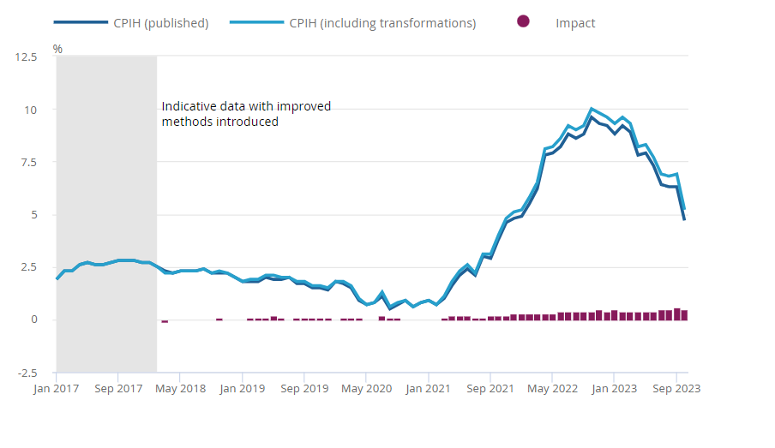
The average impact to the annual rate of change of CPIH was 0.2 percentage points
Indicative impact of transformed private rents and second-hand cars indices on CPIH 12-month rate, UK, January 2017 to October 2023
Source: ONS impact analysis on transformation of UK consumer price statistics: private rents and second-hand cars
Notes:
ONS impact analysis published in December on transformation of private rents and second-hand cars on headline consumer price indices measures: https://www.ons.gov.uk/economy/inflationandpriceindices/articles/impactanalysisontransformationofukconsumerpricestatisticsrailfaresandsecondhandcars/privaterentsandsecondhandcarsdecember2023

Slide 13
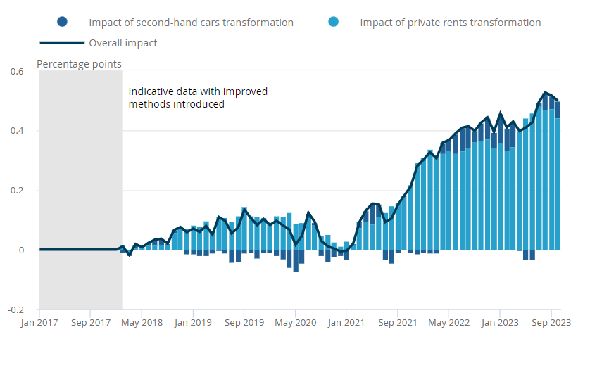
Private rents improvements had a larger impact on CPIH than second-hand cars
Contributions from transformed private rents and second-hand cars to the indicative impact in the CPIH 12-month rate, UK, January 2017 to October 2023
Source: ONS impact analysis on transformation of UK consumer price statistics: private rents and second-hand cars
Notes:
ONS impact analysis published in December on transformation of private rents and second-hand cars on headline consumer price indices measures: https://www.ons.gov.uk/economy/inflationandpriceindices/articles/impactanalysisontransformationofukconsumerpricestatisticsrailfaresandsecondhandcars/privaterentsandsecondhandcarsdecember2023

Slide 14
Regulatory issues: HCIs
HCIs are an important development, clearly filling a gap in the understanding of prices impacts on households
There are regulatory questions:
  Are the HCIs meeting user needs and what is user feedback?
  Are they timely, frequent and granular enough?
  When will they be mature enough for ONS to seek Accredited Official Statistics status?

Slide 15
Broader issues to discuss with Better Statistics
  There are three broader issues that merit discussion:
  ONS is doing a lot of change around price indices. Is there a general transformation risk (think of attempts to transform LFS…)?
  Is there an outstanding question about measurement of the contemporary economy (deflators, digital services, quality etc)?
  There is a multiplicity of indices – does this serve the public good (eg CPI and CPIH) or does this risk confusion?

Slide 16
OSR: Current regulatory issues in prices
Office for Statistics Regulation
May 2024

Slide 17
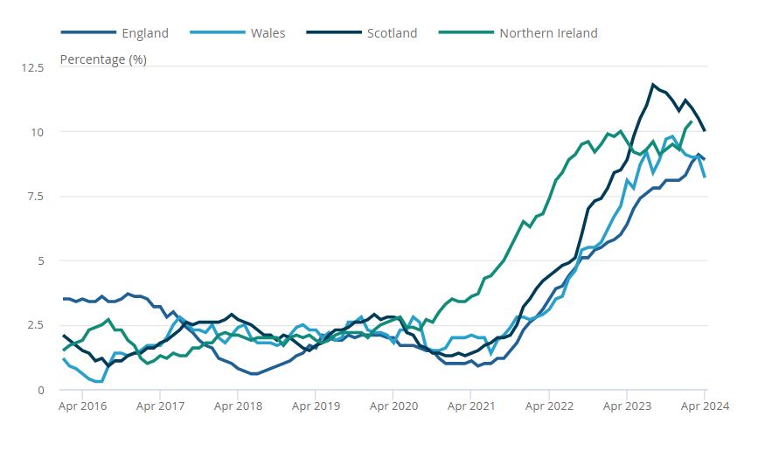
The average rent annual inflation for England, Wales, Scotland and Northern Ireland
Private rent annual inflation, UK countries, January 2016 to April 2024
Source: Price Index of Private Rents (PIPR), Office for National Statistics
Notes:
Latest PIPR statistics (update will be published Wednesday) https://www.ons.gov.uk/economy/inflationandpriceindices/bulletins/privaterentandhousepricesuk/april2024

