Slide 1
The ONS consumer price statistics and their use cases: CPIH, CPI and HCIs
Stephen Burgess
Deputy Director for Price Statistics
Office for National Statistics

Slide 2
Landscape of UK inflation indices
CPIH
    ONS leading measure in bulletins. Includes OOH on rental equivalence basis
CPI
  Inflation target variable. Excludes council tax and owner-occupier housing costs.
Household Costs Indices (HCIs)
  New and experimental measures. Published for 19 different groups of households.
RPI
  Required by legislation

Slide 3
Use cases for different indices
CPIH
    Most comprehensive measure. Useful for macroeconomic analysis
CPI
  Useful for macroeconomic analysis / policy and international comparisons
Household Costs Indices (HCIs)
  Capture price changes as experienced by different groups of households
RPI
  Served a variety of purposes since 1947
  ONS now discourages its use

Slide 4
A sketch of the UK’s recent journey (1)
2003: CPI becomes main UK inflation measure and BoE target
2007: SRSA sets out new arrangements for governance of RPI, and higher hurdle for changes
2012: Consultation on options for changing RPI calculation
2013: CPIH added to the suite of measures
2014/15: Smith Review; introduction of two advisory panels
2015: Johnson Review of consumer price statistics

Slide 5
Selected recommendations of the Johnson Review
CPIH should become the main measure of UK inflation, and should continue to use rental equivalence for OOH
ONS and UKSA should restate their position on RPI: it should not be used for new purposes and discontinued unless there are contractual commitments at stake
ONS should start working towards an annual publication that produces indices for different household types
ONS should prioritise developing the use of scanner data and web scraping techniques

Slide 6
A sketch of the UK’s recent journey (2)
2015: Astin and Leyland set out what a household inflation index should look like
2016: National statistician commits ONS to the development of Household Costs Indices
2017: First preliminary HCIs published. CPIH regains status as a National Statistic
2020: Further RPI consultation. RPI will be reformed but no earlier than 2030
2023-24: Successful introduction of rail fares, used cars and rents using more robust data sources

Slide 7
The path towards Household Costs Indices
ONS has delivered several innovations to help public understanding of the impact of higher prices:
March 2022: Personal inflation calculator
October 2022: Using webscraping to track prices of everyday grocery items
May 2023: Shopping prices comparison tool
December 2023: Production of first “official” HCIs…

Slide 8
Main differences between HCIs and CPI / CPIH
 | CPIH and CPI | HCIs
Approach to weights | Plutocratic – reflects total household spending | Democratic – within each group, all households have the same weight
Treatment of owner-occupied housing | Not in CPI; CPIH uses rental equivalence | Direct measure capturing mortgage interest, insurance, stamp duty etc.
Timing of price changes | Mostly on acquisition basis. (Eg: costs of higher education included at the point of study) | Where possible, treats more items on a payment basis (Eg: costs of higher education included when tuition fees paid and student loan repayments made)
RPI lies somewhere between these approaches, but arguably doesn’t manage to capture the experience of a typical household.

Slide 9
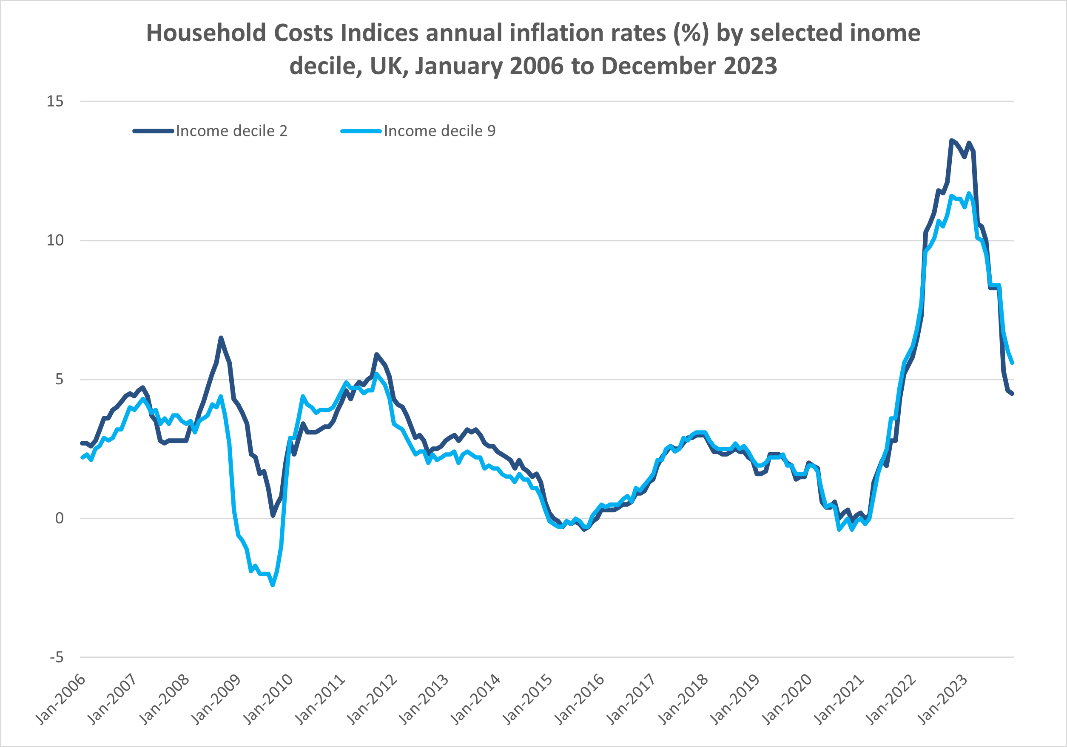
Insights from latest HCIs (1)
Lower income households have tended to experience higher inflation since 2010:

Slide 10
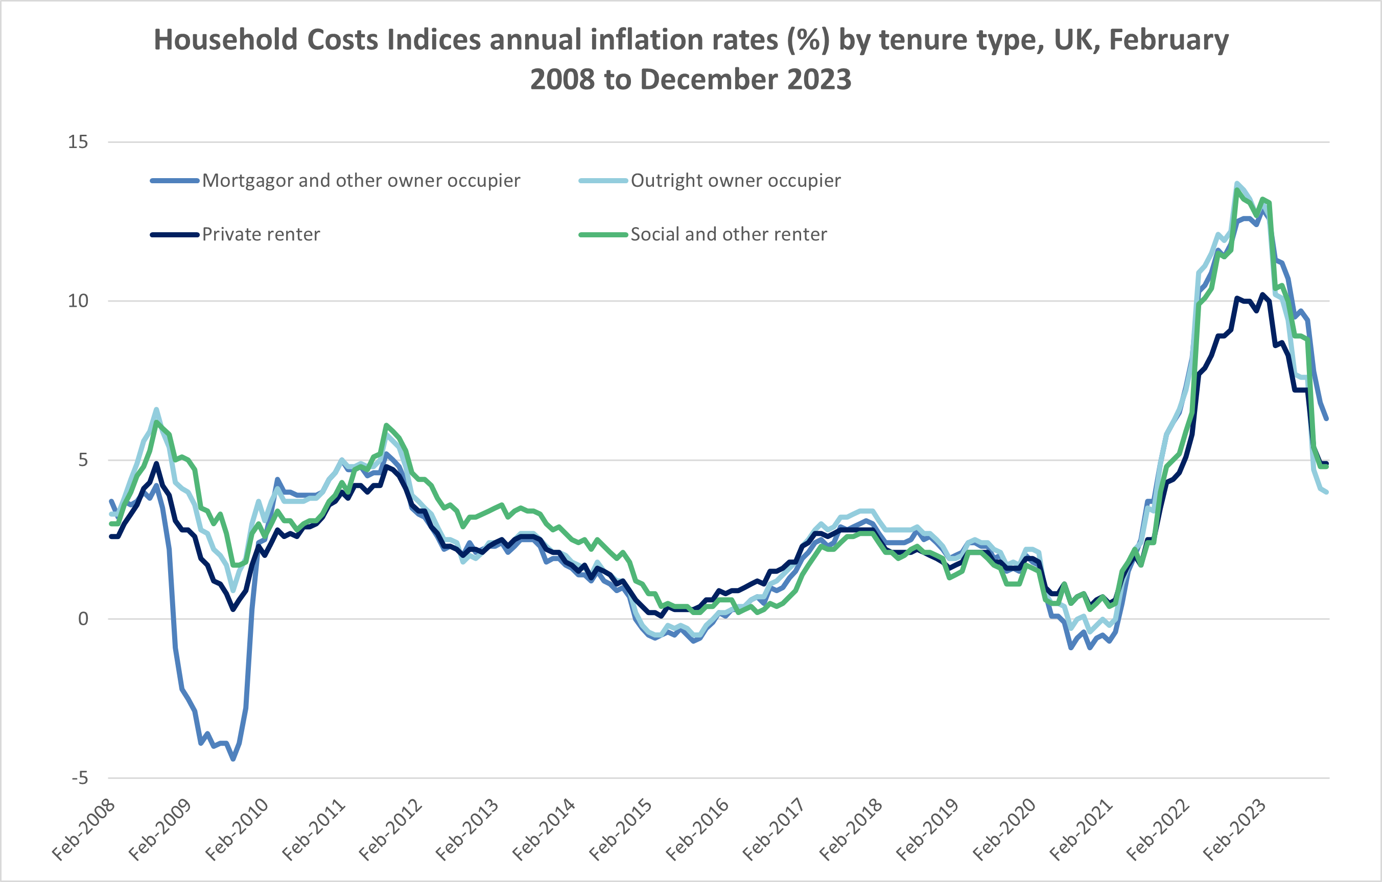
Insights from latest HCIs (2)
Over the past year, mortgagors have experienced higher inflation than other groups:

Slide 11
Future plans for developing HCIs
HCIs are new and experimental. Allow them to become established; take on user feedback; address shortcomings.
Establish the path to “National Statistic” status, including discussing the interim revisions policy with our advisory panels.
Prioritise future development requirements with our advisory panels, for example concluding discussions on mortgage interest payments.
Explore ways we can better explain the impact of differences between HCIs, with our academic partners.

Slide 12
Future priorities for ONS Prices Division
March 2025: likely introduction of grocery scanner data, accounting for over half of UK market share, into live production. This will increase accuracy and efficiency and also improve the narrative around drivers of inflation
Continue to move production away from legacy IT systems
Work programme to improve PPI statistics following OSR review.
Continue regular ongoing publication of the HCIs
We will consult our stakeholder panels on all proposed changes.

Slide 13
Questions?

Slide 14
Close
cpi@ons.gov.uk

