Slide 1
Farmers, Weather and Climate
Better Statistics: Where are we with Net Zero
London, February 2024
Nigel Jacklin
CEO, Accord.me.UK

Slide 2
Farming Readership Survey 2023
821 online interviews conducted from July 2023 to September 2023 with farmers and contractors.
Survey requests were promoted by TFF (The Farming Forum).
The data was weighted to an estimated universe based on DEFRA counts.

Slide 3
Contents
Who am I/What are my views on Net Zero
Farmers Views
Concluding Observations

Slide 4
Pevensey Levels, East Sussex

Slide 5
Scientific (and academic) Consensus?
2013…Buy a second hand diesel
Cook et al…97% consensus
@BarackObama: Ninety-seven percent of scientists agree: #climate change is real, man-made and dangerous
Montford
Cook et al. said nothing about global warming being dangerous and was based on analysis of published abstracts rather than the opinions of scientists.
2024…ULEZ
2021 Lynas et al “Greater than 99% consensus on human caused climate change in the peer-reviewed scientific literature.”
2023 Dentelski et al
“A methodologically correct statement of their analysis should have been that the consensus regarding the AGW thesis is 32% < c < 99.8%”

Slide 6
Preliminary Research

Slide 7
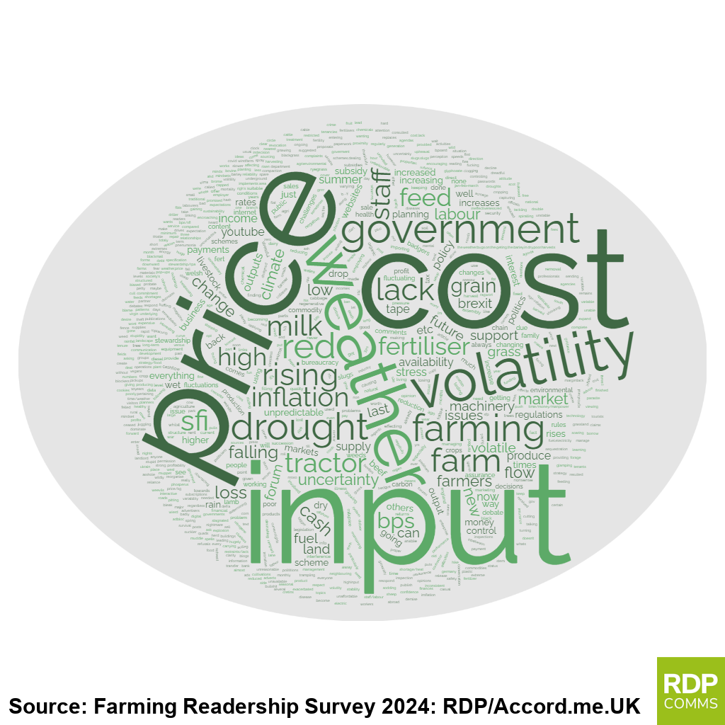
Farming Issues and Challenges (Open Question)
What are the main farming related issues or challenges you have faced in the last 12 months?
348 comments written in from 490 replies.

Slide 8
Quotes on Weather and Climate
Normal variations in weather – 126 (36%)
“The weather and loss of SFP” Arable farmer, England, 50-99 hectares “Weather and public trespassing” Arable farmer, England, 100-249 hectares “The weather” Arable, Beef farmer, England, 250-499 hectares “Rain” Arable, Beef, Sheep farmer, England, 250-499 hectares “Weather, removal of BPS (simple scheme).” Arable, Sheep farmer, England, 100-249 hectares “The weather and bugs on the barley in dry. Poor harvests.” Horticulture farmer, England, 250-499 hectares “Dry weather last year. Government policy or lack of it” Beef, Sheep farmer, Scotland, 500 or more hectares “Drought” Beef, Sheep farmer, Wales, Under 50 hectares “The weather” Sheep farmer, Wales, Under 50 hectares
Problems associated climate change – 7 (2%)
“BPS reduction, climate change” Arable, Beef farmer, England, 100-249 hectares
Legislation/measures introduced to tackle climate change – 13 (4%)
“BPS reduction and SFI so badly designed it’s not worth entering.” Arable, Beef farmer, England, 250-499 hectares
“Reduced income. The new SFI that replaces the BPS is biased against grassland farms.” Sheep farmer, England, Under 50 hectares

Slide 9
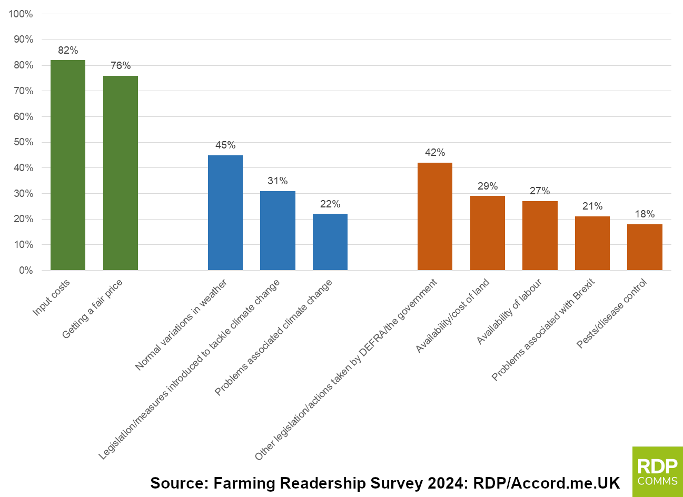
Farming Issues and Challenges (Tick Box Question)

Slide 10
Observations
Climate change is not at the top of farmers agenda’s
Farmers are fed up with red tape and changing interventions
Those promoting the Net Zero agenda have failed to get a key audience on their side
Farmers know the weather is not always the same and that there’s more than one cause of flooding.

Slide 11
Solar Lights Can be Bad for the Environment

Slide 12
Farmers Protests in the EU and Elsewhere

Slide 13
Opposition to Solar Farms on Prime Agricultural Land – JR Success (Lincs)

Slide 14
Closing Remarks: Live According to Your Beliefs

Slide 15
Further Information
On the Farming Readership Survey
Will Hurrell <Whurrell@rdp.co.uk>
On my stuff
Twitter: @TheGoodStatsMan
Nigel@Accord.me.UK
https://www.thegwpf.org/content/uploads/2013/09/Montford-Consensus.pdf
Dentelski et al: https://www.mdpi.com/2225-1154/11/11/215

