Slide 6
SECTION | INDICATOR | EVIDENCE SOURCE | MATCH | COVERAGE
Land use | Proportion of arable as ruminant feed | June Survey | Good | UK: 1990-2022
 | Carbon trading | None
Diet | High sugar grasses, grazing | FPS | Good | England: 2011-2023
 | High starch, dairy | FPS | Medium (survey questions) | England: 2015-2023
 | Precision feeding, dairy | FPS |  | England: 2011-2023
 | Methane-suppressing feed additives | None
Breeding | Genomics | None
 | Current breeding, dairy | FPS | Medium (inconsistent categories over time) | England: 2011-2023
 | Current breeding, beef | FPS |  | England: 2011-2023
 | Low CH₄ | None
Management | Milking frequency | None
 | Artificial nitrogen on grassland | BSFP | Good | UK: 1990-2022
 | Agroecological practices | None
Health | Preventative measures | FPS | Medium (survey questions) | England: 2011-2023
 | Curative measures | FPS |  | England: 2011-2023
Waste | Anaerobic digestion | FPS | Good | England: 2015-2023
 | Slurry covers | FPS | Low | England: 2015-2023
Attitudes etc | Carbon calculators/audit | None
 | Beliefs about GHG | FPS | Medium (no breakdown by farm type) | England: 2013-2023
 | Actions to reduce GHG | FPS |  | England: 2013-2023

Slide 9
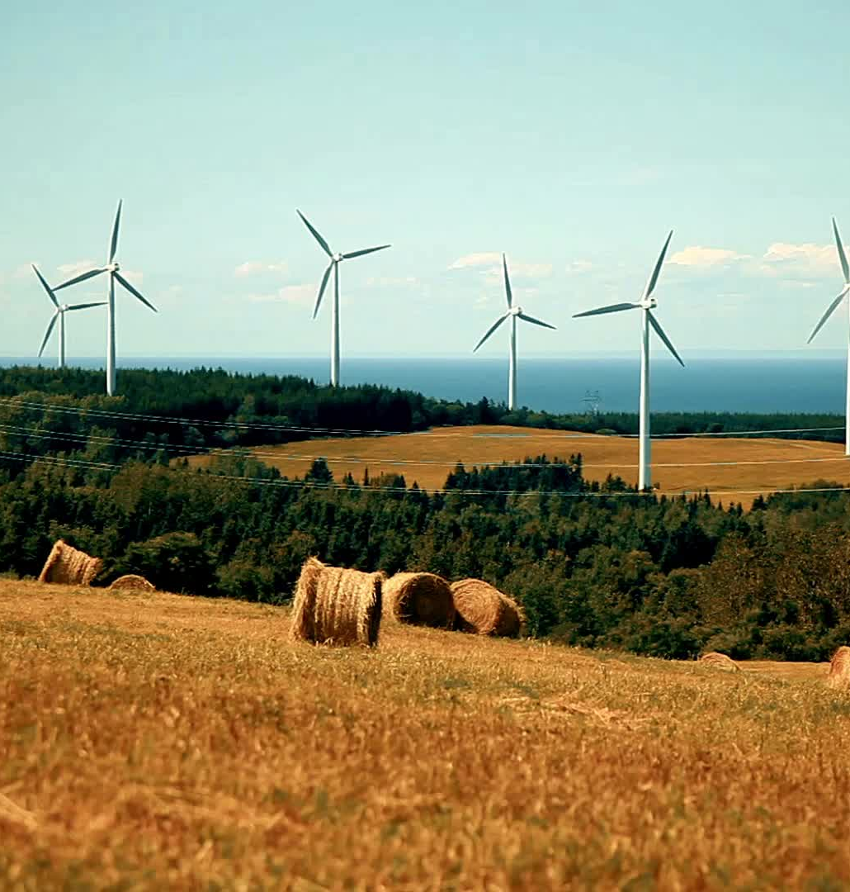
MEASUREMENT ISSUES
Agriculture and land use change (LULUCF).
Changing GWP100.
GWP100 and GWP*
Changing emissions factors.
Uncertainty estimates.

Slide 10
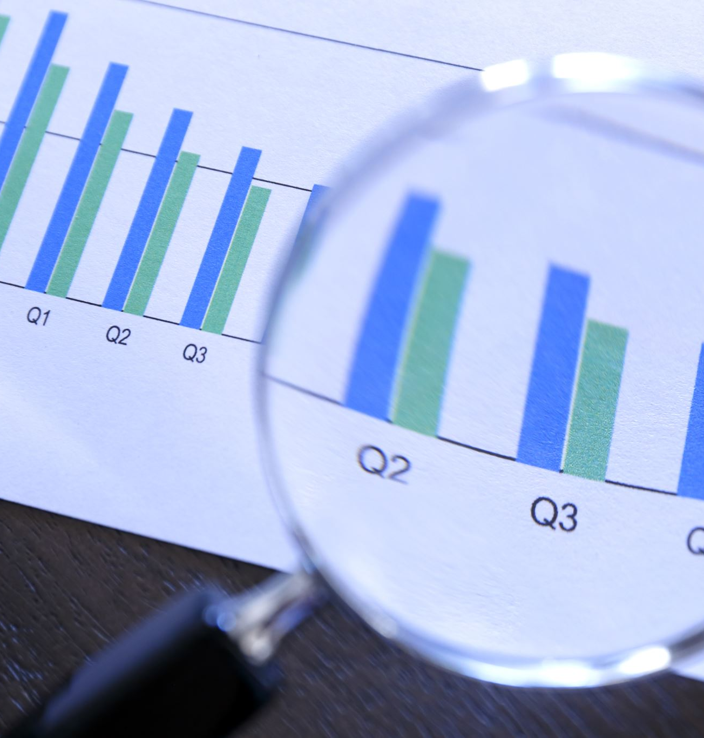
EVIDENCE GAPS
Agriculture and devolution.
Small farms.
Response rates.
Accessing microdata.
Longitudinal data.
ELMS and the Rural Payments Agency: verification, monitoring and evaluation.

Slide 12
Conclusion
The UK’s official statistics systems produce some valuable data for assessing GHG emissions from agriculture. The picture they paint for the livestock sector is one of stasis rather than change. The statistics are, however, lacking in some important ways: we are not well-informed about farming practices in the three smaller UK countries; most of the data come from surveys with low and declining response rates; there could be greater transparency about methods and a willingness to make more data available. Many of the statistics are good - but they could be much better – and used much more.

