Slide 1
How should we measure progress?
Net-zero policy tracker

Slide 2
Who are Green Alliance
Policy Tracker
What is it?
Why is it useful?

Slide 3
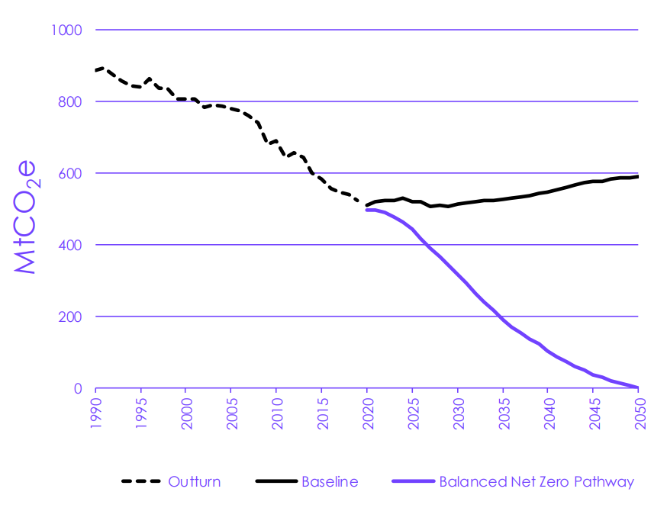
Source: CCC’s 6th Carbon Budget

Slide 4
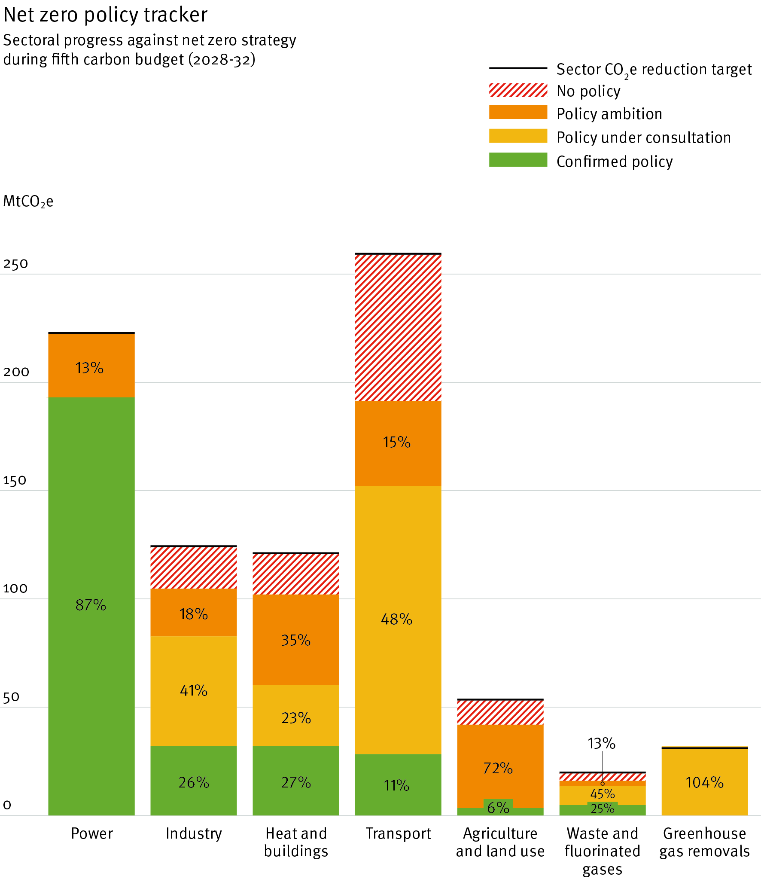
Sectoral
overview
June 2023

Slide 5
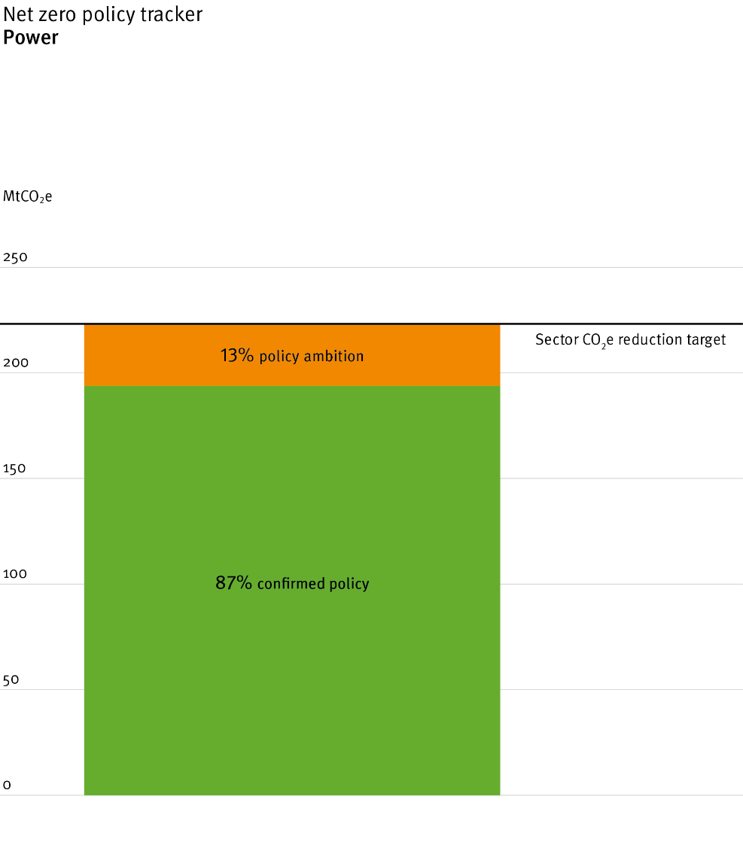
Power

Slide 6
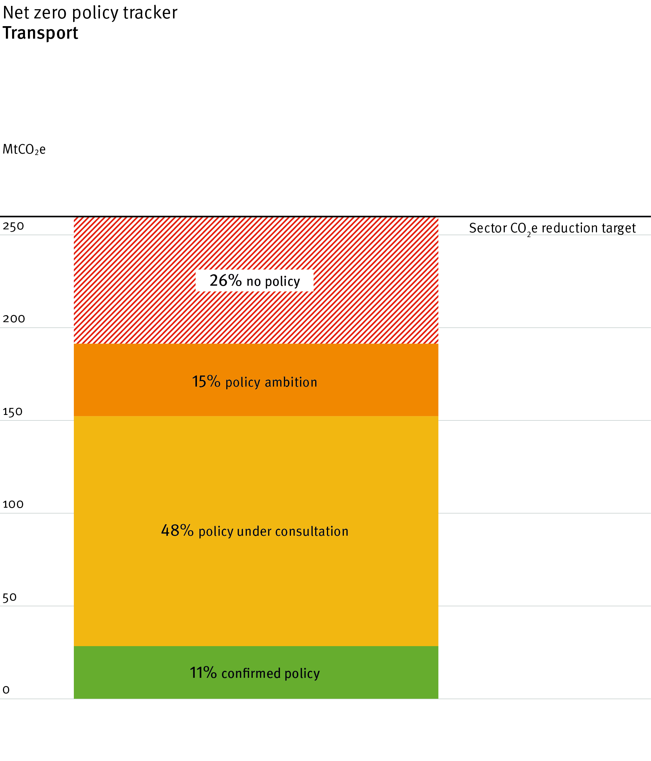
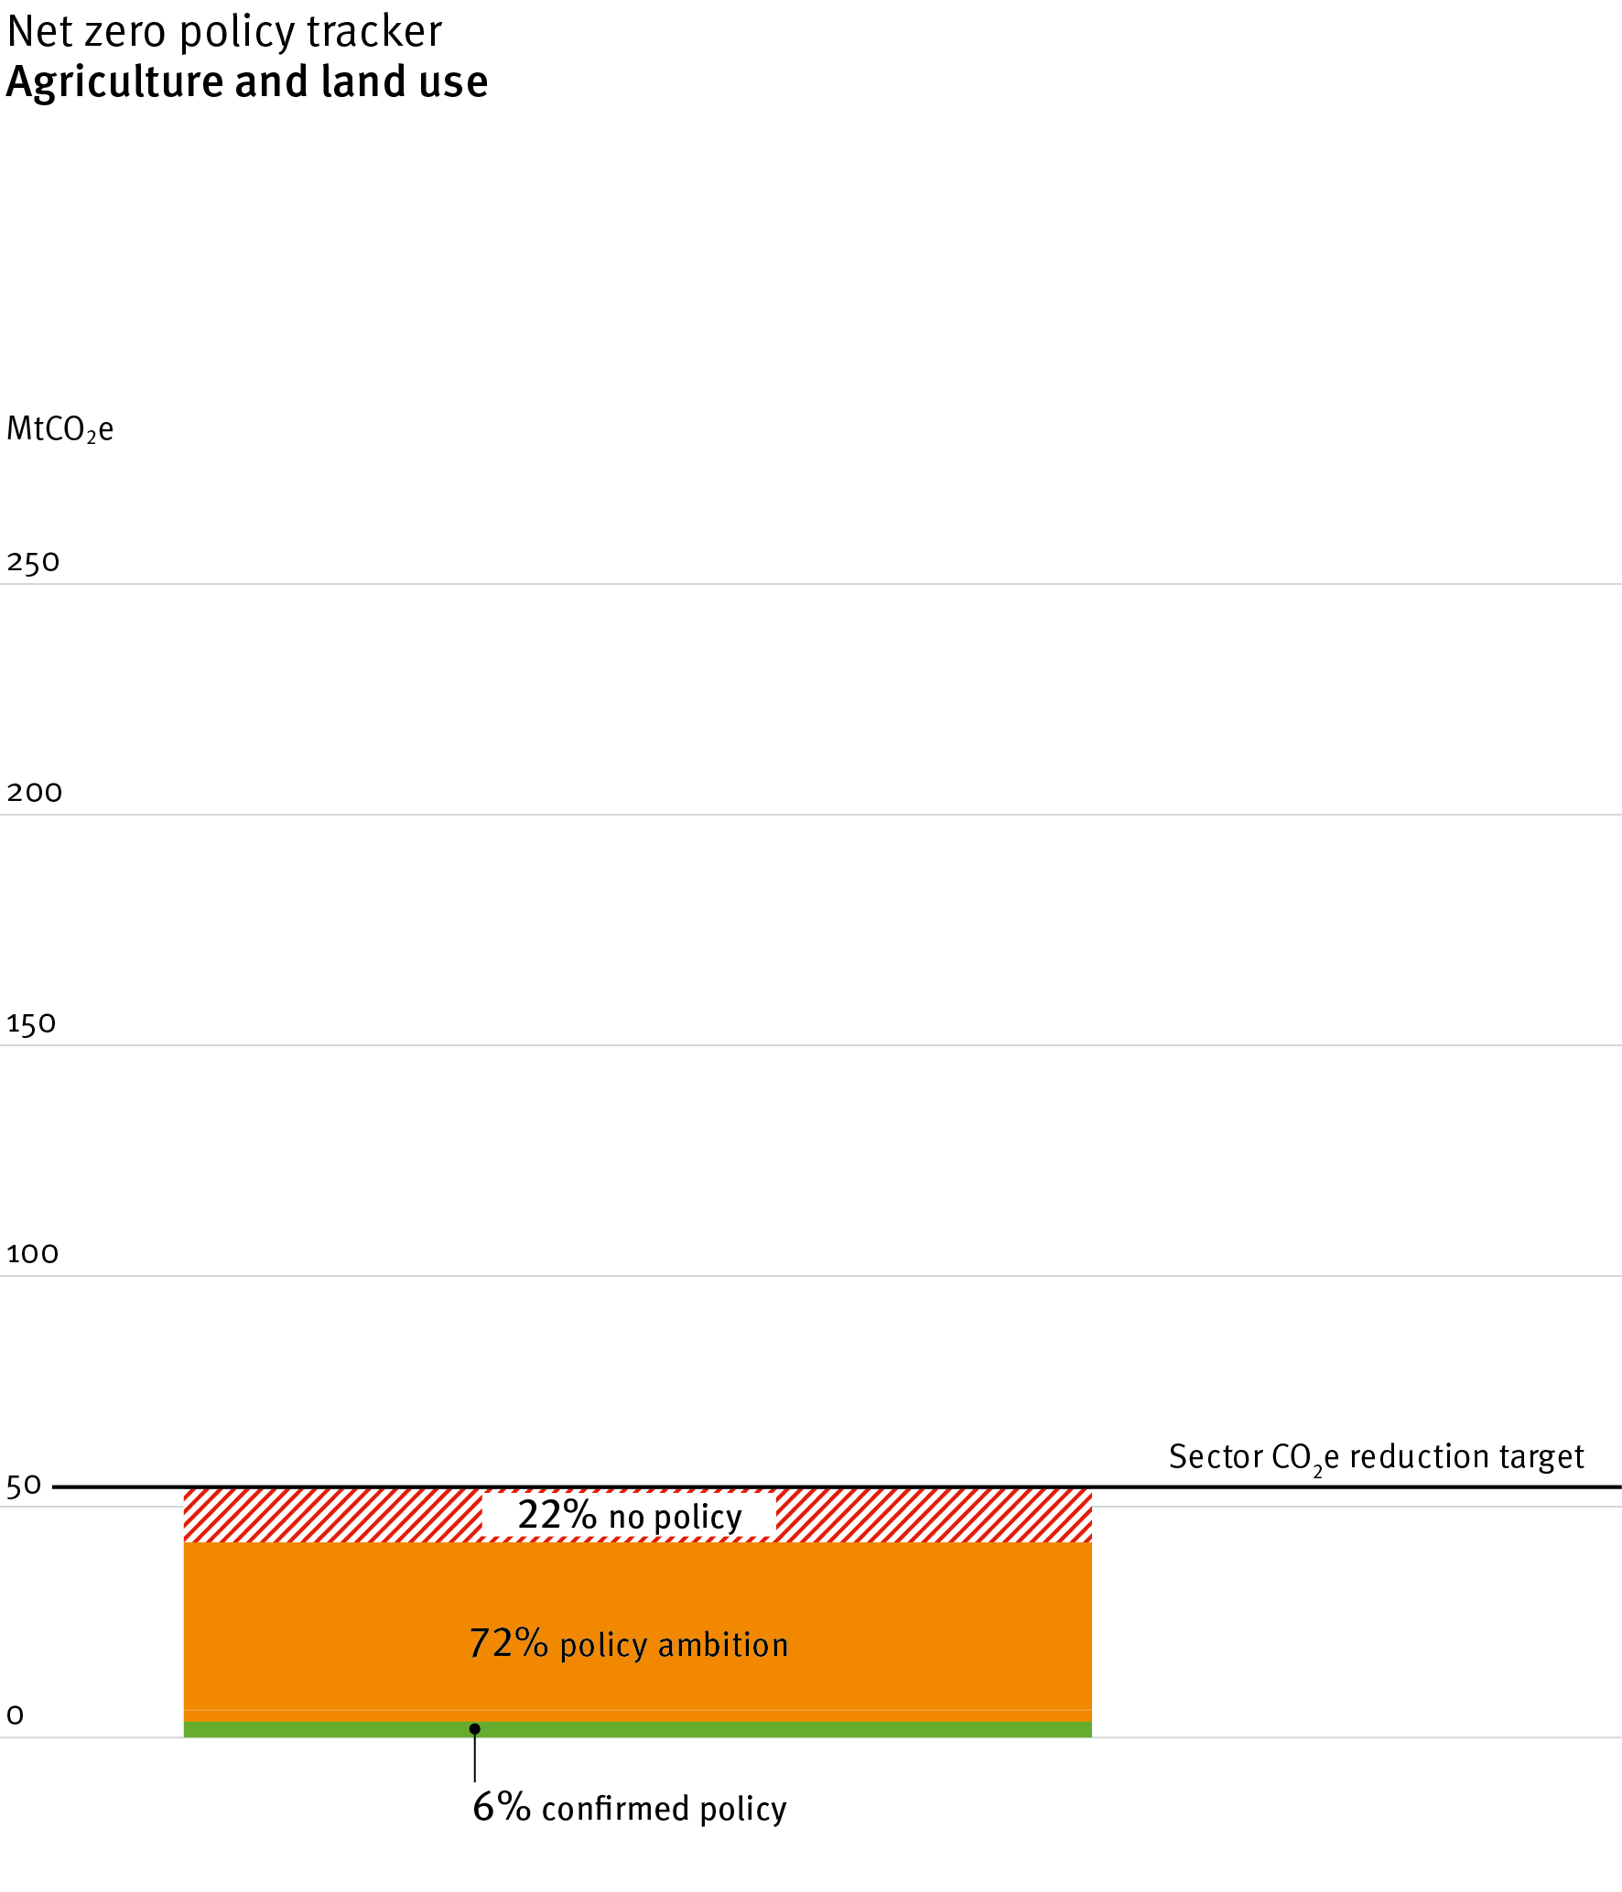
Transport
Agriculture and Land use

Slide 7
Policy Tracker
What is it?
Actual policy vs Net-Zero Strategy
Government no’s when possible
What it isn’t
Why is it useful?
Vehicle for environmental change
Another point of view, higher frequency
Accountability
Clarity
Visibility

Slide 8
Credits
Acknowledgements This work is part of Green Alliance’s Cutting Carbon Now project, supported by the Network for Social Change. It advocates for immediate action across the UK economy to drastically reduce the UK’s contribution to climate change.
Green Alliance Green Alliance is an independent think tank and charity focused on ambitious leadership for the environment. Since 1979, we have been working with the most influential leaders in business, NGOs and politics to accelerate political action and create transformative policy for a green and prosperous UK.
The Green Alliance Trust Registered charity no 1045395 Company limited by guarantee (England and Wales) no. 3037633
Graphs designed by Howdy
© Green Alliance, June 2023
Text and original graphics in this work are
licensed under the terms of the Creative
Commons Attribution License which
permits unrestricted use, provided we
are credited as the original author and
source. Details of the license are available
at: creativecommons.org/licenses/
by/4.0.
Thank you for listening

