Slide 1
Carbon and growth: can the two be decoupled?
Ehsan Masood, Nature
Better Statistics – 29th February 2024

Slide 4
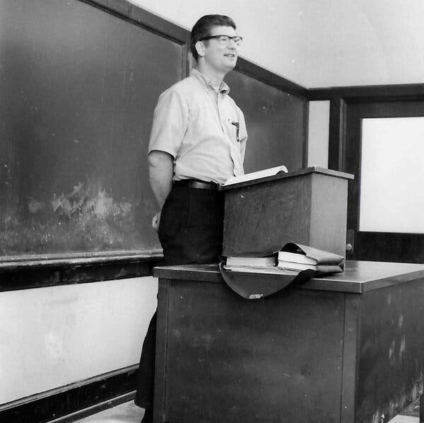
Herman Daly (1934-2022)
“The verb ‘to grow’ has become so overladen with positive value connotations that we have forgotten its first literal dictionary denotation, namely, ‘to spring up and develop to maturity’”.
Steady State Economics (1977)

Slide 5
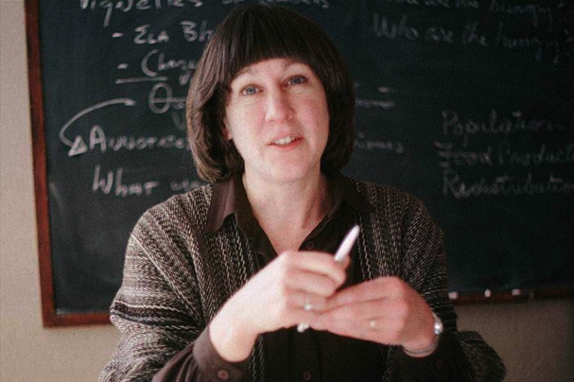
Donella Meadows (1941-2001)
“The most common criticisms of the original [Limits to Growth] model were that it underestimated the power of technology and that it did not represent adequately the adaptive resilience of the free market.”
https://donellameadows.org/archives/a-synopsis-limits-to-growth-the-30-year-update/

Slide 7
What about now?

Slide 8
The good news: decoupling is happening

Slide 9
The bad news: yes, but how quickly?

Slide 10
Sustainability leaders..

Slide 11
… Are also laggards

Slide 12
Material Footprint

Slide 14
Sources
‘Decoupling is Happening’: https://www.ons.gov.uk/economy/nationalaccounts/uksectoraccounts/compendium/economicreview/october2019
Sustainable Development Report and ‘Spillover Index’: https://dashboards.sdgindex.org/rankings
Is Green Growth Happening? The Lancet Planetary Health: Volume 7, Issue 9, September 2023, Pages e759-e769 https://doi.org/10.1016/S2542-5196(23)00174-2
Material Footprint: https://unstats.un.org/sdgs/report/2018/goal-12/

