Slide 1
29th February 2024
UK progress on Net Zero and how to speed up delivery
Professor Piers Forster
Interim Chair – Climate Change Committee

Slide 3
The UK’s path to Net Zero

Slide 4
UK progress to Net Zero
Halfway there?
Historical emissions
Carbon Budgets
International aviation and shipping
CB1 CB2 CB3 CB4 CB5 CB6
CB1 CB2 CB3 CB4 CB5 CB6
CB1 CB2 CB3 CB4 CB5 CB6
CB 1
CB 2
CB 3
CB 4
CB 5
CB 6
CB1 CB2 CB3 CB4 CB5 CB6
UK recommended pathway
Source
CCC analysis
Notes:
Roughly halfway from 1990 emissions to Net Zero 2050.
Largely achieved through phase-out of coal from the electricity system. Future actions need to extend beyond this to all sectors.
First three CBs have been met. But CB1-5 were set on a trajectory to an 80% reduction by 2050, not Net Zero. So need to overperform to be on track for Net Zero – particularly CB5 which is set higher than our 2030 NDC (68% reduction from 1990).
Will be publishing our advice on the level of CB7 (2038-42) in Feb 2025. Next step on trajectory to Net Zero.

Slide 5
UK path to Net Zero
The four big pieces of Net Zero
1. Demand reduction and efficiency
Reduced demand for carbon-intensive activities
Greater efficiency in use of energy and resources
2. Expand low carbon electricity supply
Generate low carbon electricity
3. Adopt low carbon solutions
Electrification
Bioenergy
Hydrogen
Carbon capture in industry
4. Offsetting emissions
Land-based removals
Engineered greenhouse gas removals
Source
CCC analysis
Notes:
Four pillars of our pathway:
Reduction in demand and increased efficiency.
Expanding low-carbon electricity generation.
Replacing high-carbon assets with low-carbon ones.
Offsetting residual emissions which cannot be cost-effectively avoided.

Slide 6
UK path to Net Zero
Determined by practical issues: replacing assets, supply chains, skills, infrastructure, planning, feasible consumer behaviour​
F-gases
Industry
Energy supply
Surface transport
Buildings
Waste
Aviation & shipping
Agriculture
Land use sources
Land use sinks
Removals
Source
CCC analysis
Notes:
Decarbonisation actions needed in all sectors of the economy.
Optimal pace will differ, with some actions viable today and others dependent on reducing costs, scaling up supply chains, …
Important to address key enablers so that these developments can and do occur. Examples include improving the planning system, ensuring electrification infrastructure is available when required, provision of skills, …

Slide 7
Speeding up delivery

Slide 8
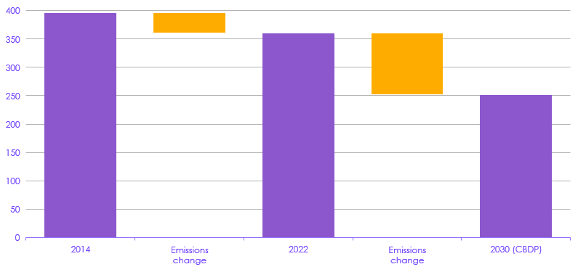
2030 goal – looking back 8 years and forward 8 years
Total emissions excluding shipping, aviation and electricity supply
-1.2%
per year
-4.4%
per year
Source
CCC analysis
Notes:
Chart shows emissions changes outside the aviation/shipping (significantly impacted by the pandemic) and electricity supply (driver of most past change, but with limited scope for further reductions).
Across all other sectors, pace of emissions reduction needs to increase by a factor of four over the next eight years from 2022-2030 compared to the previous eight years.
Based on reductions needed to (nearly) meet the 2030 NDC as quantified in Government’s Carbon Budget Delivery Plan.

Slide 9
2030 goal – looking back 8 years and forward 8 years
Change in UK emissions per year by sector
Source
CCC analysis
Notes:
Significant acceleration of action needed in almost all sectors.
Particularly pronounced in surface transport, industry, agriculture, and waste.
Not long to 2030, so this needs rapid action.
Promising signs in some areas (e.g. electric cars), but more needed.

Slide 10
On track for 2030?
Assessment for the 2030 goal for key sectors (June 2023)
Source
CCC analysis
Notes:
There is substantial risk around the UK’s ability to meet its 2030 NDC. Only a quarter of the required emissions reductions are assessed as having ‘credible plans’, while around a fifth have ‘insufficient plans’.
This ‘policy gap’ needs to be filled urgently to speed up delivery.
Has been some real and tangible policy progress since this assessment:
ZEV mandate, increasing share of ‘credible plans’ in surface transport.
Port Talbot decarbonisation deal, reducing share of ‘insufficient plans’ in industry.
But countered by mixed messaging from decision to relax important policies to decarbonise buildings and transport, increasing risk in some areas.

Slide 11

Progress snapshot in key sectors
Summary of progress against key indicators (June 2023)
Surface transport | Energy supply | Buildings | Industry | Agriculture and land
Electric car sales | Grid storage | Electricity to gas price ratio | Bioenergy use in industry | Livestock numbers
Battery cell prices | Dispatchable low-carbon capacity in development | Greening Government Commitments | Electricity use in industry | Livestock exports
Petrol/diesel car intensity | Offshore wind | Low-carbon share of heat supply | Energy consumption per unit of GVA | Food waste
Petrol/diesel van intensity | Onshore wind | Energy efficiency measures | Private sector targets | Woodland management
Van km | Unabated gas | Heat pump installations | Industrial process emissions | Crop yields
HGV km | Refineries emissions | Heat pump costs | Hydrogen use in industry | New woodland
Electric van sales | Solar PV | Trained heat pump installers | Pipeline of hydrogen projects | Peatland restoration
Car km | Active demand response | Residential energy demand | Industrial energy efficiency | Anaerobic digestion uptake
Public charge points | Low-carbon hydrogen production | Non-residential energy demand | Pipeline of Industrial CCS projects | Energy crops
Public transport demand | Oil and gas production emissions | Non-residential buildings energy intensity | Industry consumption emissions | Meat consumption
Notes:
Off track in a number of key delivery indicators. Need to speed up delivery to get these outcomes occurring at the pace required.
Aim should be for policies to unblock barriers that are hindering these, to get more of these into the green area.
Learn from good news stories (e.g. ZEV mandate and success of early-market subsidies to scale up early sales).
Have developed a set of monitoring maps setting out the outcomes required in each sector and how these combine to deliver the emissions reductions that are needed.
Notes from UKPR 2023 Executive Summary:
Table 1 summarises the progress seen this year in key sectors. While there have been some positive developments, we see action being significantly off track in a range of areas:
Surface transport. Sales of new electric cars are continuing to grow ahead of our pathway, although electric van sales are still lagging and remain significantly off track. This is particularly concerning given that van traffic is also increasing fast, already exceeding our pathway.
Electricity supply. Renewable electricity capacity increased in 2022, but not at the rate required to meet the Government’s stretching targets, particularly for solar deployment. Given short lead-times, rapid deployment of onshore wind and solar could have helped to mitigate dependence on imported gas during the fossil fuel crisis.
Buildings. The Government proposes to scale-up the market for heat pump installations to 600,000 by 2028, but current rates are around one-ninth of this and are not increasing fast enough. Installation rates of energy efficiency measures continue to be below necessary levels and fell further in 2022.
Electricity prices. The Government’s decision to take policy costs off electricity prices as part of financial support on energy bills means that the ratio of electricity prices to gas prices has fallen. It is now essential that this improvement in relative prices is made permanent, in the rebalancing of electricity and gas prices which the Government has committed to implement by March 2024.
Land use. Tree-planting rates continue to be too low and are not increasing at the rate required. Rates will need to double by 2025 for the Government to reach its target of 30,000 hectares per year of woodland creation. Peatland restoration rates increased slightly in 2022 but remain a factor of five less than our recommended rates.
Agriculture. Livestock numbers are on track despite no policy support in this area to support the current momentum in the right direction. Reported meat consumption is also on track, but data on meat availability shows a less clear picture; further policy intervention on diets is therefore required.
Industry. Progress in this sector is hard to track due to poor availability of data, but is off track for most available indicators. As we recommended last year, the Government should review, invest in and reform industrial decarbonisation data collection and reporting.

Slide 12
Sixth Carbon budget costs will be updated for CB7, early 2025

Slide 13
www.theccc.org.uk
@theCCCuk

