Slide 1
Overview of the ONS Environment Division
Ian Townsend
Divisional Director Environment

Slide 2
Environment: A big topic linked to many issues
Many national/devolved government departments and related bodies produce UK environment/climate change-related statistics, such as…
Department for Energy Security and Net Zero (DESNZ): e.g. overall greenhouse gas emissions, renewable energy, solar panel installations
Department for Transport (DfT): publishes statistics on electric vehicles
Met Office: climate and weather statistics/forecasts

Slide 3
Environment: ONS focus
On the intersections of environment and economy/society, including:
Measuring the ‘environmental economy’ and green jobs
Sectoral (residence-based/production) emissions
Valuing the services that the UK’s nature provides us
People and business concern or action on environment/climate change

Slide 4
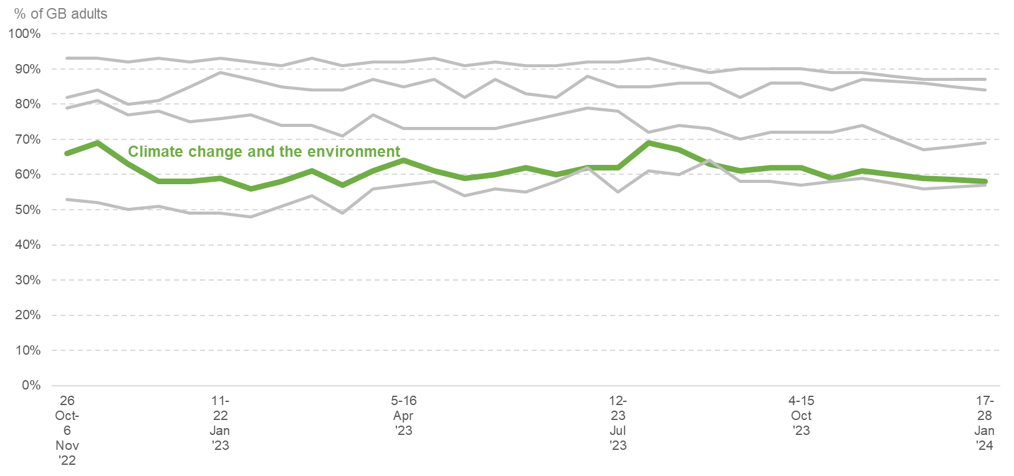
How are people feeling about climate change?
Regularly ask adults in Great Britain about important issues facing the country
58% said ‘climate change and the environment’ is an important issue (17-28 Jan)
4th most commonly- reported issue: ahead of housing and after the cost of living, the NHS and the economy
Broadly around 60% over the last 15 months
New headline figures due out on 1 March
Important issues facing the country % of GB adults, 2022-Jan 2024
ONS, OPN/various editions of Public Opinions & Social Trends, Oct 2022-Jan 2024

Slide 5
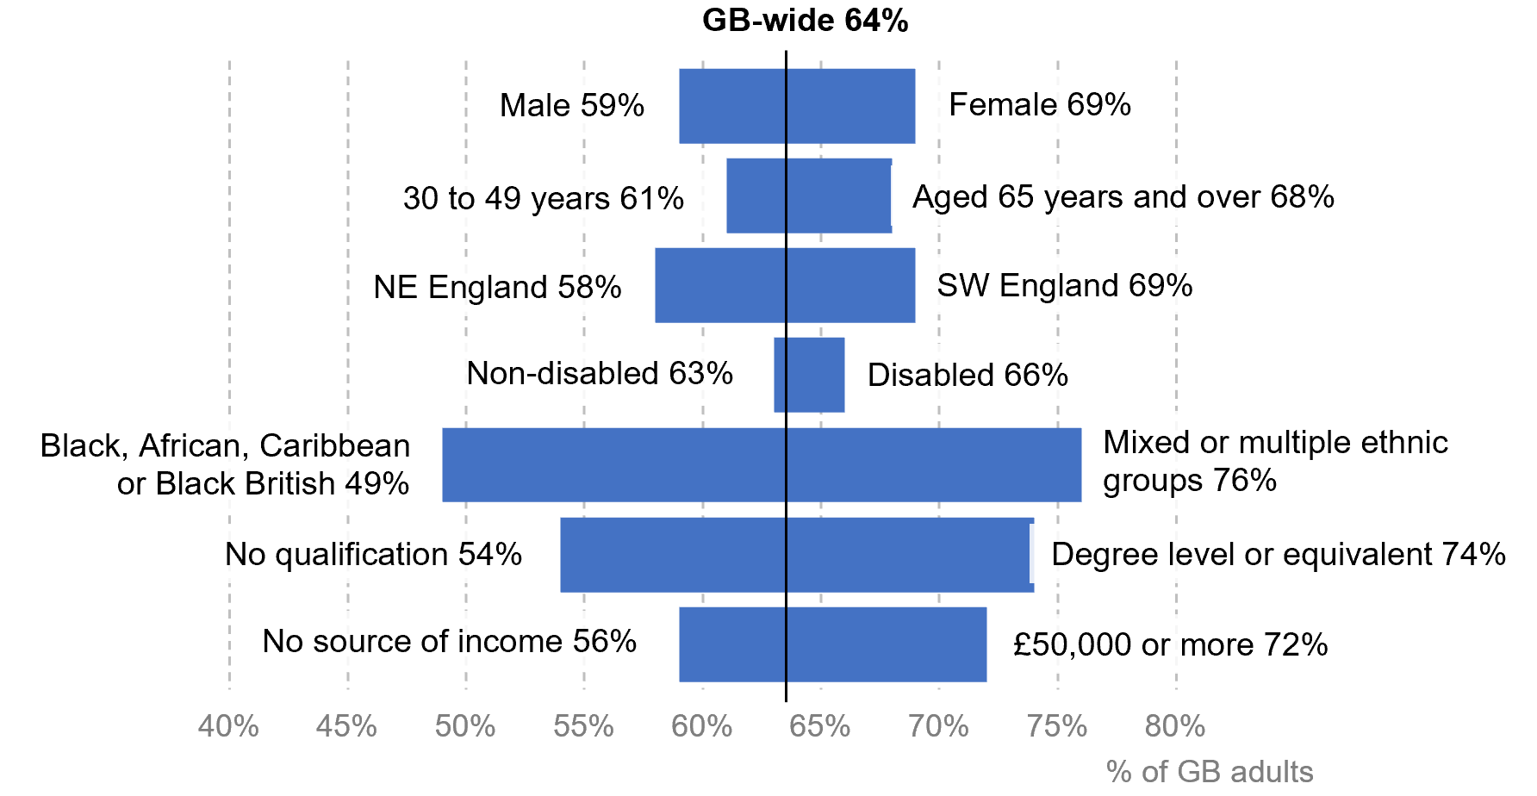
What about feeling among different groups?
Climate change and the environment as an important issue facing the country % of GB adults and of various groups, Jul-Oct 2023
Variations seen across different characteristics/groups
Using combined Jul-Oct 2023 survey data
ONS, Impact of increased cost of living on adults across Great Britain: 12 Jul-1 Oct 2023

Slide 6
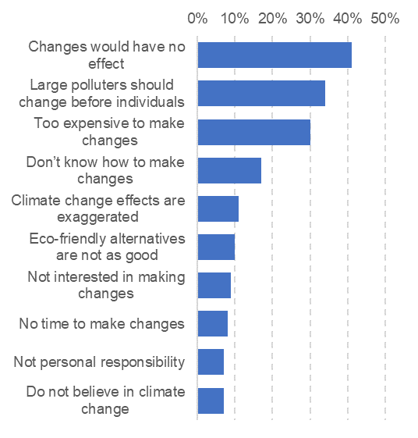
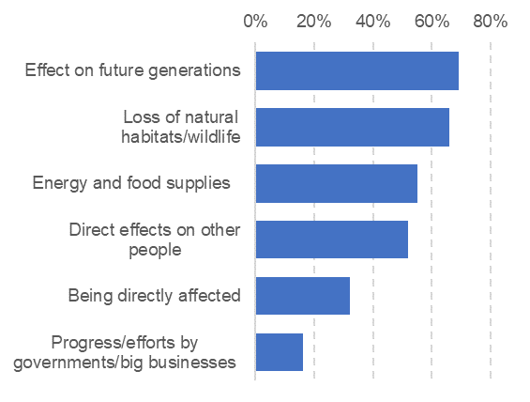
What about people’s action or inaction?
Asked GB adults whether they had made lifestyles changes to help tackle climate change, Nov 2023:
64% said they had made “some” changes, 8% “a lot of” changes, 28% said they had made no changes
Top motivating concerns given by those that reporting making at least “some” changes, % of this group
Reasons given by 28% reporting that not making changes, % of this group
ONS, Public opinions & social trends, 15-26 Nov and dataset

Slide 7
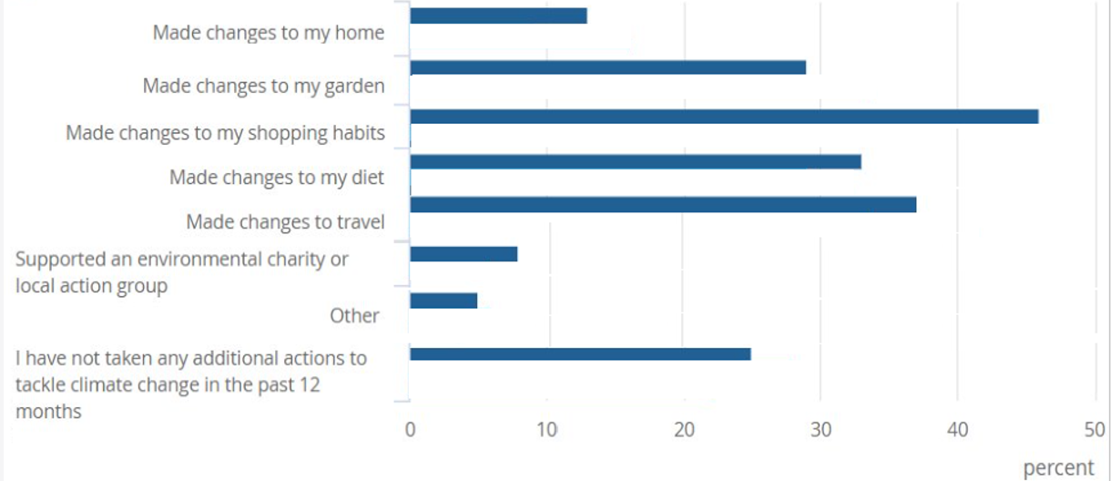
What actions are people taking?
Actions reported to help tackle climate change % of all adults Great Britain, 14 Jun to 9 Jul 2023
Asked GB adults about the changes they had made in the previous year, most recently in June-July 2023:
From changed shopping habits, 46%
To supporting an environmental charity or a local action group, 8%
Also, 25% reported not making any changes
ONS, Climate change insights, families and households fig 6 (from OPN 14 Jun-9 Jul 2023)

Slide 8
What about businesses concern?
We asked UK businesses about climate change in Nov 2023:
47% of businesses surveyed somewhat concerned about impact climate change may have on their business (including about 10% being very concerned)
34% were not concerned
18.5% were not sure
Our BICS survey excludes certain sectors, inc. oil and gas, energy generation and supply, financial and insurance, agriculture
Business Insights and Conditions Survey 16 Nov 2023: data tables

Slide 9
What about business actions or inactions?
At a strategic level:
14% of business report having a climate change strategy
11% report some kind of greenhouse gas emissions target
10% report monitoring climate-related risks
At a practical level:
40% report switching to more efficient LED light-bulbs
35% have adjusted their heating or cooling systems
20% electrifying vehicle fleet, 17% introducing cycle to work
18% installing a smart meter, 10% insulating buildings, 10% installing their own renewable electricity or heating
ONS, Business Insights and Conditions Survey 16 Nov 2023: data tables

Slide 10
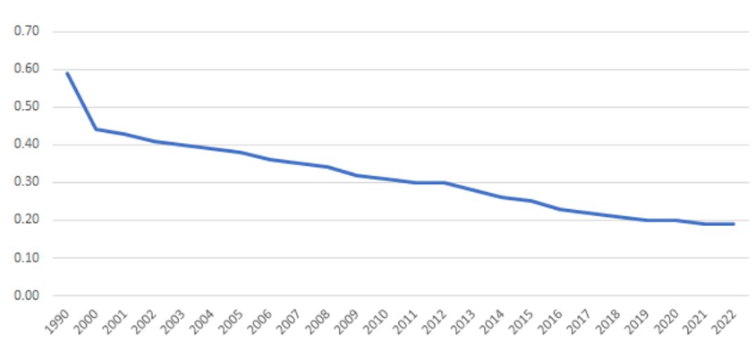
‘Greening’ the UK economy
Emissions intensity – excluding consumer spending
thousand tonnes of CO2e (residence basis) per £million GVA
‘Greening’ of the UK economy seen through greenhouse gases emitted for each unit of economic activity (Gross Value Added)
Down 68% between 1990 and 2022, from 0.59 to 0.19 thousand tonnes of CO₂ equivalent per £million GVA
ONS, Environmental Accounts: Provisional 2022

Slide 11
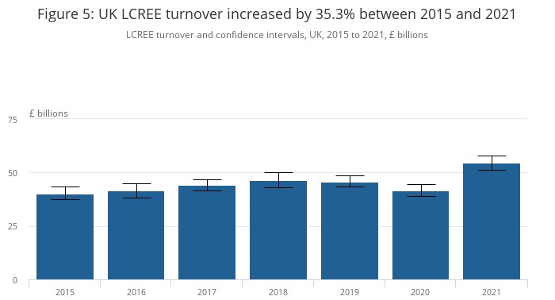
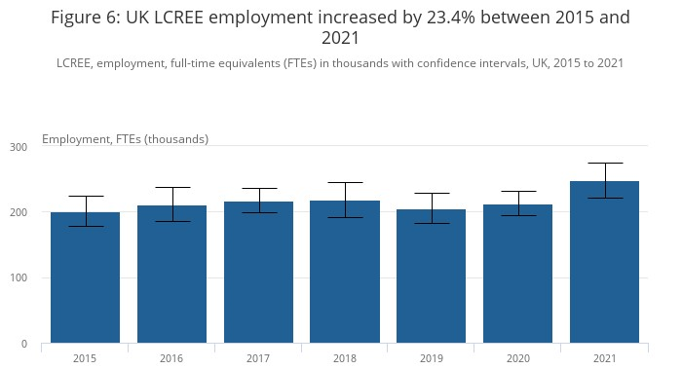
And the ‘green economy’?
We measure the low carbon and renewable energy economy (LCREE)
LCREE turnover increased 35% between 2015 and 2021
LCREE employment increased 23% in the same period
Also, Environmental Goods and Services Sector: 17 activities across the economy, with combined output of £89.6 billion in 2020

Slide 12
What about ‘green jobs’?
Lots of different definitions inc. internationally for different purposes
Major recent project to define and measure for UK purposes
March 2023 definition: “Employment in an activity that contributes to protecting or restoring the environment, including those that mitigate or adapt to climate change”
Initial figures based on this definition last year, using industry-based approach:
Total UK employment in green jobs: ~526,000 full-time equivalents
Compared with ~507,000 in 2015
Our latest LCREE and green jobs figures are due out on 8 March and 14 March

Slide 13
What about nature’s role in climate change action?
“Net” part the UK’s net zero target can sometimes receive less attention
Amid decarbonisation, some sectors are more difficult to decarbonise
Technology and the natural world are expected to play key roles
We produce the UK natural capital accounts, estimating the economic value of the services that nature provides to us. On this issue:
In 2022, UK wooded areas removed c.18m tonnes CO₂ equivalent (CO₂e), compared with net UK territorial emissions of c.400 million tonnes in 2022
In 2021, UK nature was a net source of just over 1m tonnes of CO₂e, costing £208 million rather than contributing.
Substantial proportion due to damaged peatlands

Slide 14
Other relevant ONS outputs
Energy efficiency
Annual energy efficiency of housing release, Nov 2023
Who is most likely to live in homes that are harder to keep warm?, Dec 2023: Linking Energy Performance Certificate and Census data to understand households in high- and low-rated energy efficient properties
Health
Climate-related mortality, England and Wales, 1988 to 2022, Sep 2023, showing an estimated 4,507 deaths associated with the hottest days in England in 2022

Slide 15
To sum up:
The ONS plays an important role in UK climate change-related statistics
Concern expressed by people and businesses – with some taking action, but they report facing barriers
The economy as a whole is greening with emissions intensity falling
The ‘green’ (low carbon and renewable energy economy) is also increasing
Nature has an important role to play in achieving the ‘net’ of net zero
New key issues, low carbon economy and green jobs statistics in March
Also: Help us to make our statistics as useful as possible, contact: environment@ons.gov.uk

