Slide 1
The Unknown Unknowns
The Economic Life of Net Zero is much more uncertain than we are usually told.

Slide 2
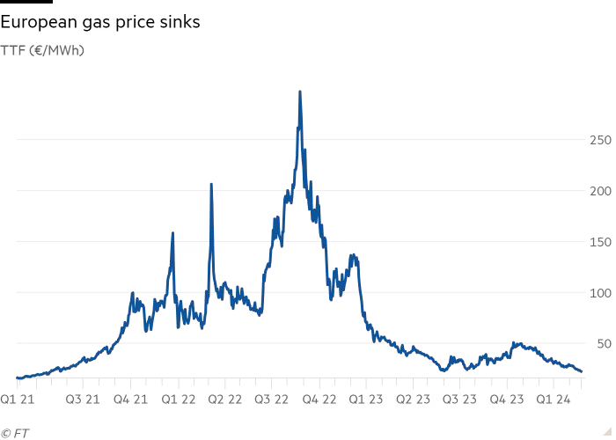

Slide 3
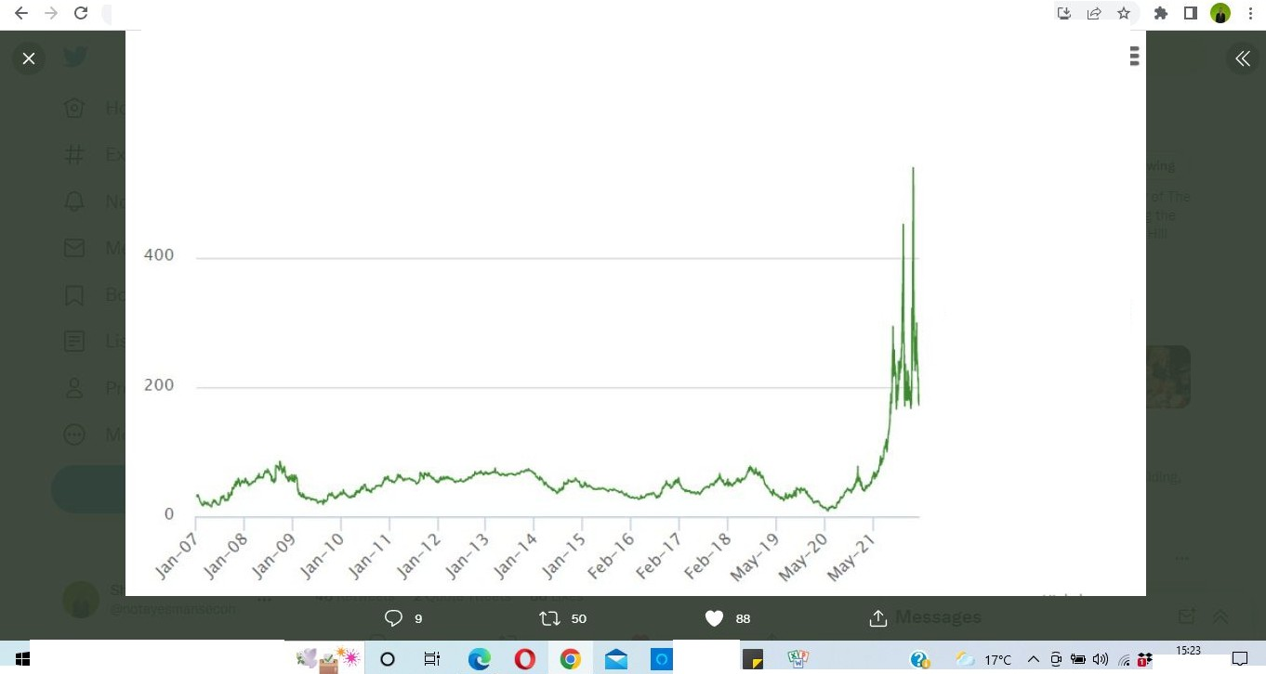
FT Fin< x I rm Eco x I ll!l Inv, x I ® The x I r= AO x I
'ti cor
AO x .,, Bisi x G lau, x I fl Th, x I Qi Ma x I O Pri< x I G tak x I +
X
V
i twitter.com/aDissentient/status/1521783780507328519/photo/1
Gas Spot Price
Source: Intercontinental Exchange, US Energy Information Administration, ERCE Estimates
600
- UK NBP (p/therm)
P Type here to search
"
10/05/2022

Slide 4
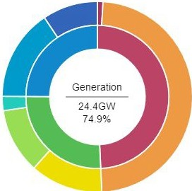
fl Home/X X
Google Slid X □ Better Statis
X ⁰⁰• India vs Eng X II Discover the X
· National Gr X
National G· X G screenshct X +
X
C: (D File C:/Users/User/Downloads/National%20Grid_%20Live.html
.±. [J
Time@
10:30am
Price@
£47.80/MWh
Emissions@
193g/kWh
Demand@
32.6GW
Generation @
24.4GW
Transfers@
8.2GW
=
+
Generation
36.9% fossil fuels |  |  | 25.1% interconnectors
Coal@ | 0.23GV, | 0.7°0 | D Belgium@ | 1.00G''V | 3.1••
Gas@ | 11.78GV, | 36.2°0 | D Denmark@ | 0.81G''V | 2.s⁰•
 |  |  | D France@ | 3.99GW | 12.3°0
19.3% renewables |  |  | Ireland@ | -0.07GW | -0.2 .
 |  |  | D Netherlands @ | 1 05G\/'v | 3.2%
Solar@ Wind@ Hydroelectric@ | 3.01GW 2.70GV, 0.59GV, | 9.2% 8.3°0 1.8°0 | D Norway@ | 1.40G\/'v | 4.3%
18.6% other sources
0.0% storage
3.78GW 11.6%
2.29GW 7.0%
D Pumped storage@
D Battery storage @
Note: percentages are relative to demand, so will exceed 100% if power is being exported
Nuclear@
Biomass@
Past day
Past week
Past year
All time
II
P Type here to search A -f "J
"
0
6°C Cloudy
10:38
A (]>)) 9-1 25/02/2024 CJ
l

Slide 5
Lords Economic Committee: Sir Dieter Helm
It is now much more expensive—in fact, it is twice as expensive—to get a wind turbine as it was a matter of a year ago
It is absolutely clear that renewables are not 10 times cheaper than fossil fuels, or three times cheaper. In fact, fossil fuel prices are falling very sharply. I think these are really quite expensive.
Offshore wind has doubled in cost in the last 12 months to £70 or £80 per megawatt hour, not incorporating the intermittency.
.

Slide 6
Intermittency Issues
If want an intermittent system with 50 gigawatts wind, you do not need the old capacity that we required, 70 or 80 gigawatts to meet total demand; you need about 130 gigawatts
The reason for that is because the calculation of the costs of the other technologies, particularly the renewables, does not properly incorporate the cost of intermittency or the fact that they are low-density energy, or the fact that they are distributed geographically very widely
CfDs just exclude all the intermittency costs. They are the average cost for that unit delivered to a system that has to absorb the cost. Building the supergrid, the offshore grid and all those things are not in the CfDs.

Slide 7
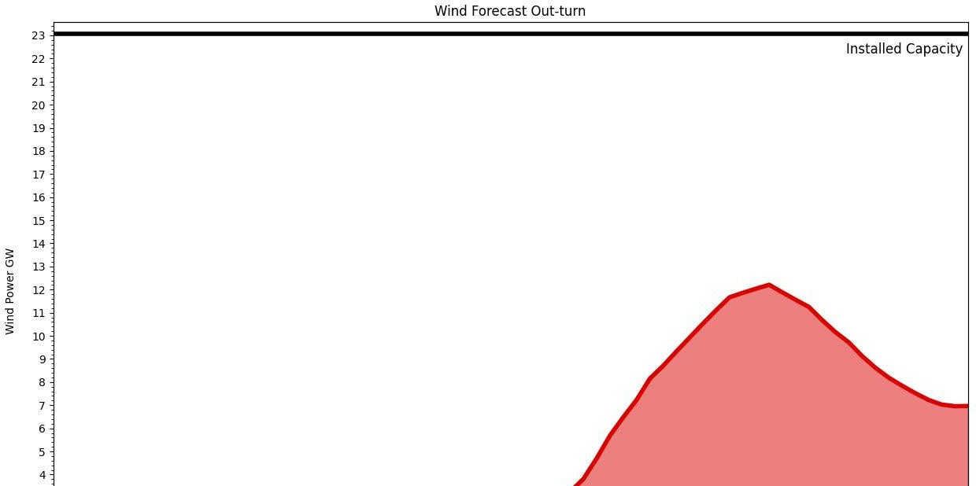
Dunkelflaute

Slide 8
How to really get Net Zero
If you want to get the numbers down a bit further, as I once explained to Boris Johnson, just go around and take off the last of the intensive industries. We close most of the fertiliser, aluminium, steel and petrochemical industries, and we import the stuff instead. That is why the numbers do not tell you anything particularly sensible. Oh, and by the way, we do not include Drax’s emissions in our territorial numbers either.

