Slide 1
Climate Change
Possible Macroeconomic Implications
Better Statistics: Combating Climate Change – Where Are We With Net Zero?
29th February 2024
Boromeus Wanengkirtyo
Any views expressed are solely those of the presenter and so cannot be taken to represent those of the Bank of England or to state Bank of England policy. This presentation should therefore not be reported as representing the views of the Bank of England or members of the Monetary Policy Committee, Financial Policy Committee or Prudential Regulation Committee.

Slide 2
A framework of the macroeconomic impacts of climate change
Physical
impacts
Climate change
Transition impacts

Slide 3
A framework of the macroeconomic impacts of climate change
(1) & (2): Effects on shorter-term economic variables (e.g. output, inflation) by physical and transition impacts
Physical
impacts
Climate change
Transition impacts
(1)
(2)
Business cycle variables

Slide 4
A framework of the macroeconomic impacts of climate change
(1) & (2): Effects on shorter-term economic variables (e.g. output, inflation) by physical and transition impacts
(3) & (4): Effects of longer-term economic variables (e.g. r*) by physical and transition impacts
Physical
impacts
Climate change
Transition impacts
(1)
(2)
(3)
(4)
Business cycle variables
Long-run “star” variables

Slide 5
A framework of the macroeconomic impacts of climate change
(1) & (2): Effects on shorter-term economic variables (e.g. output, inflation) by physical and transition impacts
(3) & (4): Effects of longer-term economic variables (e.g. r*) by physical and transition impacts
Physical
impacts
Climate change
Transition impacts
(1)
(2)
(3)
(4)
Business cycle variables
Long-run “star” variables
Monetary policy
Central
banking

Slide 6
A framework of the macroeconomic impacts of climate change
(1) & (2): Effects on shorter-term economic variables (e.g. output, inflation) by physical and transition impacts
(3) & (4): Effects of longer-term economic variables (e.g. r*) by physical and transition impacts
(5): effects of climate change on the transmission/effectiveness of monetary policy
Physical
impacts
Climate change
Transition impacts
(1)
(2)
(3)
(4)
Business cycle variables
Long-run “star” variables
(5)
Monetary policy
Central
banking

Slide 7
A framework of the macroeconomic impacts of climate change
(1) & (2): Effects on shorter-term economic variables (e.g. output, inflation) by physical and transition impacts
(3) & (4): Effects of longer-term economic variables (e.g. r*) by physical and transition impacts
(5): effects of climate change on the transmission/effectiveness of monetary policy
Effect on financial stability policies, which could feed back to macro variables
Physical
impacts
Climate change
Transition impacts
(1)
(2)
(3)
(4)
Business cycle variables
Long-run “star” variables
(5)
Monetary policy
Central
banking
Financial stability policy

Slide 8
Physical impacts on business cycles

Slide 9
Physical impacts of climate change: key literature takeaways
Natural disasters often have a negative impact on GDP, but large heterogeneity
(Cavallo & Noy, 2009; Raddatz, 2009; Loayza et al., 2012; von Peter et al., 2012)

Slide 10
Physical impacts of climate change: key literature takeaways
Natural disasters often have a negative impact on GDP, but large heterogeneity
(Cavallo & Noy, 2009; Raddatz, 2009; Loayza et al., 2012; von Peter et al., 2012)
Natural disasters/extreme weather raises inflation (particularly food)
(Heinen et al., 2019; Parker, 2018; Ciccarelli et al., 2023)

Slide 11
Physical impacts of climate change: key literature takeaways
Natural disasters often have a negative impact on GDP, but large heterogeneity
(Cavallo & Noy, 2009; Raddatz, 2009; Loayza et al., 2012; von Peter et al., 2012)
Natural disasters/extreme weather raises inflation (particularly food)
(Heinen et al., 2019; Parker, 2018; Ciccarelli et al., 2023)
Gradual temperature rises also negative on economic growth, both in the short and long run
(Felbermayr et al., 2014; Burke et al., 2015)

Slide 12
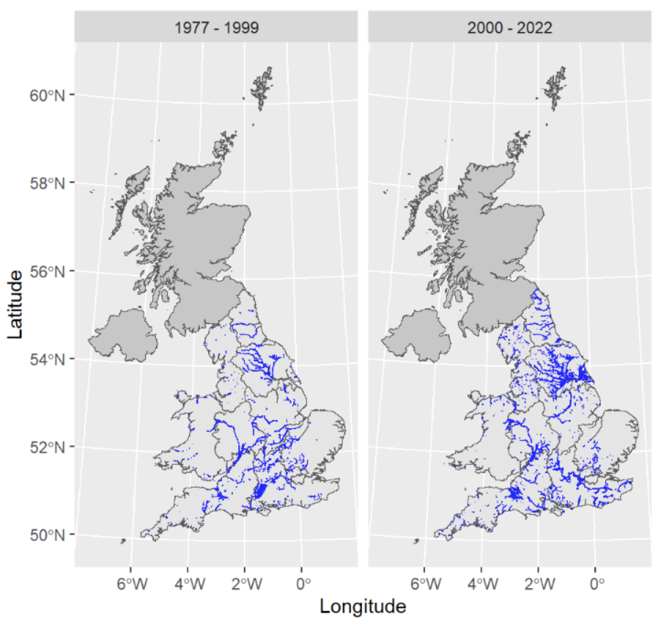
Floods and its macroeconomic impacts
Historical flooding in England & Wales
UK Climate Change Risk Assessment 2022 rates the risks by 2050s to:
People, communities & buildings from river/surface flooding as ‘very high’ (>£1bn p.a. damages) and from coastal flooding as ‘high’ (>£100m p.a. in damages)
Business sites as ‘very high’ and infrastructure networks as ‘high to very high’
Economic impacts on firms
Novel dataset merging business premise address information with flood maps and corporate financial records for all businesses in England and Wales
SMEs more likely to terminate their business operations following a flood (unlike with large firms)
Among those continuing operations, flooding to a business premise leads to a significant reduction in the firm’s turnover, employment and total assets on the year of the flooding, followed by a recovery in the subsequent years
Source: Crampton, Gilman & Mari (2024) Staying Afloat: The Impact of Flooding on UK Firms

Slide 13
Transition impacts on business cycles

Slide 14
Transition impacts of climate change: key literature takeaways
Cap-and-trade schemes appear to be inflationary, carbon taxes less so
(ETS coverage tends to be in high pass-through sectors & carbon tax rev. recyc.)*
Elgie and McClay (2013), Bernard et al. (2018), Metcalf (2019), Metcalf and Stock (2020), Konradt and Weder di Mauro (2022), * Kaenzig & Konradt (2023)

Slide 15
Transition impacts of climate change: key literature takeaways
Cap-and-trade schemes appear to be inflationary, carbon taxes less so
(ETS coverage tends to be in high pass-through sectors & carbon tax rev. recyc.)*
Elgie and McClay (2013), Bernard et al. (2018), Metcalf (2019), Metcalf and Stock (2020), Konradt and Weder di Mauro (2022), * Kaenzig & Konradt (2023)
Green patents positively impact GDP, through higher investment
(effects comparable to non-green patents)
Hasna et al. (2023)

Slide 16
Transition impacts of climate change: key literature takeaways
Cap-and-trade schemes appear to be inflationary, carbon taxes less so
(ETS coverage tends to be in high pass-through sectors & carbon tax rev. recyc.)*
Elgie and McClay (2013), Bernard et al. (2018), Metcalf (2019), Metcalf and Stock (2020), Konradt and Weder di Mauro (2022), * Kaenzig & Konradt (2023)
Green patents positively impact GDP, through higher investment
(effects comparable to non-green patents)
Hasna et al. (2023)
About a third of UK firms raised climate-related capex over last 3 years
February 2024 Monetary Policy Report

Slide 17
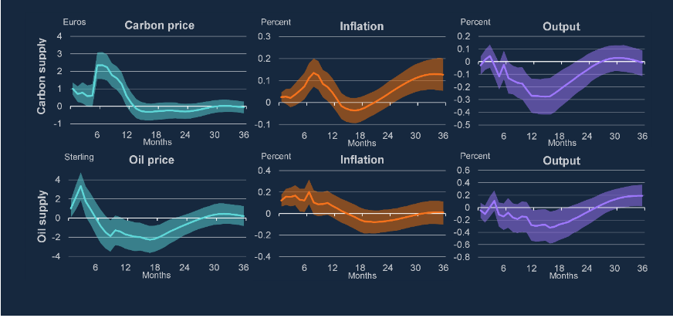
Carbon price shocks are similar to, but not the same as, oil price shocks
Impulse response functions to a carbon policy & oil supply shock
Source: Bank calculations, in Catherine L Mann speech Climate policy and monetary policy: interactions and implications. Notes: The model is a structural VAR identified using an internal instrument approach. The proxies for the identified shocks (carbon policy supply and oil supply) are ordered first in the causal chain, and are thereby exogenous to variation in the other variables. The carbon supply version of the model identifies the effect of a change in the supply of emissions certificates on the price of carbon, CPI inflation, energy price inflation, GDP, equity returns, GHG emissions, the unemployment rate, policy rate and the output gap. The output gap is interpolated to monthly frequency using monthly GDP, and the GHG emissions are interpolated to monthly frequency using industrial production (as in Känzig, 2023). The oil supply version of the model orders oil supply shocks first, followed by Brent oil prices, and the remaining variables are the same as the carbon supply model. The response of carbon and oil prices are scaled to be €1 on impact. Shaded areas are the 68% bootstrapped confidence intervals.

Slide 18
Latest Decision Maker Panel survey climate module in 2023
Decision Maker Panel (BoE-Stanford-Nottingham survey, with a panel of 9,000+ firms): new climate-related questions added in 2021, and repeated in 2023
Around a third of DMP Survey respondents reported that climate change has resulted in an increase in their capital expenditure over the past three years.

Slide 19
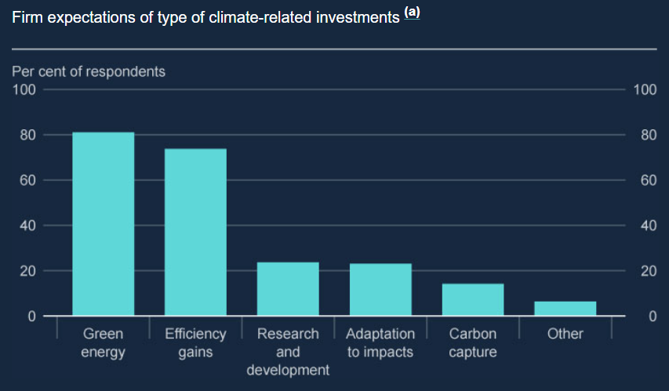
Latest Decision Maker Panel survey climate module in 2023
Decision Maker Panel (BoE-Stanford-Nottingham survey, with a panel of 9,000+ firms): new climate-related questions added in 2021, and repeated in 2023
Around a third of DMP Survey respondents reported that climate change has resulted in an increase in their capital expenditure over the past three years.
Out of firms expecting to increase investment over the next three years, they are most likely to do so by investing in switching to green energy sources or more energy-efficient production methods
Source: February 2024 Monetary Policy Report. The DMP Survey asks firms who expect a positive impact of climate change on their capital expenditure over the next three years about the sources of climate-related investment they expect to make. Firms are asked to select from: (i) energy-efficiency improvements, (ii) switching to greener energy sources, (iii) carbon capture, (iv) research and development in new green technologies, (v) adaptation to physical impacts, and (vi) other. Firms are allowed to select multiple sources of investment, therefore the percentages do not add up to 100.

Slide 20
Only a small minority of UK firms report monitoring climate risks…
*
Number of employees
Source: Business Insights and Conditions Survey (Office for National Statistics), 30 Oct 2023 to 12 Nov 2023

Slide 21
… but more have a climate change strategy…
*
Number of employees
Source: Business Insights and Conditions Survey (Office for National Statistics), 30 Oct 2023 to 12 Nov 2023

Slide 22
... and majority of UK firms took some action to reduce emissions…
*
Number of employees
Source: Business Insights and Conditions Survey (Office for National Statistics), 30 Oct 2023 to 12 Nov 2023
* At least one of: Adjusting heating and cooling systems, Going paperless, Electrifying vehicle fleet, Installing a smart meter, Installing charging points, Installing own renewable electricity or heating, Insulating buildings, Introducing a cycle to work scheme, Switching to LED bulbs

Slide 23
… which was a little higher in 2023 relative to 2022
*
Number of employees
Source: Business Insights and Conditions Survey (Office for National Statistics), 21 March to 3 April 2022
* At least one of: Adjusting heating and cooling systems, Going paperless, Electrifying vehicle fleet, Installing a smart meter, Installing charging points, Installing own renewable electricity or heating, Insulating buildings, Introducing a cycle to work scheme, Switching to LED bulbs

Slide 24
Conclusions

Slide 25
Adapting to structural changes is not new to monetary policy
UK CPI inflation and its components, 1997-2019
Accession of China to WTO in 2001
Sustained period reduced the prices of manufactured goods imported by advanced economies in early 2000s
Ultimately, monetary policy must allow the economy to adjust to such shocks
A sustained rise in carbon prices may induce similar effects, but in an upward direction on carbon-intensive parts of the CPI basket
Source: ONS and Bank calculations

Slide 26
Conclusion
Climate change comprises another set of economic shocks and structural changes for monetary policymakers to assess and monitor in order to achieve monetary policy targets
But it presents new challenges: a global dimension, its very long time horizon and the degree of uncertainty on future climate policy and the response of economic agents will respond
Many of the questions in this area are new, open and worthy of further research

Slide 27
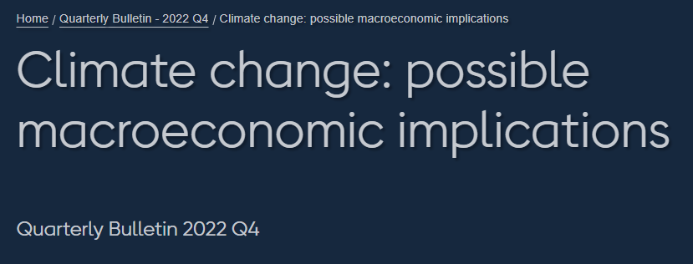
Effects on macroeconomic fluctuations
Box A: Case study – flooding and house prices in the UK
Box B: The Balanced Net Zero Pathway (Climate Change Committee, 2020)
Box C: Amplification channels and international spillovers
Effects on the long-run equilibrium interest rate, R*
Monetary policy considerations
Climate and monetary policy strategy
Monetary policy trade-offs
Possible changes in the transmission mechanism of monetary policy
Conclusion

