Slide 1
Title goes here
Misinformation about net zero
Bob Ward
Policy and Communications Director
29 February 2024
Names go here

Slide 2
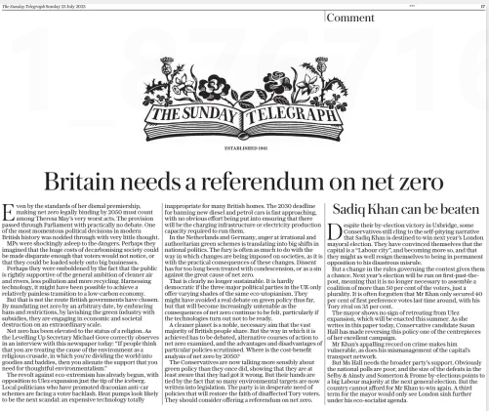
The Sunday Telegraph, 23 July 2023

Slide 3
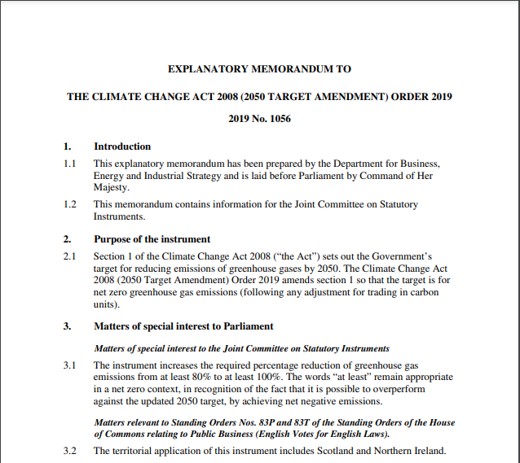
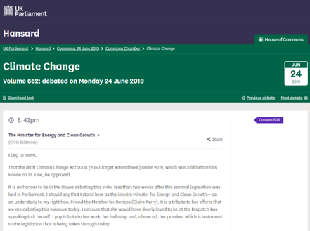
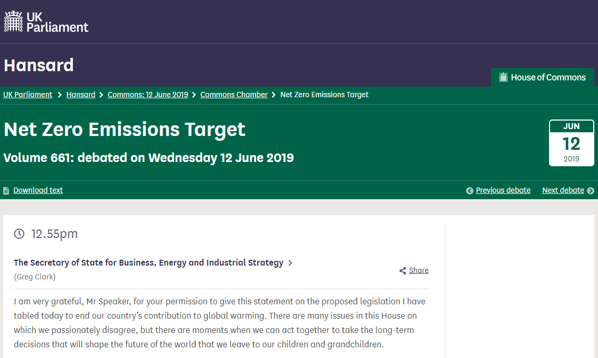
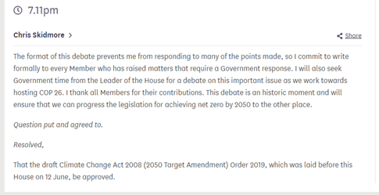
The Sunday Telegraph, 23 July 2023
“Even by the standards of her dismal premiership, making net zero legally binding by 2050 must count among Theresa May’s very worst acts. The provision passed through Parliament with practically no debate. One of the most momentous political decisions in modern British history was nodded through with very little thought.”
Three hours of debate in the House of Commons.

Slide 4
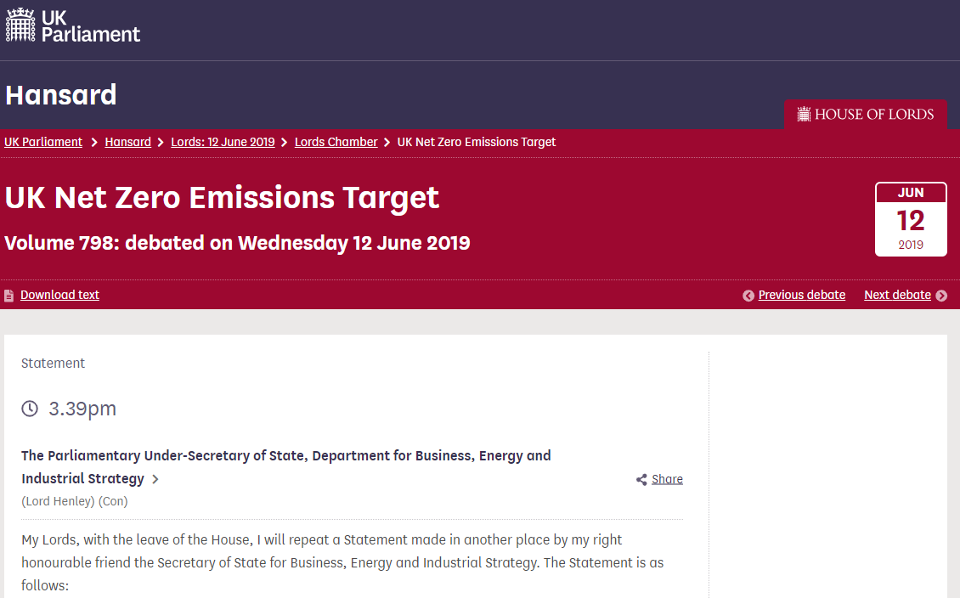
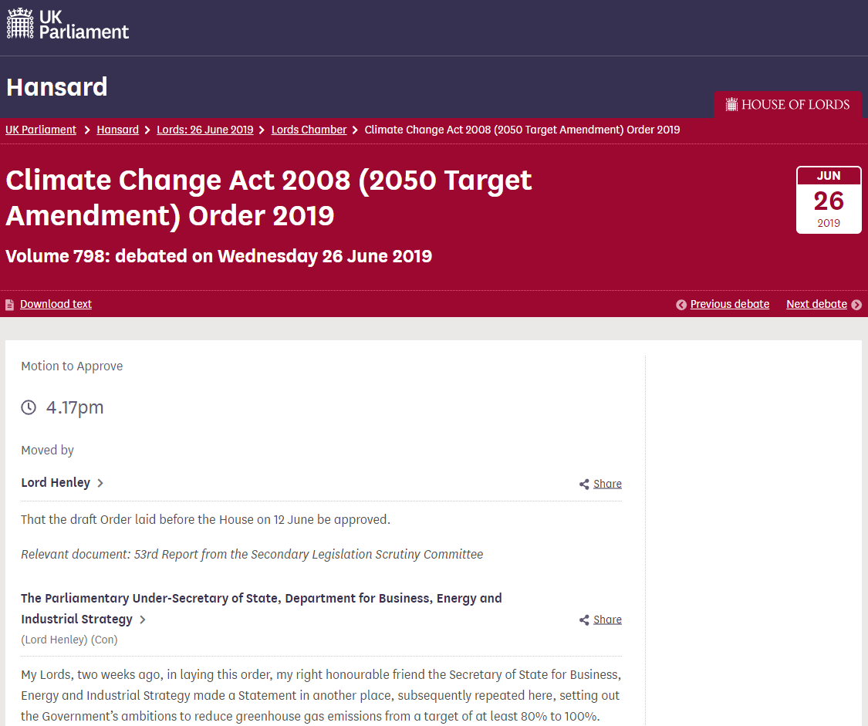
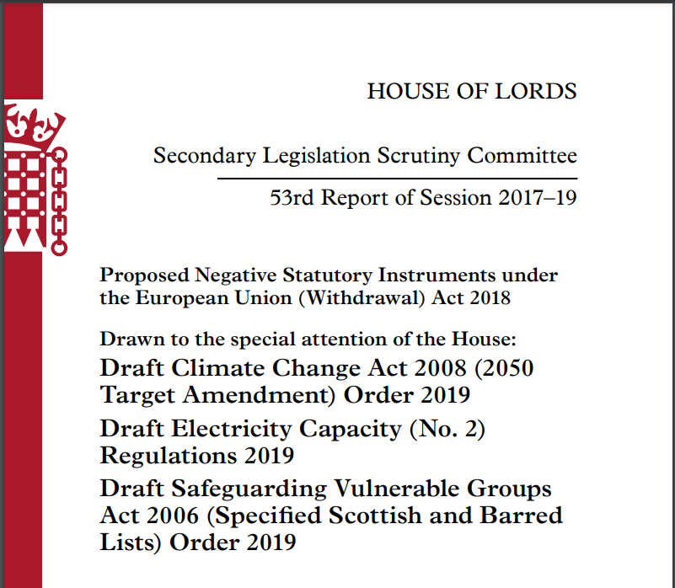
The Sunday Telegraph, 23 July 2023
“Even by the standards of her dismal premiership, making net zero legally binding by 2050 must count among Theresa May’s very worst acts. The provision passed through Parliament with practically no debate. One of the most momentous political decisions in modern British history was nodded through with very little thought.”
Three and half hours of debate in the House of Lords and report from the House of Lords Secondary Legislation Committee.

Slide 5
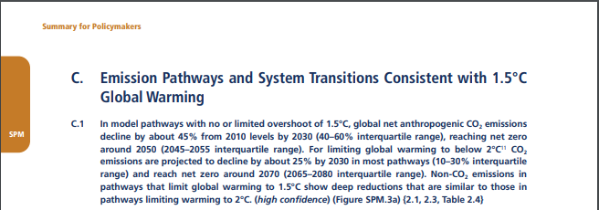
The Sunday Telegraph, 23 July 2023
“By mandating net zero by an arbitrary date, by embracing bans and restrictions, by lavishing the green industry with subsidies, they are engaging in economic and societal destruction on an extraordinary scale.”
275-page report by the Climate Change Committee published on 2 May 2019. 616-page report by the Intergovernmental Panel on Climate Change published on 8 October 2018.

Slide 6
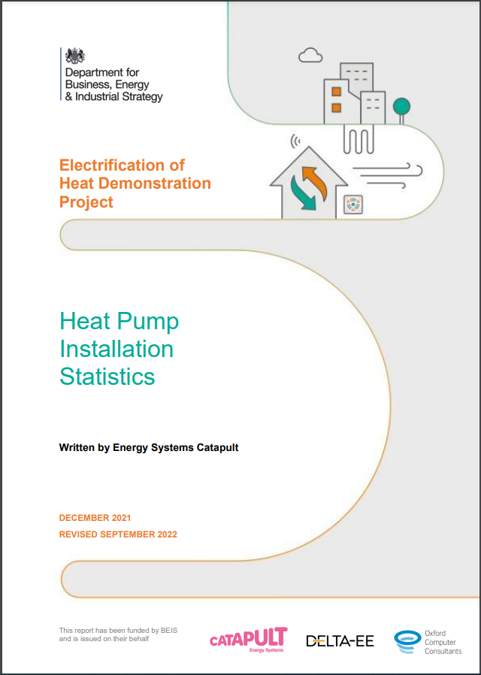
The Sunday Telegraph, 23 July 2023
“Heat pumps look likely to be the next scandal: an expensive technology totally inappropriate for many British homes.”

Slide 7
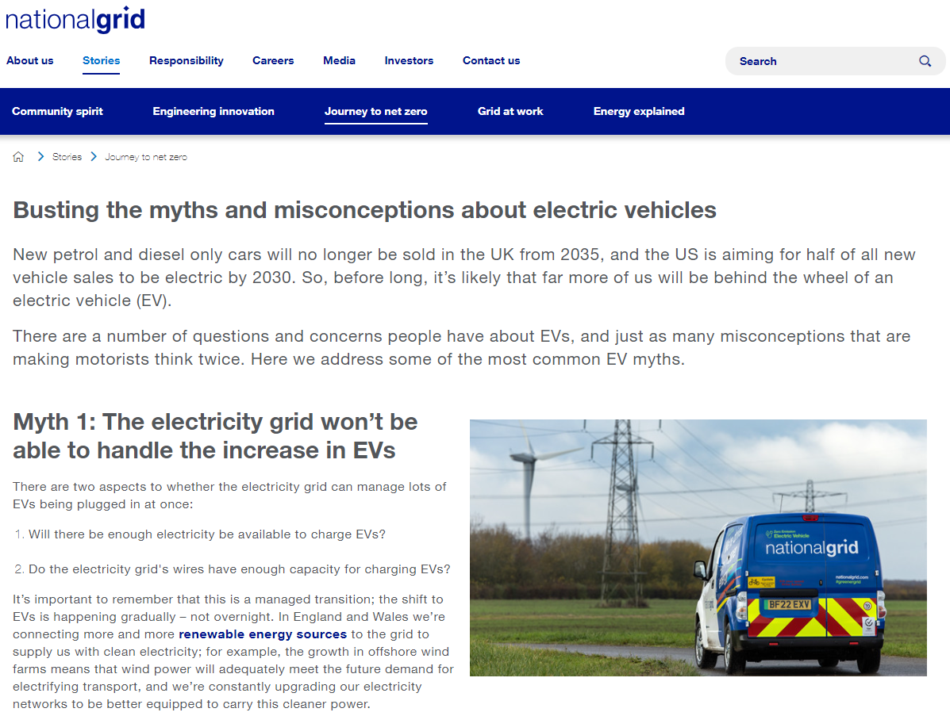
The Sunday Telegraph, 23 July 2023
“The 2030 deadline for banning new diesel and petrol cars is fast approaching, with no obvious effort being put into ensuring that there will be the charging infrastructure or electricity production capacity required to run them.”

Slide 8
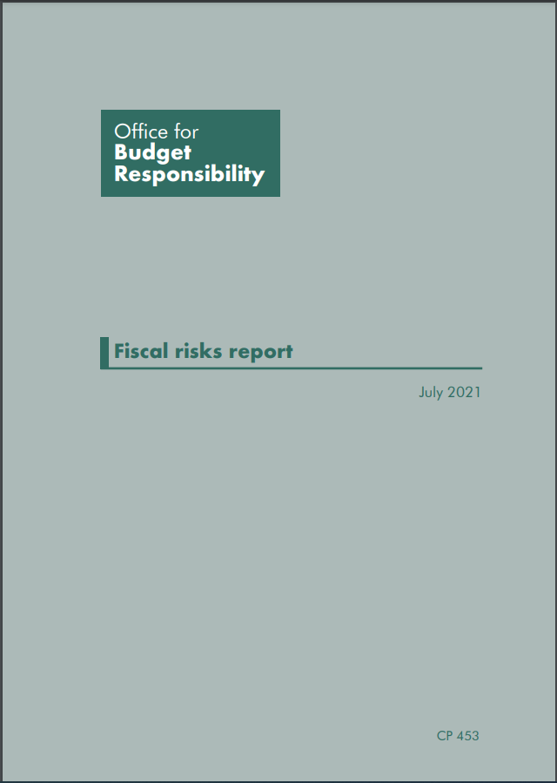
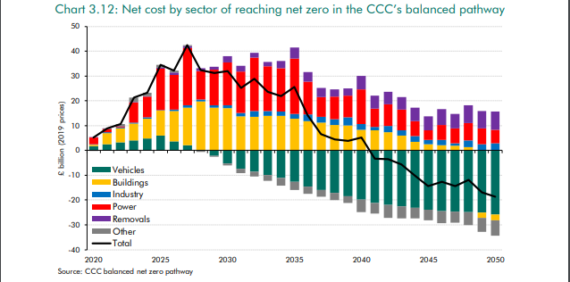
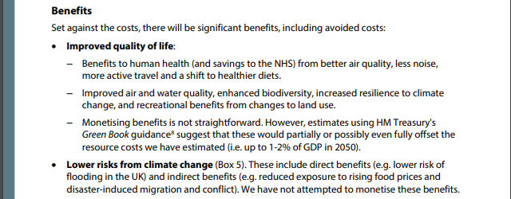
The Sunday Telegraph, 23 July 2023
“Where is the cost-benefit analysis of net zero by 2050?”

Slide 9
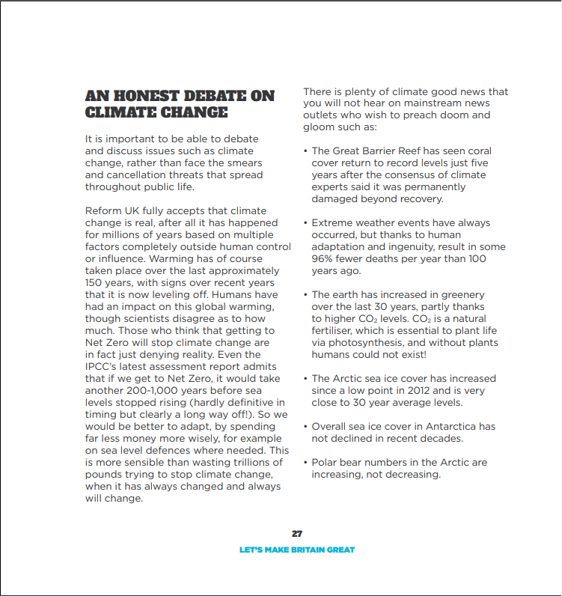
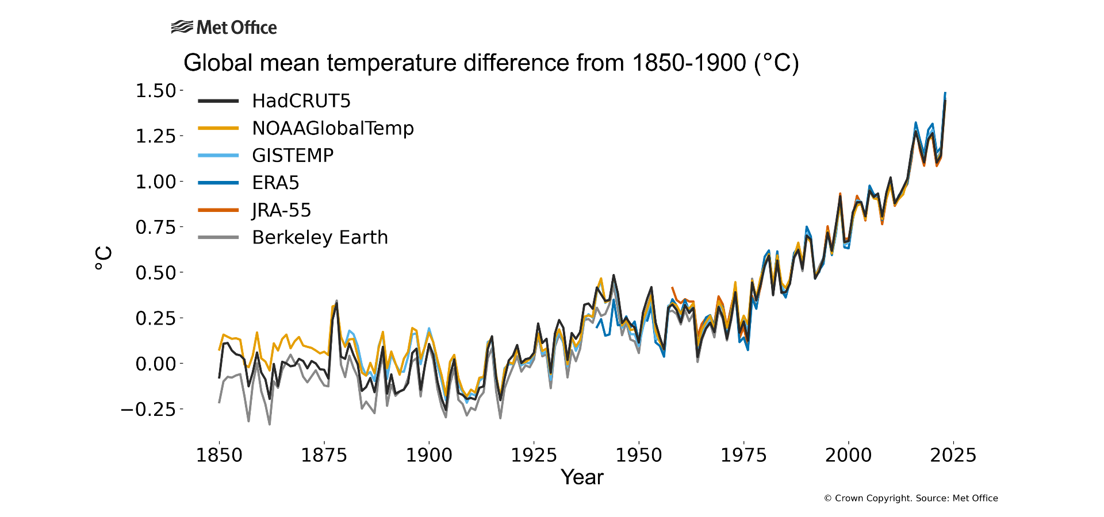
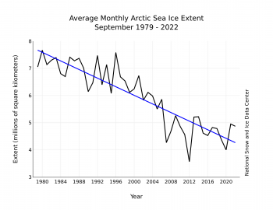
Reform UK

