Slide 1
Smart Data for Social Inclusion
Professor Alex Singleton
Consumer Data Research Centre
University of Liverpool
data.cdrc.ac.uk

Slide 2
data.cdrc.ac.uk

Slide 3
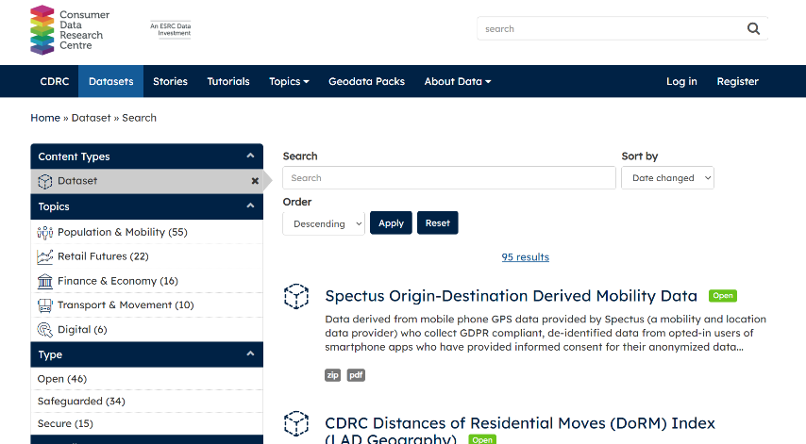
Users and Usage
2016 - 2023
3.7m Page Views
13.4k Registered Users
430.4k Downloads
data.cdrc.ac.uk

Slide 4
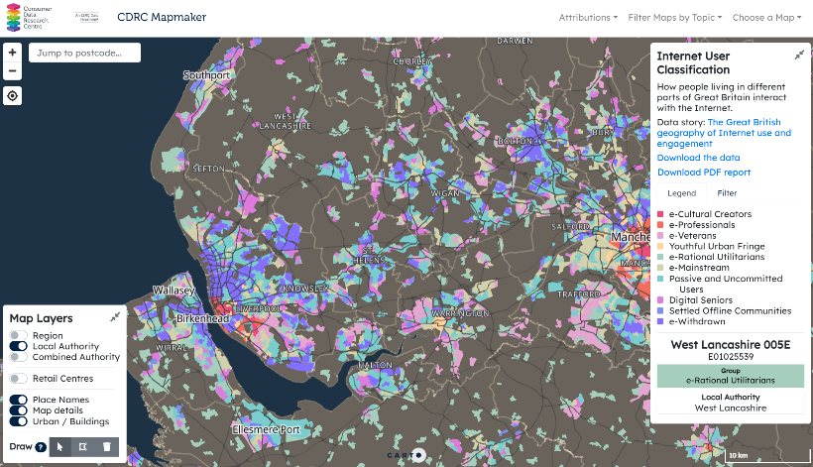
Users and Usage
2016 - 2023
5.8m Page Views
1m Unique Visitors
mapmaker.cdrc.ac.uk

Slide 5
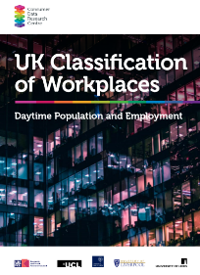
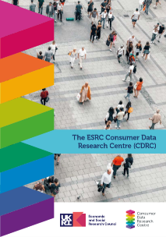
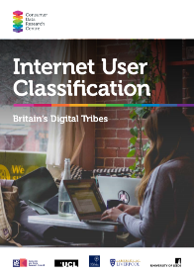
Analysis Ready Data
Open
User
Demand
Safeguarded
Controlled
Simplicity of Access

Slide 6
Smart Data and Social Exclusion
Analysis Read Data
Can tell you things you don’t know about people and places
Context matters
Useful to frame policy or interventions
Integrate “Smart Data” (and other administrative data)
Needs census data to enhance utility

Slide 7
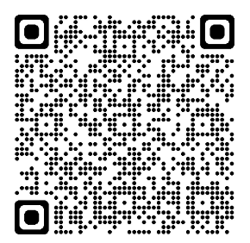
Internet User Classification

Slide 8
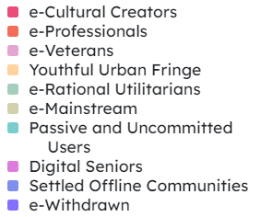
Internet User Classification
Integrates a range of smart data
Consumer data from online retailers
Large commercial surveys
Innovative machine learning creates small area estimates
These are pegged to the census

Slide 9
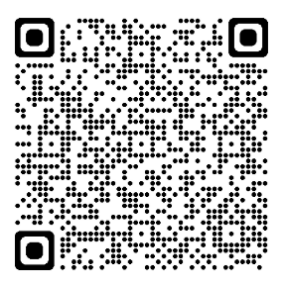
Ageing in Place Classification

Slide 10
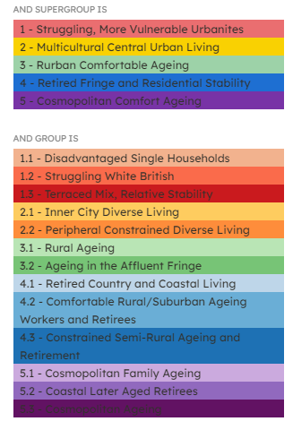
Ageing in Place Classification
Specifically looks at the over 50s population in England
Integrates a range of data
2011 Census
British Population Survey (BPS)
Access to Healthy Assets & Hazards (AHAH)
NHS English Prescribing Data (EPS) and Registered Patient (RP) data.

Slide 11
Takeaways
Smart data provide a new lens to look at different types of social exclusion
CDRC provide free access to such data and platforms
Census data are a key ingredient when turning smart data into “smart information”

Slide 12
Thanks If you have further questions….
alex.singleton@liverpool.ac.uk

