Slide 1
Something Human
The case for simpler statistics (even if they’re less accurate!)

Slide 2
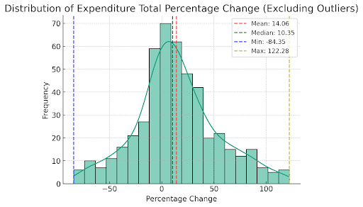
Obvious point 1:
dealing with complex social phenomenon
We’ll never perfectly measure or understand it
But complexity of phenomenon does not entail complexity of measurement
Virtue of simple, legible measures - even if less accurate

Slide 3
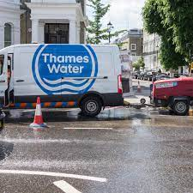
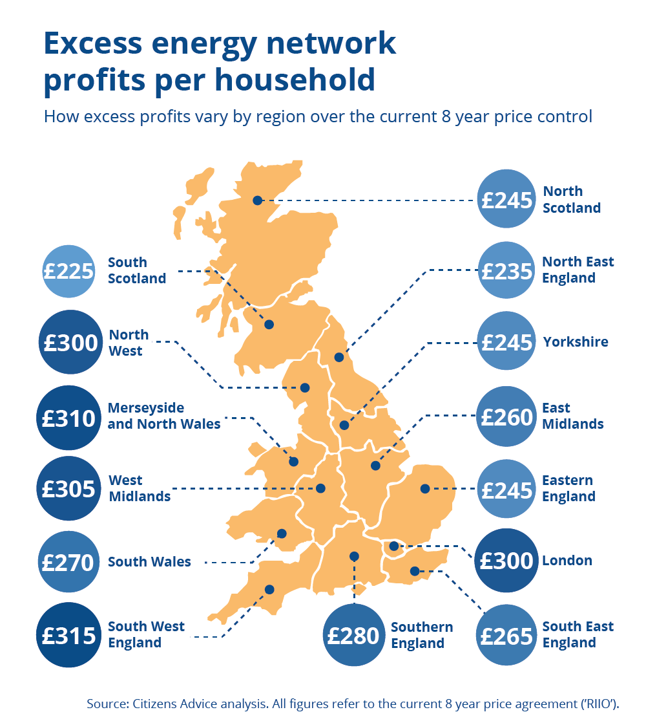
A cautionary comparison
RPI-X => Modern, complex price controls
Utility regulators fell for complexity
Start with simple model
Grow in complexity (for good reasons!)
But companies more sophisticated

Slide 4
Virtues of a human, simple measure
Legibility is important: institutions can identify flaws and outsiders can too. Easier to identify whether the flaws are important
Easier to avoid fooling yourself (applies to an institution as much as an individual)
It’s easier to be surprised by the result

Slide 5
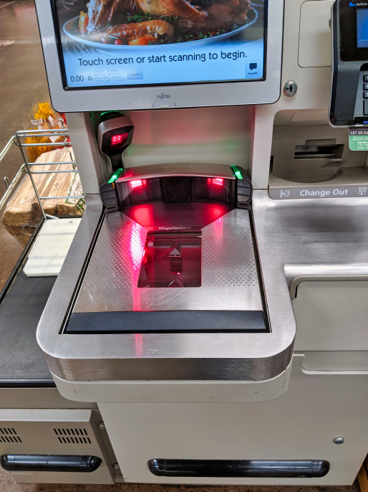
Could the ONS be going in the wrong direction?
E.g. scanner data may be more accurate - but is it legible?
How many people can understand if it goes wrong?
Is it resilient to unexpected change?

Slide 6
A better approach?
Respect the complexity - only chase it if you need to
Start from policy objectives: you are measuring for a purpose
Is the measure good enough to meet that policy objective? E.g. inflation plainly higher for people on low incomes, so not good enough for benefits indexation

Slide 7
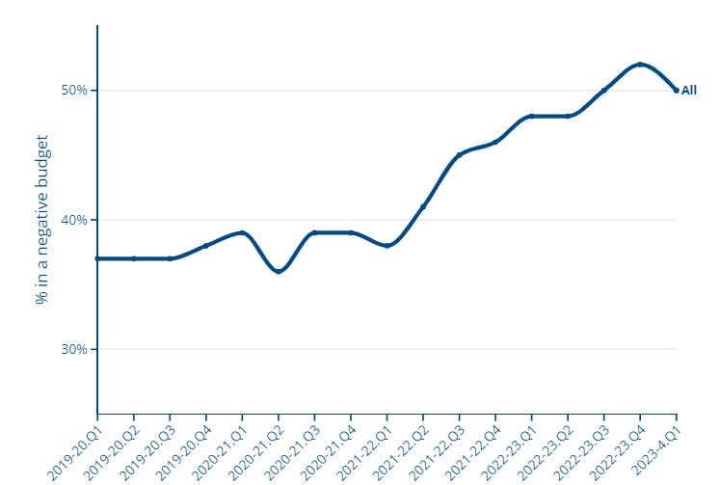
Half of the people we help with debt advice are now in a negative budget
Finally:
What are your external warning signals that your measurement is going wrong?

