Slide 1
Future PROOFING THE CODE OF PRACTICE?
Stephen Penneck
What is the future for UKSA?
19 September 2023

Slide 2
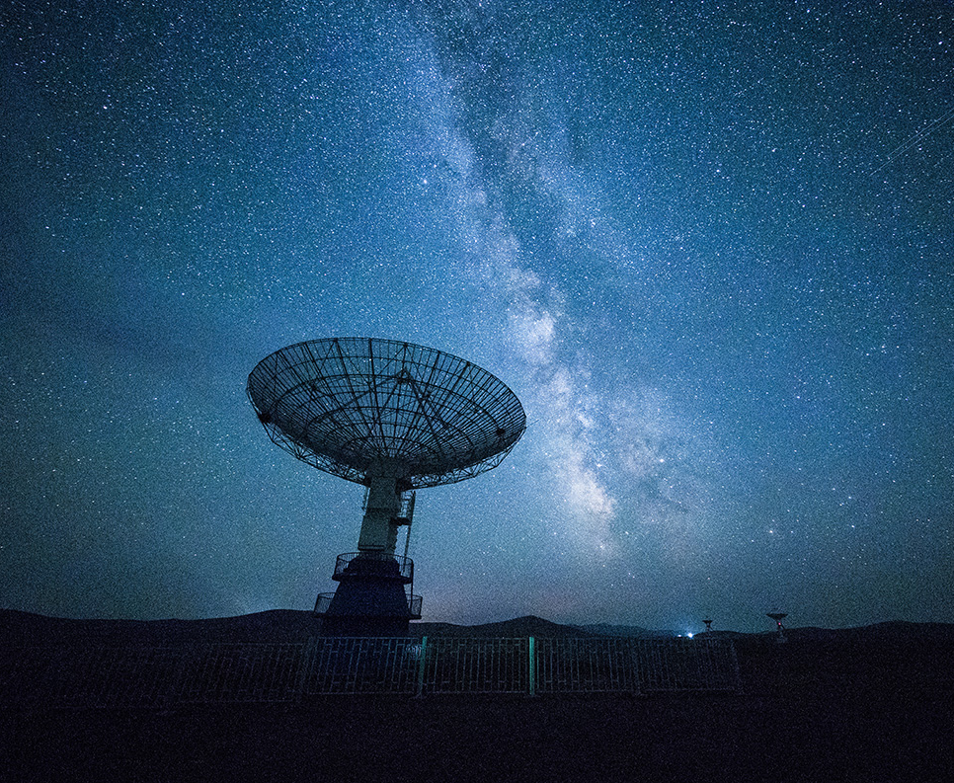
What are the challenges?
Increased complexity
Mistrust
Resources, quality and innovation
Users

Slide 3
Pillars of the Code of Practice
Trustworthiness
Quality
Value

Slide 4
How the challenges fit into the current code
Challenge | Existing pillar | Principle
Complexity | Trustworthiness | T2 Independent decision making and leadership
 | Value | V4 V4.1 to 4.5 covering keeping up to date, experimental statistics, ongoing developments, wider collaboration, etc
Mistrust | Trustworthiness | T2.5 The Chief Statistician should challenge the inappropriate use of statistics and data and reflect upon how further misuse can be prevented
Resources, quality and innovation | Trustworthiness | T 4.3 Sufficient … resources should be provided to deliver statistical services that serve the public good.
Users | Trustworthiness | T4.2 A work programme should be established and regularly reviewed. Users and other stakeholders should be involved to help prioritise statistical plans.
 | Value | V1.1 Statistics producers should maintain and refresh their understanding of the use and potential use of the statistics and data. They should consider the ways in which the statistic might be used and the nature of the decisions that are or could be informed by them.

Slide 5
Some conclusions
1. Does ‘Value’ cover too much? Does this downplay user focus?
2. Does the Code adequately reflect the complexity of statistical system, especially administrative systems? Does it pay enough attention to the need to develop statistical leadership?
3. Is there a need to strengthen the role of statisticians in addressing the question of misuse?
4. Should there be greater emphasis of the impact of resources on quality?
5. Do draft business plans to be published and subject to transparent user consultation?
6. Should statisticians do more to understand the business of their key users?
7. Should they balance the needs of government against the needs of other users?

Slide 6
Thank You!
Stephen.Penneck@gmail.com

