Slide 1
Gender Identity in the 2021 Census of England and Wales
Michael Biggs
michael.biggs@sociology.ox.ac.uk
Royal Statistical Society, London, September 2023

Slide 2
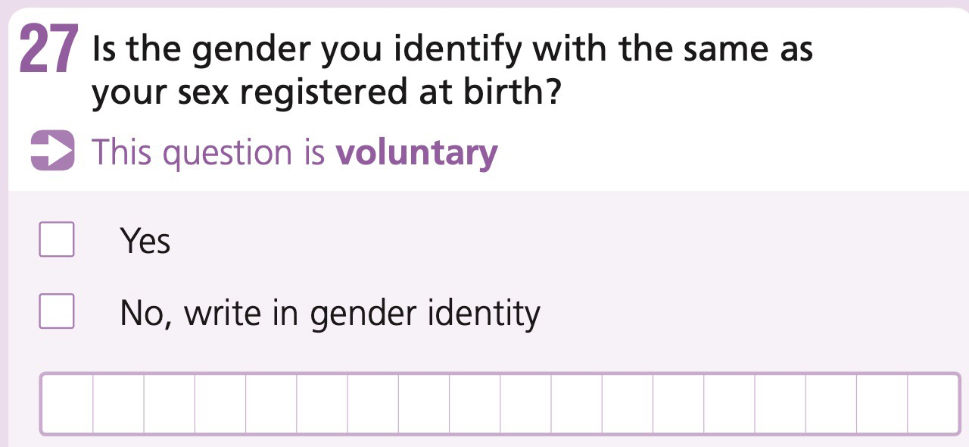
Census of England and Wales 2021
Oﬃce for National Statistics, Jan 2023:
‘the first oﬃcial data on the size of the transgender population in England and Wales’
‘Of the 10 local authorities with the largest proportion of the population aged 16 years and over whose gender identity was diﬀerent from their sex at birth, 8 were in London, with Newham (1.51%) and Brent (1.31%) topping the list’

Slide 3
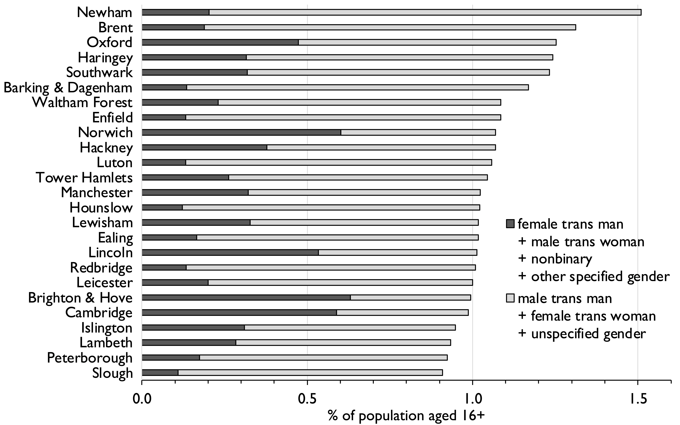
25 local authorities with highest “trans” proportion

Slide 4
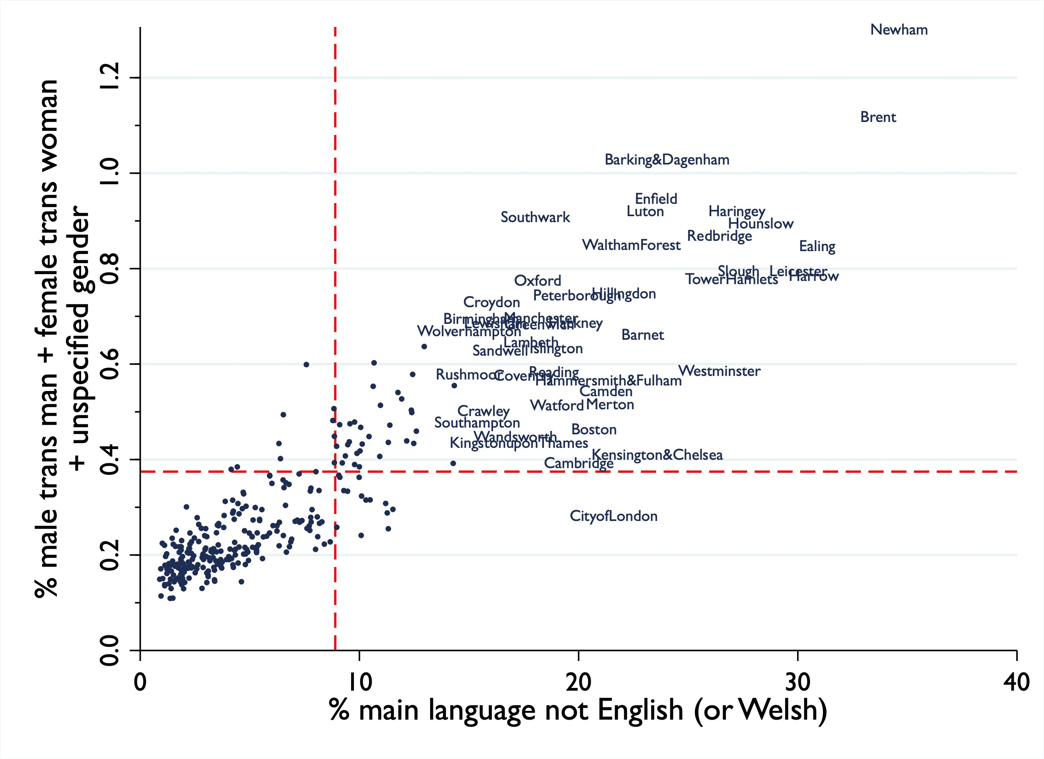
Ecological correlation with language

Slide 5
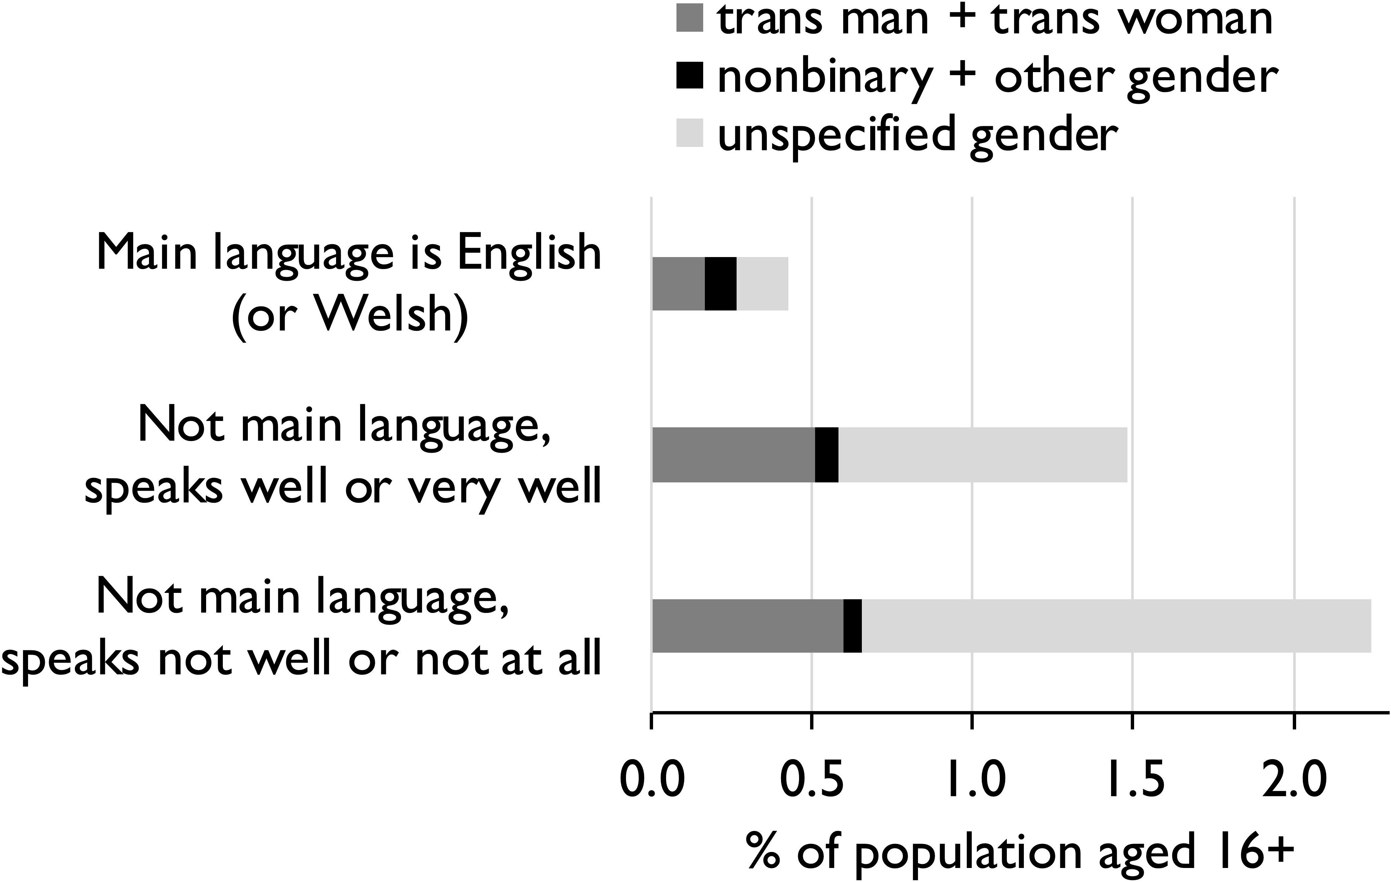
Individual characteristics

Slide 6
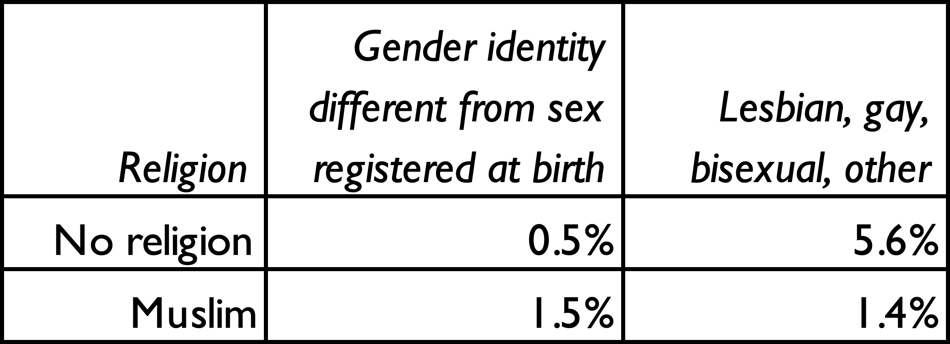
Individual characteristics

Slide 7
Origins of the question
Press for Change, 2007:

Slide 8
Origins of the question
Press for Change, 2007:
NatCen gives question to focus groups in 2011:
Non-transgender group: ‘very confusing’
Transgender group: ‘accepted that non-trans people would not understand the question, especially if first language [sic] was not English’
‘It was thought to use “ridiculous trans lingo” associated with “queer academia”’

Slide 9
What should have been asked
1. Two-step method, widely adopted from 2016, e.g. 2021 Census of Canada

Slide 10
What should have been asked
1. Two-step method, widely adopted from 2016, e.g. 2021 Census of Canada
2. Single question, e.g. U.S. Behavioral Risk Factor Surveillance System from 2014:
Do you consider yourself to be transgender?
—no
—yes, female to male
—yes, male to female
—yes, gender nonconforming

Slide 11
APPENDIX

Slide 12
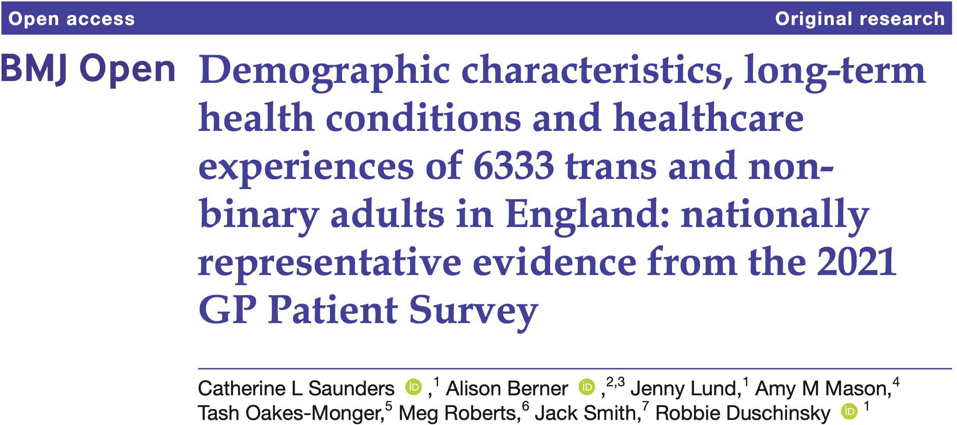

Slide 13
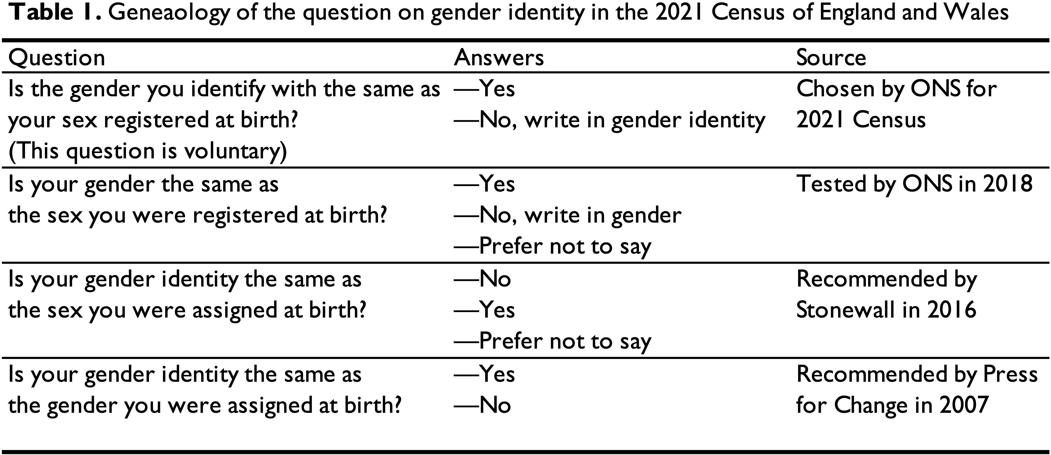

Slide 14
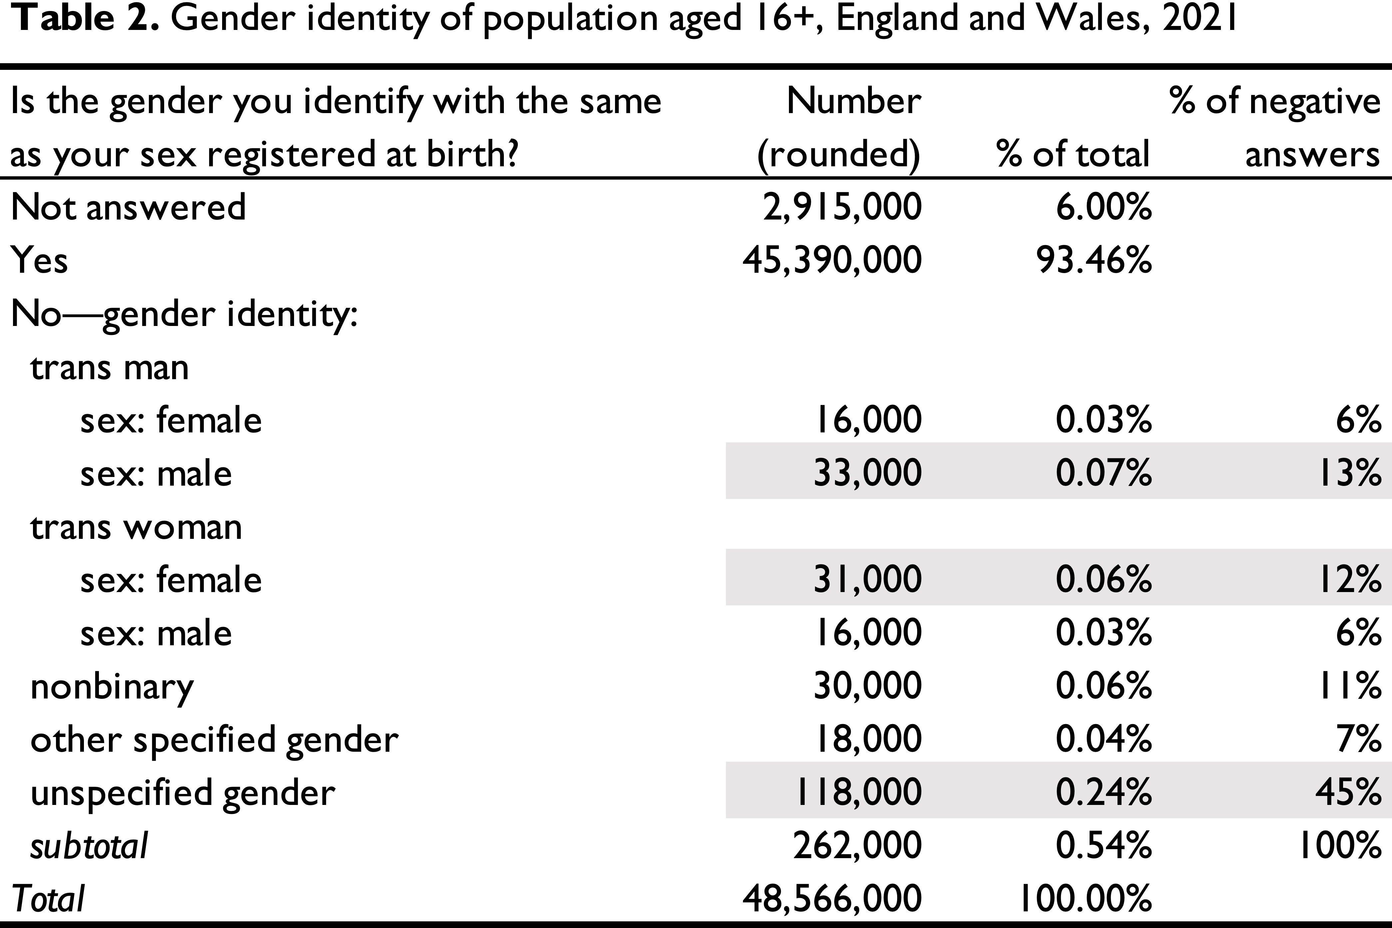

Slide 15
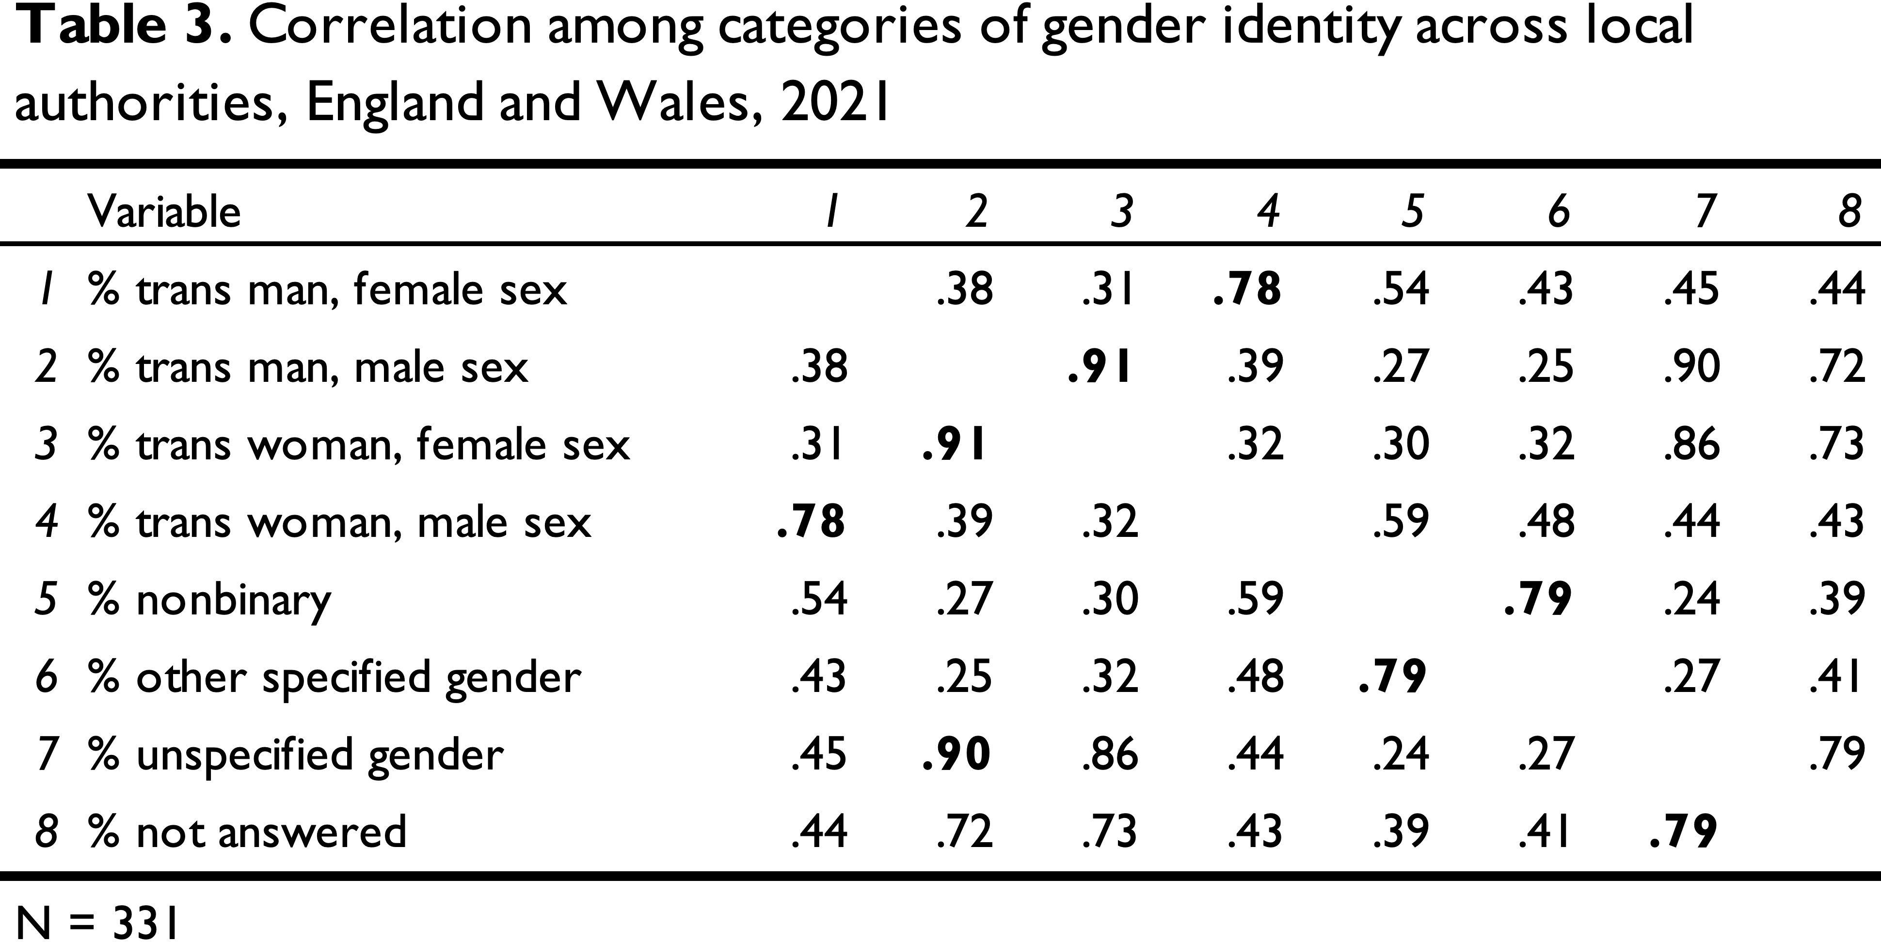

Slide 16
