Slide 1
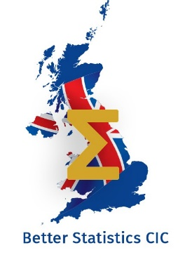
What is the Future for UKSA? ---------- Welcome
Tony Dent MSc
Director, Better Statistics

Slide 2
Objectives of Better Statistics
1. Educating people as to the value of reliable statistics, via discussion, debate and engagement
2. Encouraging people to participate in appropriate surveys and therefore improve the potential reliability of the data.
3. Challenging poorly prepared or presented published statistics

Slide 3
History
Campaign for Better Business Statistics - UKPLC
Investigation of Gig economy, foundation research, public meeting October 2019.
Campaign for Better Statistics
Covid-19 extended the interest of the principals to concerns with the presentation of statistics other than purely business data.
Better Statistics Community Interest Company
Formed February 2021, formally launched in November 2021

Slide 4
Governance
Directors of Better Statistics
Tony Dent is chairman of CMR Group and of Sample Answers Ltd. He is a statistician with over 40 years’ experience of International Market Research working as a consultant for such companies as the Civil Aviation Authority, DHL, IBM, Hewlett Packard, Radio Free Europe, and the Xerox Corporation.
Phyllis Macfarlane is a life-long Market Researcher with a career that included CEO of GfK NOP and two terms as chairman of the UK Market Research Society. Phyllis has specialised in creatively adapting existing techniques to new situations – including the early development of B2B Research and International Research.
Iain Mackay holds an MA in Computer Science from Cambridge and has championed innovation in software technology for market(ing) research since the 1980s. Iain remains actively engaged with contract work for the NHS and the development of online platforms for qualitative and quantitative research.
Advisory Committee
Simon Briscoe: Simon is a director of data science start-up t-tab. Among various contributions to our public life he was an adviser to parliament’s Public Administration Committee and a trustee of FullFact.
Sir Vince Cable: Vince was the Business, Innovation and Skills Secretary in the coalition government, now retired from politics he retains an active interest in business and economic affairs.
Sir John Curtice: John is Professor of Politics at the University of Strathclyde and Senior Research Fellow at the National Centre for Social Research; he is also chief commentator on What UK Thinks.
Ms. Vicky Pryce: Vicky is Chief Economic Adviser and a board member at the Centre for Economics and Business Research (CEBR). Vicky has previously held senior positions in business and the Civil service. #e.

Slide 5
The 2007 Act - Objectives
1) In the exercise of its functions under sections 8 to 21 the Board is to have the objective of promoting and safeguarding the production and publication of official statistics that serve the public good.
(2) In subsection (1) the reference to serving the public good includes in particular—
(a) informing the public about social and economic matters, and
(b) assisting in the development and evaluation of public policy.

Slide 6
First Topic
INFLATION

