Slide 1
A view from Trade Unions
Geoff Tily

Slide 2
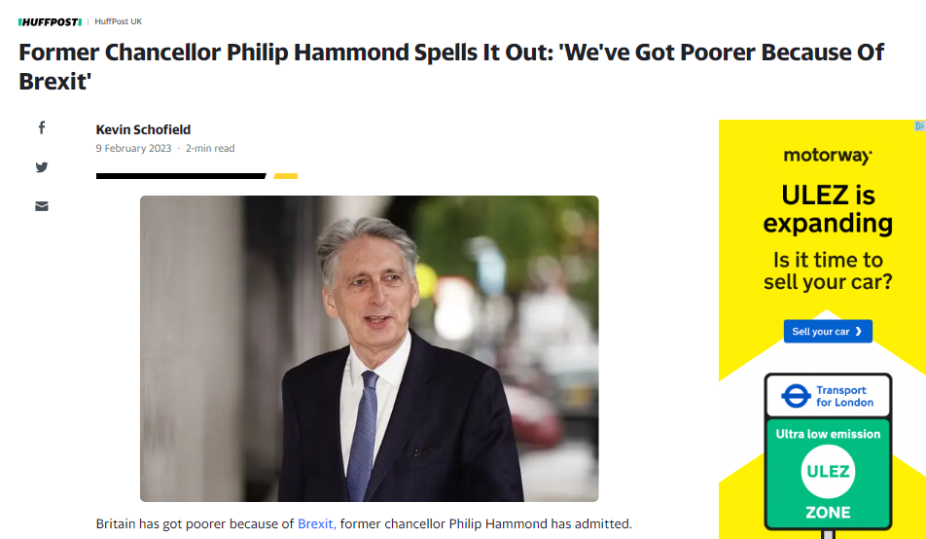

Slide 3
The worse pay crisis since the Napoleonic Wars
2008-2025
1798-1822
All other pay crises

Slide 5
Governor on profits, Mar. 23:
"when companies set prices I understand that they have to reflect the costs they face"
[Q. "So companies ... have to take a hit to profits?"]
"No I am not saying that"
Governor on wages, Feb. 22:
"we do need to see a moderation of wage rises. That's painful"

Slide 7
IMF:

Slide 8
Andrew Sentance, The Times, 23 Jan. 2023
It has neglected the retail prices index — a long-established and well-respected inflation measure — and has not sought to repair its defects. It has promoted its own view of measuring inflation, based on the controversial methodology of CPIH. And it has not recognised the fact that no one is using or referring to its favoured measure.

Slide 9
Differences between measures

Slide 10
Groups of interest by measure
 | Food | Clothing and footwear | Energy | OO Housing
CPI | 19.6 | 7.1 | 85.6 | N/A
CPIH | 19.8 | 7.1 | 83.7 | 4
RPI | 18.9 | 14.5 | 87.7 | 18.6

Slide 11
TUC General Council statement, 18 Nov. 2020
We are disappointed that expert calls to retain the RPI have been repeatedly ignored. The Royal Statistical Society and House of Lords Economic Affairs ​Committee have both presented compelling evidence for keeping it.
We urge the government to listen to these bodies and to unions. Scrapping RPI will hit workers in the pay packet and make it harder for them to have dignity in retirement.
And it will damage the reputation of inflation measurement in the UK.
MINORITY OPINION: https://uksa.statisticsauthority.gov.uk/wp-content/uploads/2020/08/Consumer-Prices-Stakeholder-Advisory-Panel-response-to-HMT-final.pdf

Slide 12
What am I and why?

Slide 13
J. K. Galbraith, 'The war against the poor’ The Observer, 29 September 1996
In the modern economy let us say simply that the rich do not want to pay for the poor: that unemployment is necessary and good; that recession can be tolerated, certainly by the many who do not suffer as compared with the smaller number who do. Even mild inflation affects the many as compared with unemployment, which affects the relatively few … Recession … is far better than the possible need to pay for the measures that arrest it.

