Slide 1
Misjudged metrics?
A perspective on inflation from the frontline

Slide 2
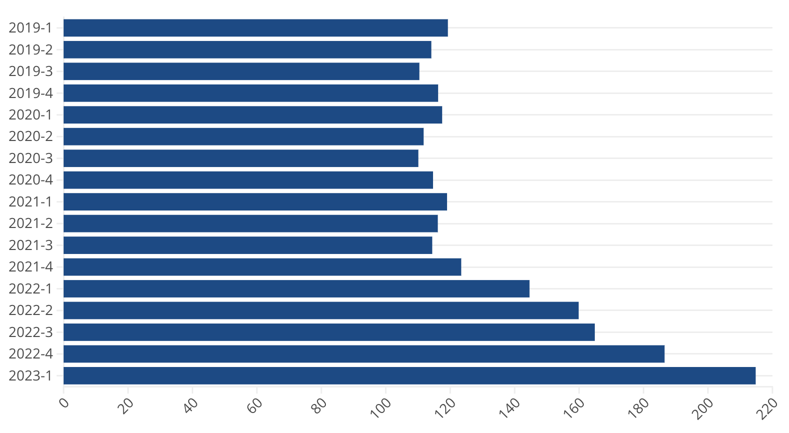
Energy spend by Citizens Advice clients

Slide 3
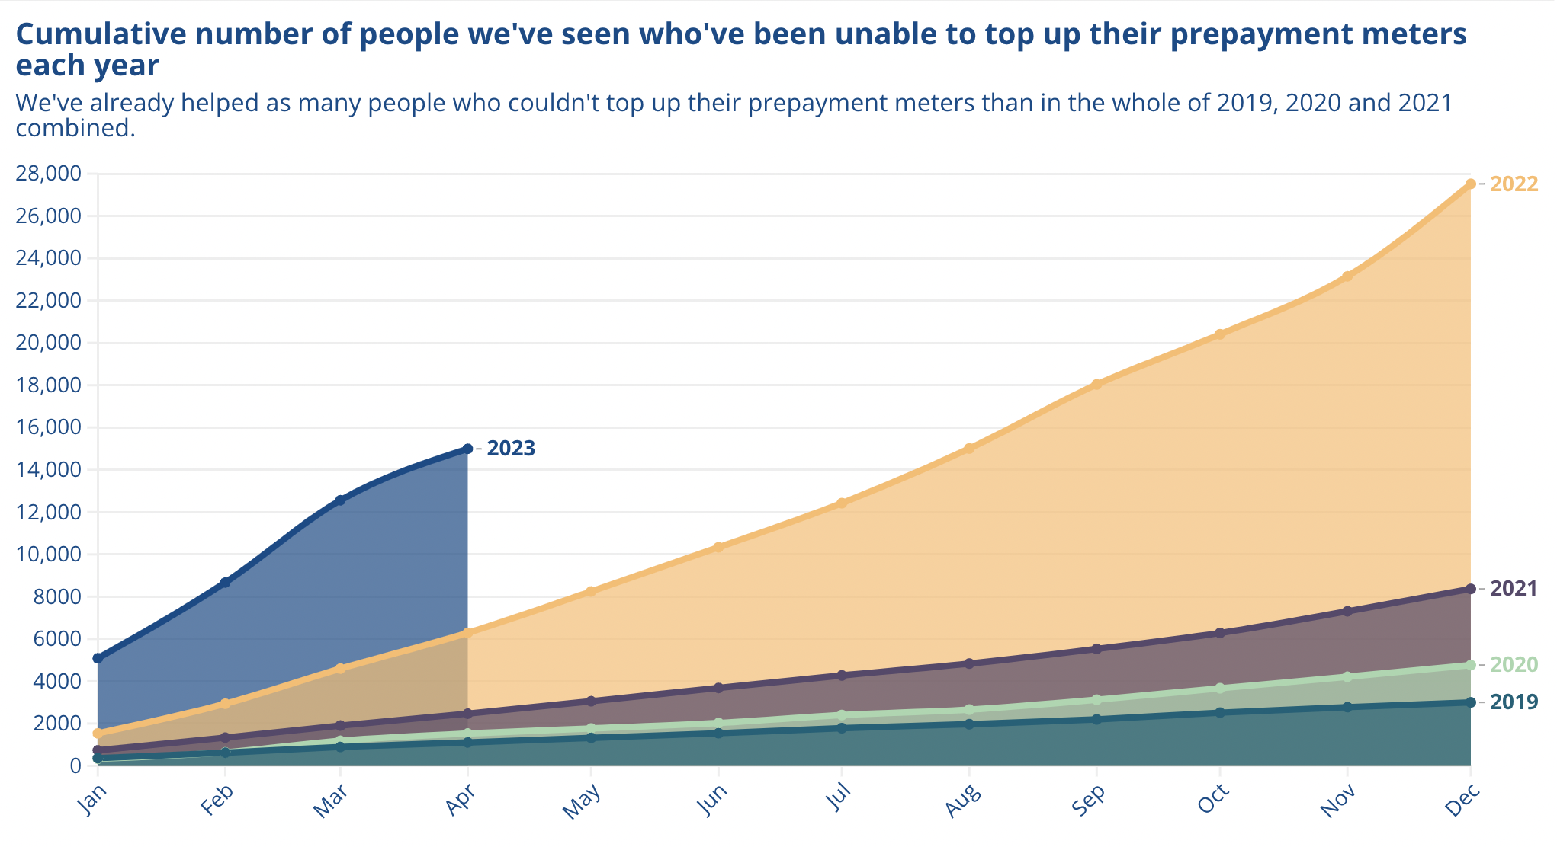

Slide 4
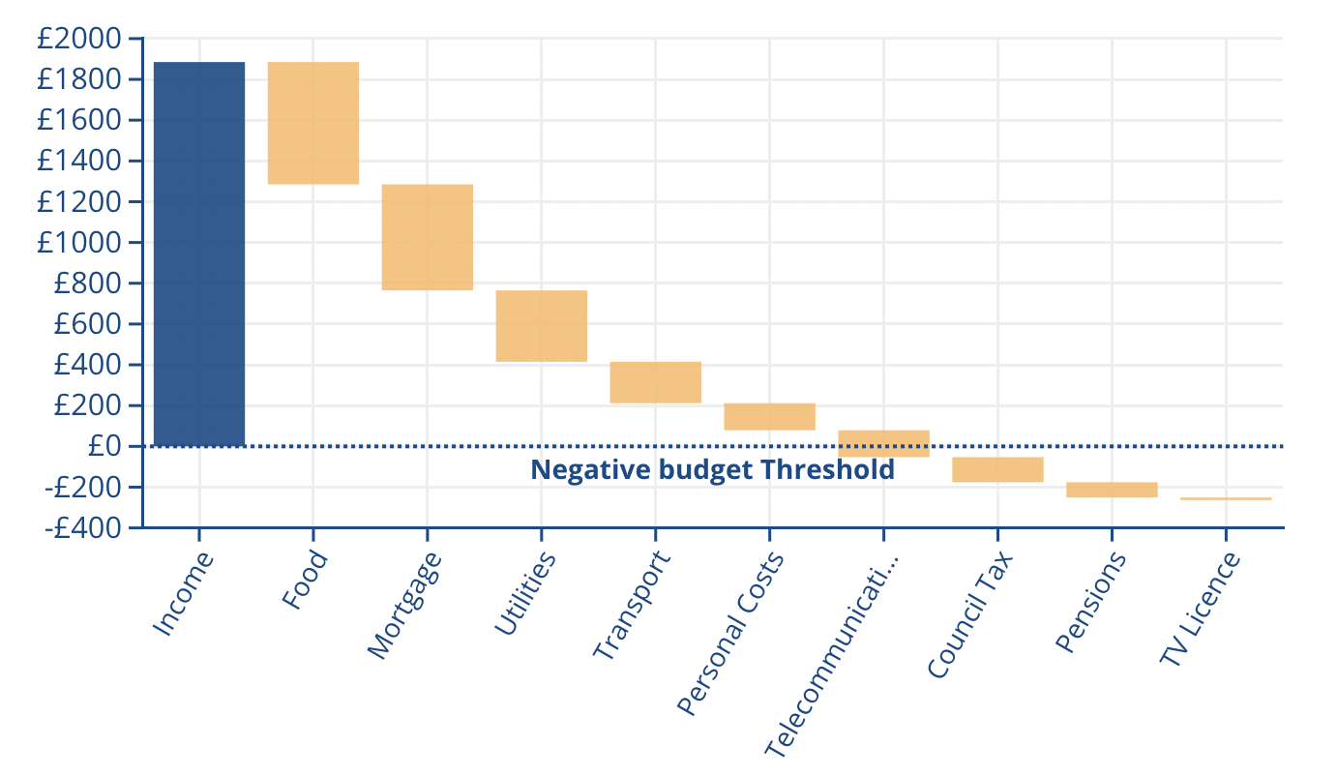
Michelle’s budget

Slide 6
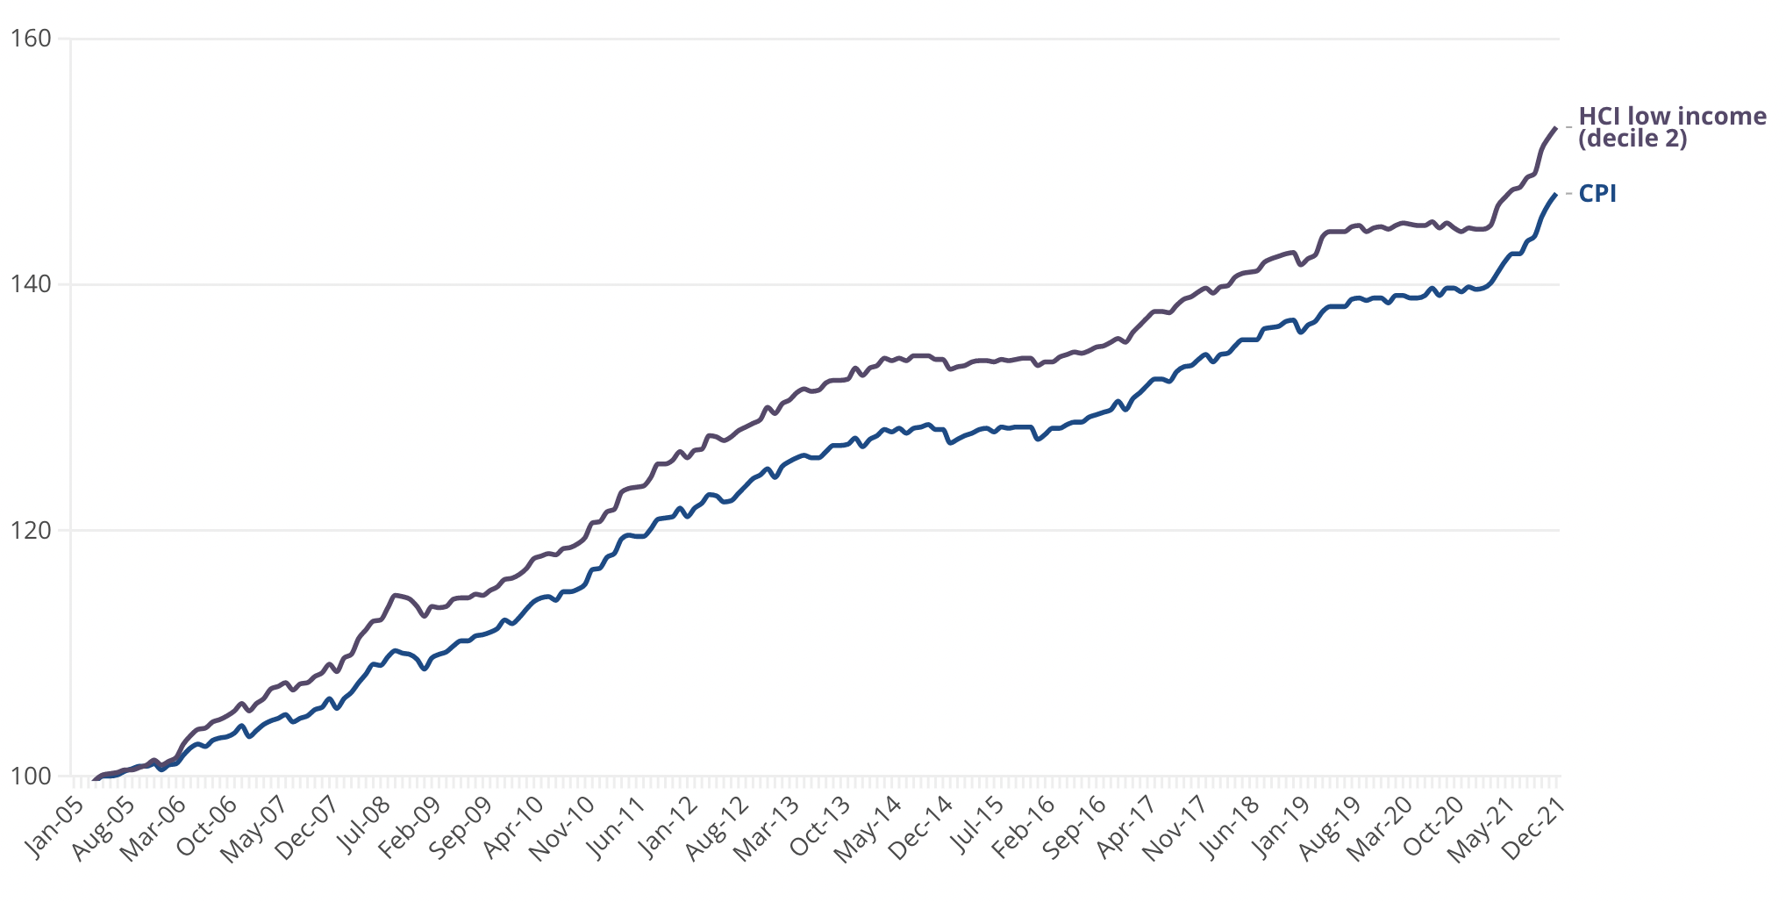

Slide 7
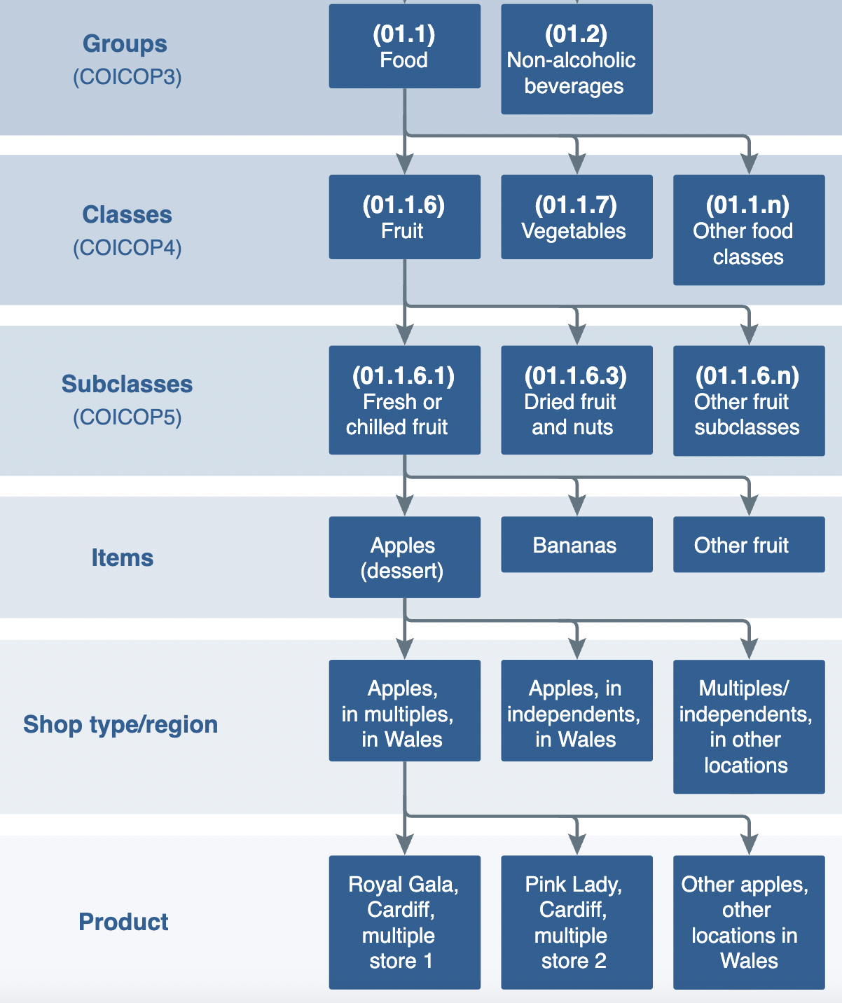

Slide 8
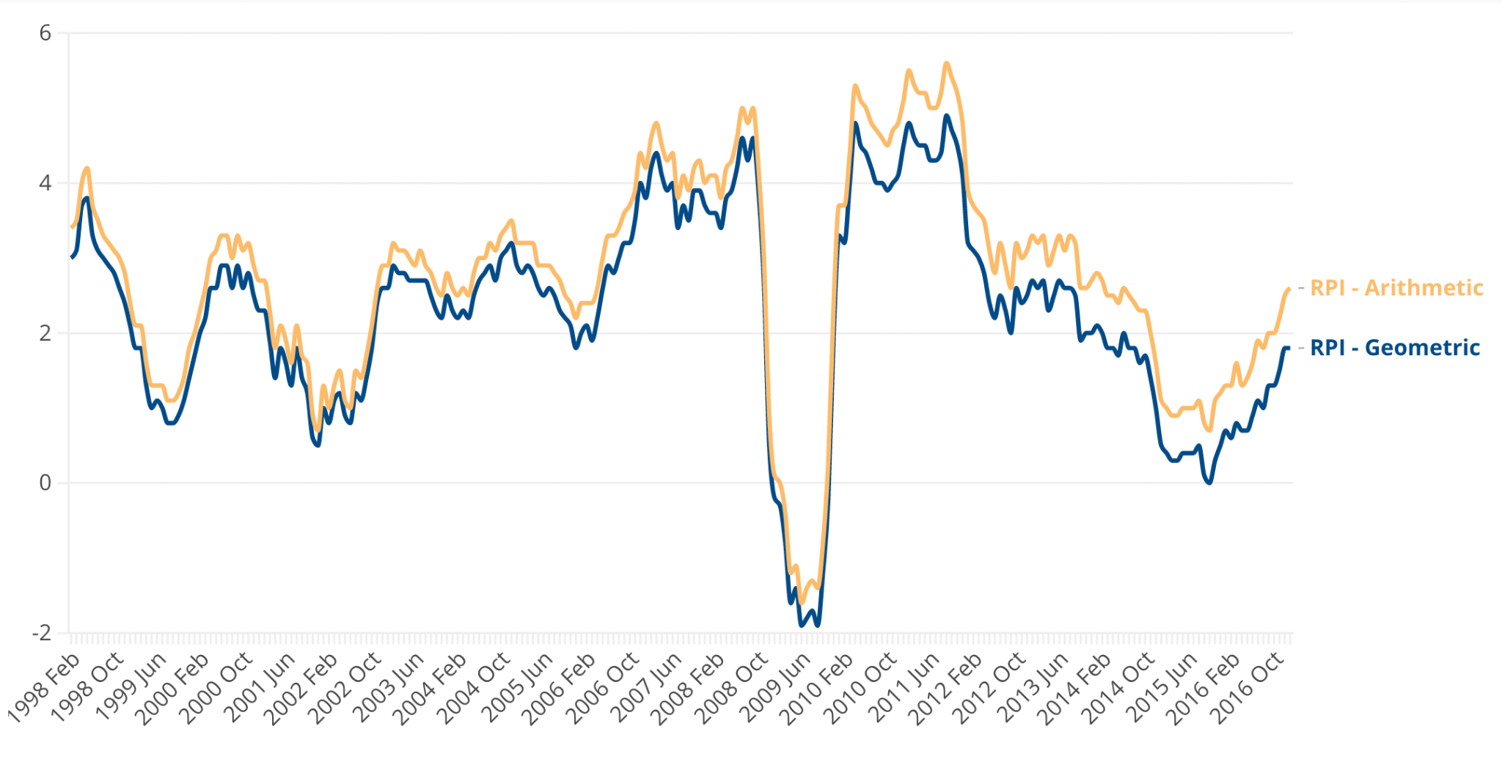

Slide 9
Summary
The cost of living crisis is worse than it looks.
CPI understates inflation for the poorest households, because it doesn’t reflect their expenditure shares and because it implies they have substitutional freedom in their budgets.
This is a serious policy problem. We use CPI to uprate benefits, so we are cutting people’s benefits in real terms - even though that is not the government’s current stated policy goal.
We need a measure of inflation that reflects experience of poorest households.
Final point: Statisticians - remember your history!

