Slide 1
The (Changed?) Politics of Inflation
John Curtice
Univ of Strathclyde and National Centre for Social Research
‘The UK in a Changing Europe’

Slide 2
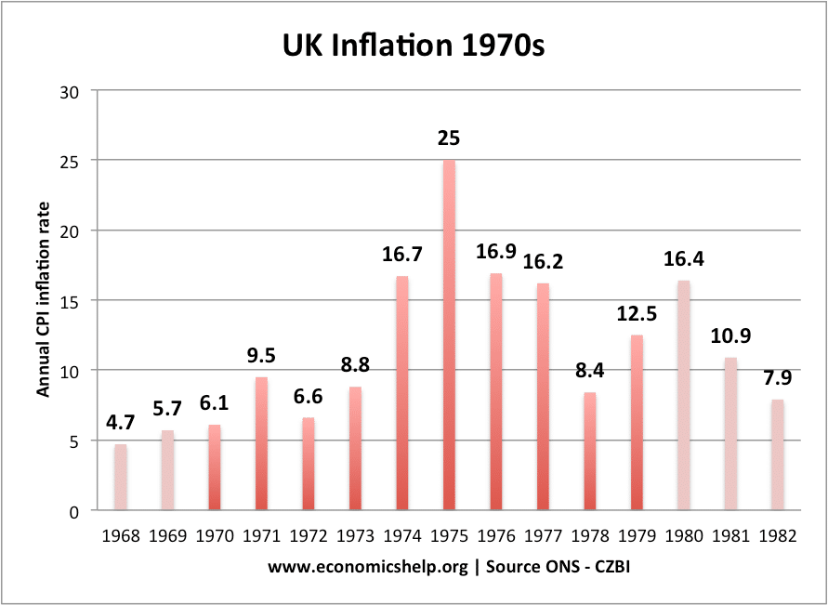
Inflation in the 1970s

Slide 3
Days Lost to Strikes in 1970s
Source: ONS

Slide 4
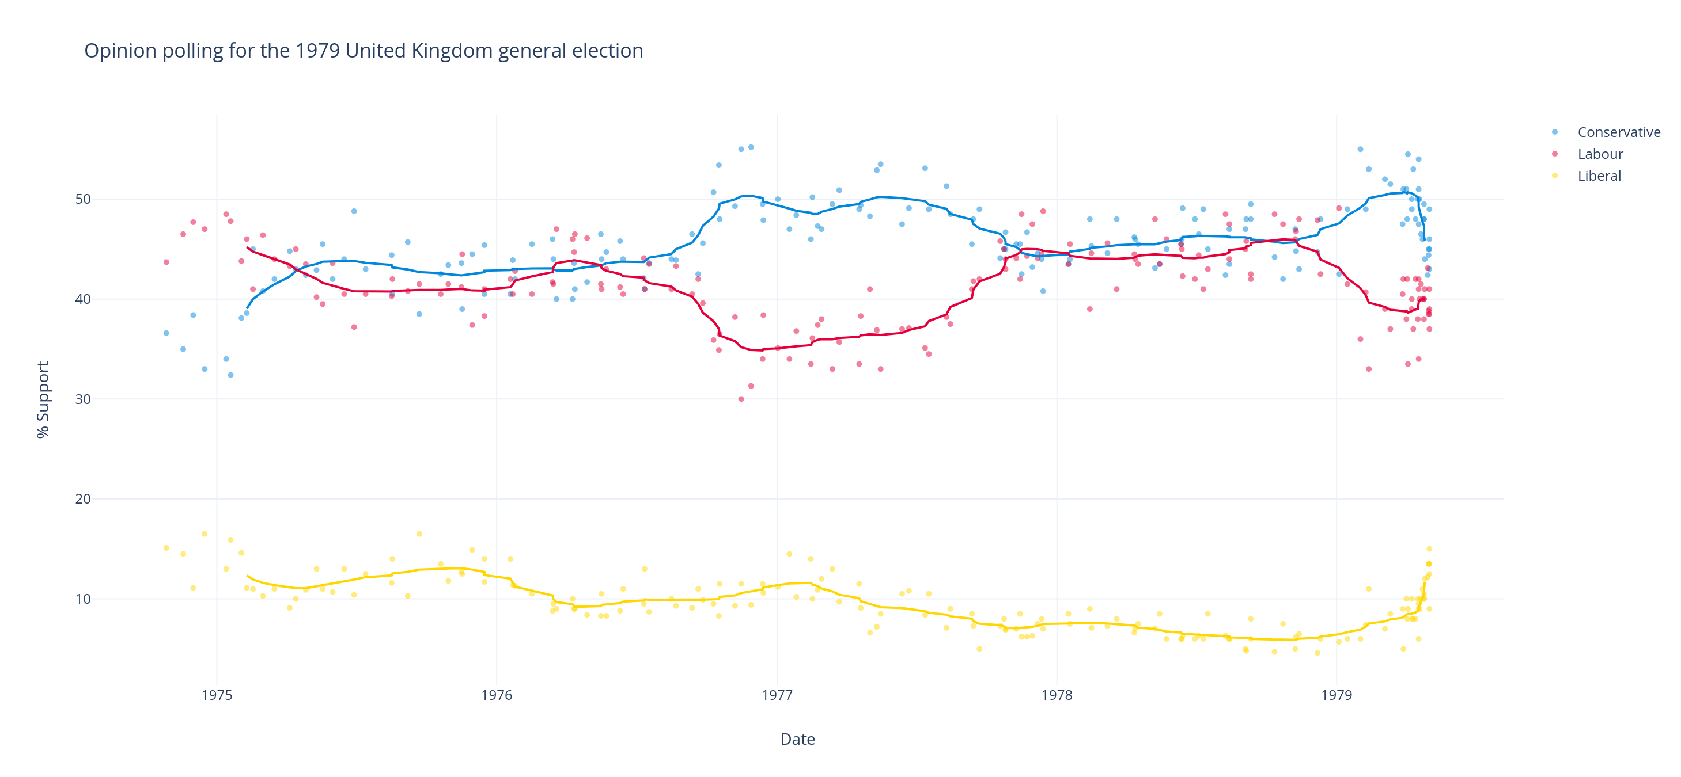
Opinion Polls 1974-9
Source: Wikipedia

Slide 5
Inflation Now
Source: ONS

Slide 6
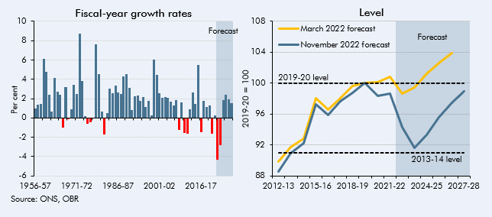
Trends in Living Standards

Slide 7
The Public Sector Pay Battle
Source: YouGov

Slide 8
Days Lost to Strikes
Source: ONS

Slide 9
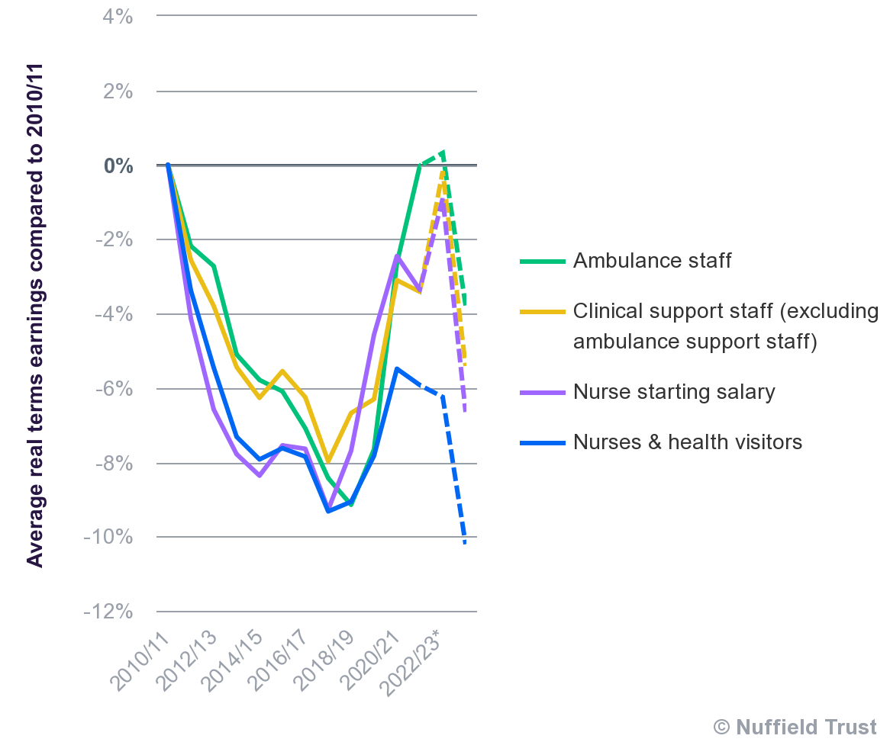
The Nurses Etc ‘Settlement’

Slide 10
Mr Sunak and His Party
Source: YouGov

Slide 11
Recent Trends in Economic Confidence
Source: ipsos

Slide 12
Economic Optimism and Conservative Loyalty
Source: British Election Study Internet Panel May 22. 51% expected Britain’s economy to get a lot worse, 32% a little worse, 11% to stay the same/get better

Slide 13
Perceptions of Government’s Economic Competence
Source: YouGov. ‘How well or badly do you think the government is handling the following issues? The economy’

Slide 14
The Trajectory of Party Support since Dec 2019
Source: Average of most recent poll in each month by each polling company. Not all companies polled each month..

Slide 15
Key Points
Despite widespread public sympathy for many strikers, government has not suffered a significant political cost for holding out (with some but not complete success) against ‘inflation busting’ rises
Relative weakness of trade unions revealed
But economic confidence eroded as inflation started take off (and living standards hit)
Pessimism about the economy’s future is highly correlated with defection from the Conservatives
But the biggest hit to Conservative popularity came from the ‘fiscal event’ – much like the IMF crisis of 1976

