Slide 1
UK labour market after covid
Jonathan Portes
King’s College London & UKandEU
November 2022
@jdportes UKandEU.ac.uk

Slide 2
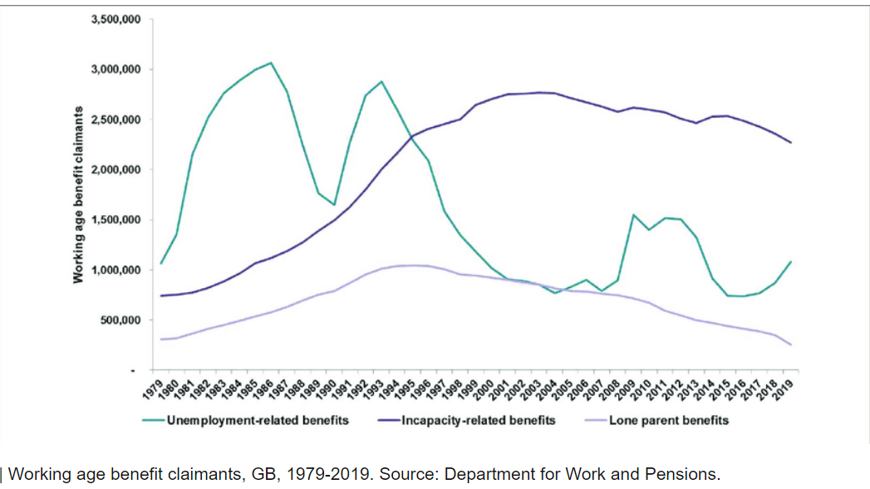
Conclusions
Genuinely a “reset moment”…
Key questions:
Medium term impacts of covid, new system, Hong Kong..
Public opinion post-Brexit
Interaction between migration policy and broader economic policy (“levelling up”, etc)
Global Britain or little England?
…
Notes:
₂

Slide 3
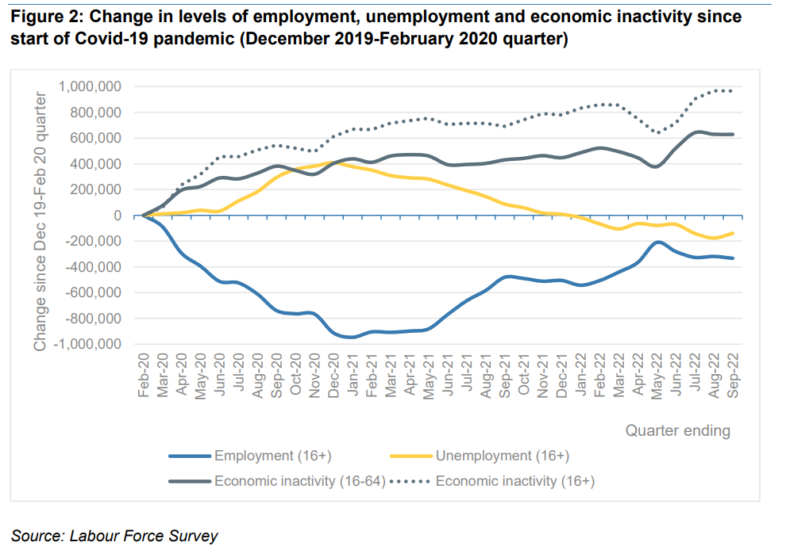
Immigrant populations in EU

Slide 4
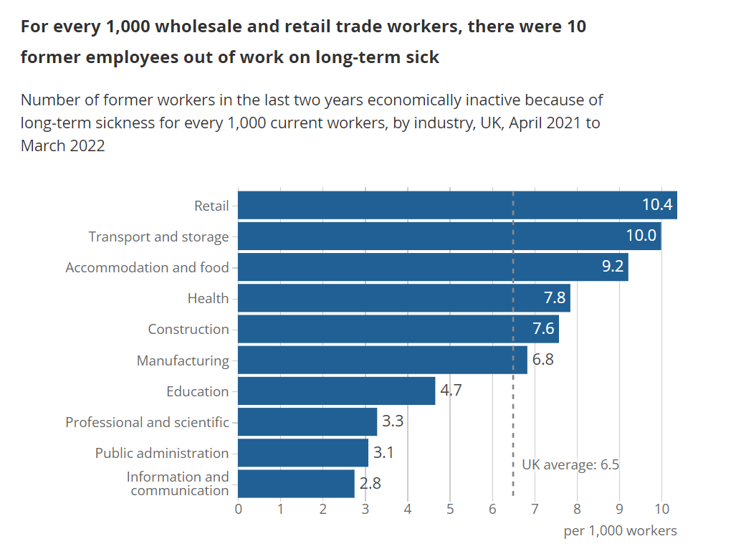
Conclusions
Genuinely a “reset moment”…
Key questions:
Medium term impacts of covid, new system, Hong Kong..
Public opinion post-Brexit
Interaction between migration policy and broader economic policy (“levelling up”, etc)
Global Britain or little England?
…
Notes:
₄

Slide 5
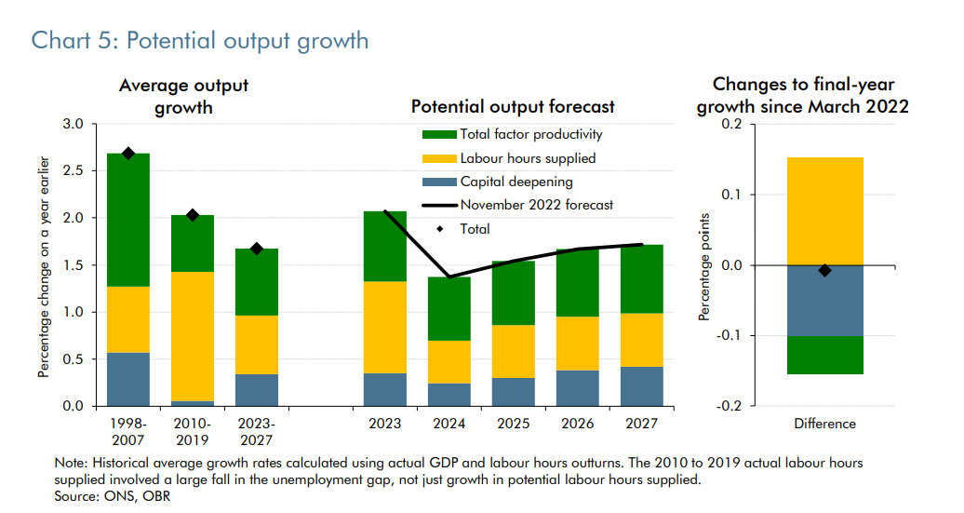
Conclusions
Genuinely a “reset moment”…
Key questions:
Medium term impacts of covid, new system, Hong Kong..
Public opinion post-Brexit
Interaction between migration policy and broader economic policy (“levelling up”, etc)
Global Britain or little England?
…
Notes:
₅

Slide 6
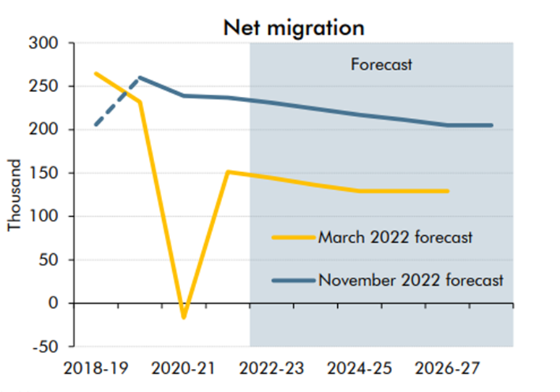
Conclusions
Genuinely a “reset moment”…
Key questions:
Medium term impacts of covid, new system, Hong Kong..
Public opinion post-Brexit
Interaction between migration policy and broader economic policy (“levelling up”, etc)
Global Britain or little England?
…
Notes:
₆

Slide 7
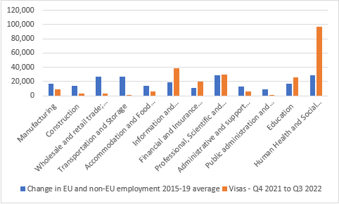
Conclusions
Genuinely a “reset moment”…
Key questions:
Medium term impacts of covid, new system, Hong Kong..
Public opinion post-Brexit
Interaction between migration policy and broader economic policy (“levelling up”, etc)
Global Britain or little England?
…
Notes:
₇

Slide 8
UK labour market after covid
Jonathan Portes
King’s College London & UKandEU
November 2022
@jdportes UKandEU.ac.uk

