Slide 1
Better Statistics Conference
Delivering Growth in Revenue, EBITDA and Real Wages,
……One Firm at a Time
The Neatsmith Project
Mathew Nagel – COO Neatsmith
David Stroll – CTO Opagio

Slide 2
Brief Introductions - Neatsmith
We are an SME who deliver high-end bespoke wardrobes
We have five showrooms in London and a Head Office and Factory in Watford
Founded in 2008 we have grown to £10m turnover, £2.3m EBITDA and 75 employees at the end of 2021
We have worked with Opagio on the Neatsmith Growth Programme since July 2021 and we aim to complete the programme by June 2023

Slide 3
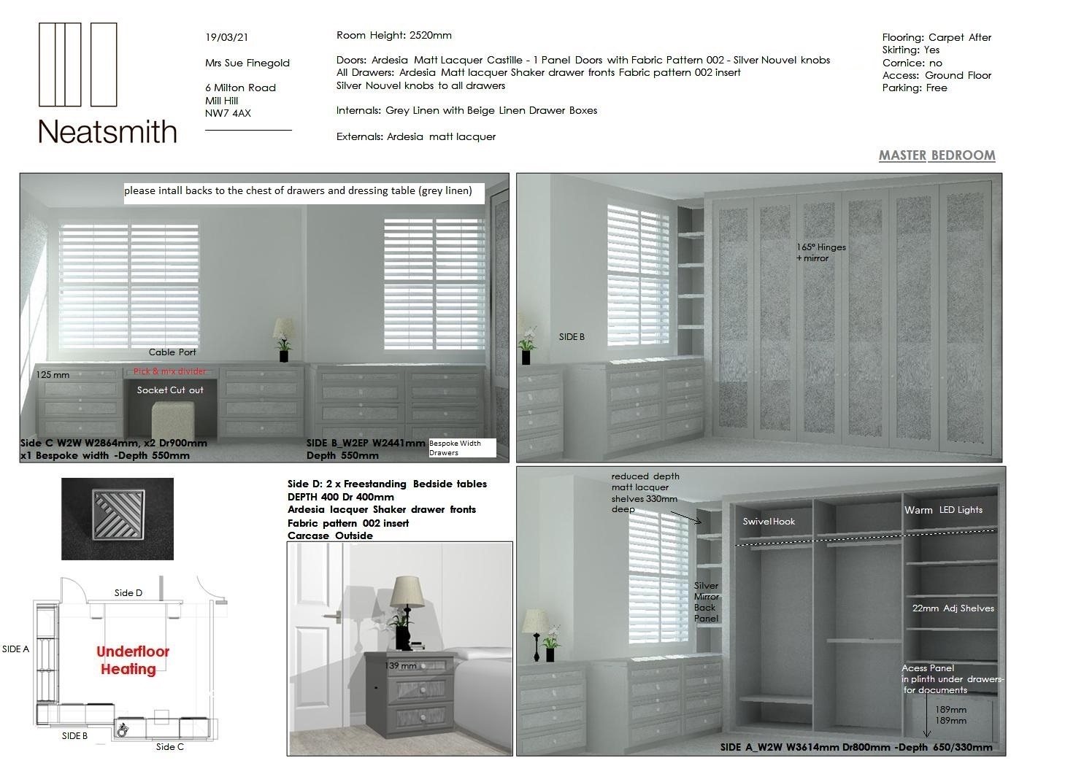
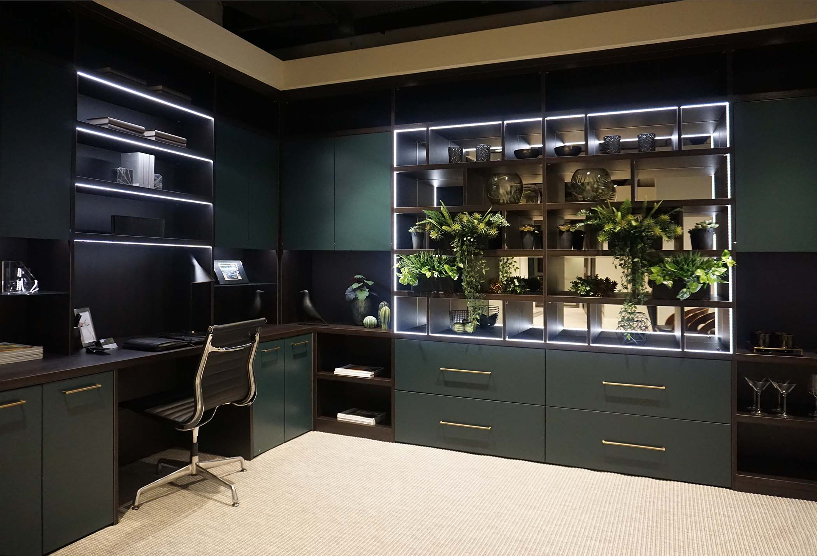
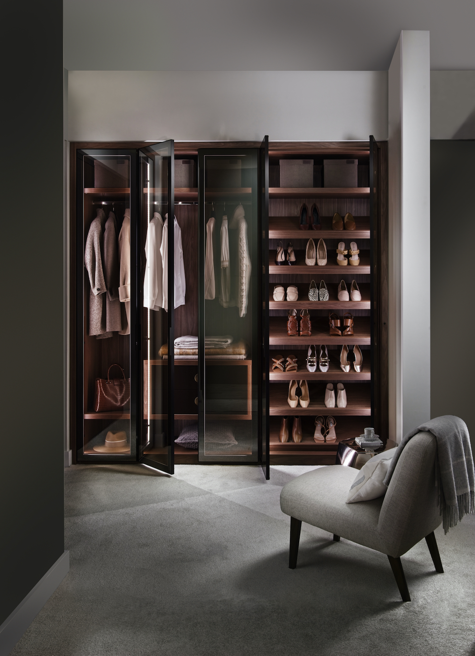
Proposal to Client
Photo of completed installation

Slide 4
Brief Introductions - Opagio
Opagio was founded in September 2020 to bring to market the results of a long-term R&D project conducted by David Stroll and Tony Hillier
Over the last 24 months they have worked with three SMEs (including ourselves) and been awarded an Innovate UK Grant
This grant helped to fund the unmeasured intangibles project presented at ESCoE / IARIW conference on Intangible Assets in November 2021 and the Growth Strategy Reporting application
Opagio are now completing development of their Opagio Growth Platform (OGP)

Slide 5
Opagio helps Employees & Managers to:
Grow Labour Productivity
Grow Capital Productivity
Grow Revenue
Grow EBITDA faster than Revenue
Grow Labour Productivity
Grow Employee Engagement
Grow Innovation
Grow Intangible Assets
Grow Human Capital
Grow Firm Valuation

Slide 6
Opagio provides Five Levers of Growth
Growth Strategy and Reporting
Operational Excellence & Employee Engagement
Integrated Digital Applications and Databases
Growth Investments and Innovation
Growth Accounting Balance sheet and Human Capital Valuation

Slide 7
Lever 1 Growth Strategy and Reporting 5 Year Forecast – 20% Revenue Growth and 10% Productivity Growth
 | 2020 | 2021 | 2022 | 2023 | 2024 | 2025 | 2026
Sales | 7,012,406 | 9,657,199 | 11,588,638 | 13,906,366 | 16,687,639 | 20,025,167 | 24,030,200
Cost of Materials | 2,123,999 | 2,993,732 | 3,592,478 | 4,310,973 | 5,173,168 | 6,207,802 | 7,449,362
Total Purchases | 3,420,000 | 4,732,028 | 5,678,433 | 6,814,119 | 8,176,943 | 9,812,332 | 11,774,798
Labour Services | 2,050,000 | 2,540,000 | 2,739,585 | 3,123,127 | 3,560,364 | 4,058,815 | 4,627,050
Total Employees | 63 | 75 | 81 | 92 | 107 | 122 | 140
GVA | - | 4,780,702 | 6,401,132 | 7,681,359 | 9,217,630 | 11,061,157 | 13,273,388
GVA per hour | - | 31 | 38 | 40 | 41 | 44 | 46
GVA Surplus | - | 2,064,911 | 3,426,671 | 4,276,380 | 5,319,044 | 6,598,677 | 8,161,942
D + A Charges | - | 249,476 | 299,371 | 359,246 | 431,095 | 517,314 | 620,777
EBITDA | £ - | £2,300,000 | £3,326,042 | £4,235,626 | £5,350,139 | £6,715,991 | £8,382,719
EBITDA as a % of Sales | -% | 22.01% | 28.70% | 30.46% | 32.06% | 33.54% | 34.88%

Slide 8
Lever 2 Operational Excellence Focus on the Work and the People
We are a labour intensive business, with labour services accounting for 53% of GVA compared to 5% for capital services, so we have implemented the following strategy:
Start by describing the work, tracking it and then measuring it
Deliver intense and continuous engagement with employees and managers to improve workplace wellbeing, innovation and performance through Fair Work
Implement an Apprentices programme for Fitters
Upskill key roles where there are labour shortages
Measure and report productivity daily and weekly to every employee

Slide 9
Lever 2 Operational Excellence Implementing the Work Activity System
Marketing
Sales &
Showrooms
Manufacturing
Factory
Customer Installation
Finance &
Administration
Support
Services
Red – work not started
Amber – being implemented
Green – live operations

Slide 10
Lever 2 Operational Excellence Measuring Manufacturing
The number of work activities grows quarter on quarter from the first quarter onwards
The chart shows how weekly work-activities for a single department can be aggregated quarterly to provide trend information
The number of work activities that might need rework is an important measure of quality
This is just one department – in the whole firm we are talking about 60 Work Activities and 60,000 tasks to be completed each year

Slide 11
Lever 3 Integrated Digital Applications & DBs
Marketing
Sales &
Showrooms
Manufacturing
Factory
Customer Installation
Finance &
Administration
Support
Services
API Tracking Enquiries
BOM
Quote System
Customer DB
Scheduler
Automated Design Flow
Product DB
Mobile App + To Do Lists
Mobile App + To Do lists
API to Sage
Integrated
Reporting
Human Capital DB
Scheduler

Slide 12
Lever 4 Growth Investments & Innovation
Step 1 Open the Growth Investment Menu to create and name a New Growth Investment
Step 2 Open up the Allocate Labour Services command to allocate costs to the New Growth Investment
Step 3 Open up the Allocate Purchases command to allocate purchases to the New Growth Investment
Step 4 Run the Historical Growth Report and store the Results in the Historical Growth table
Step 5 Use the Growth Strategy command to create a strategic forecast (up to five years) which includes variables for revenue, labour productivity, purchases and wages and store it in the Strategic Forecast table
Step 7 Run the Monthly Variance reports
Step 8 File the Growth Investment Narrative
Step 9 Allocate Growth Investments to the Innovation Register
Step 10 Allocate Growth Investments to Measured and Unmeasured Intangibles Registers

Slide 13
Lever 4 Growth Investments & Innovation
Marketing
Sales &
Showrooms
Manufacturing
Factory
Customer Installation
Finance &
Administration
Support
Services
Growth Projects
Lead + Channel Tracking
New Showroom and Product line
Planner
Mobile App + To Do lists
Drilling Machine
Saw
Edgebander
New Software
Mobile App + To Do lists
Video Instructions
API to Sage
Integrated Reporting
Human
Capital Assessment
£22,000
£150,000
£32,000
£412,000
£28,500
£67,500

Slide 14
Lever 5 Growth Accounting & Human Capital
Source ONS
Dunn, R. 2022
Figure 7: Comparison of current UK net worth with experimental UK net worth including human capital assets.

Slide 15
Lever 5 Growth Accounting & Human Capital What do we Measure within the Firm?
Knowledge – educational qualifications
Skills
Competencies
Attributes
Lifetime earnings
Levels of Work – this measures the complexity of the work
Mode of Development – the rate at which people can handle more complex work

Slide 16
Lever 5 Growth Accounting Reporting
Revenue & Revenue Growth
EBITDA & EBITDA Growth
GVA and GVA Growth
Labour Productivity & Growth
Fair Work Engagement & Growth
Labour Services Experience, Skills and Training
Tangible Capital Investment Charges
Intangible Capital Investments Charges
Unmeasured Intangible Assets Charges
Innovation Expenditures

Slide 17
Lever 5 - Growth Accounting Balance Sheet
Tangible Capital Investment Stock
Intangible Capital Investments Stock
Unmeasured Intangible Assets Stock
Innovation Stock
Human Capital Stock
Firm Valuation based on Stages of Growth

Slide 18
Opagio Growth Programme Scorecard
 | Neatsmith
 |  | 2021 | 2022
 | Grow Revenue | £9,500,000 | £9,800,000 | 3%
 | Grow EBITDA faster than Revenue | £2.3m | £2m | -15%
 | Grow Installations (Flow) | £8,300,000 | £9,700,000 | 17%
 | Grow Labour Productivity (GVA per Hour) | 31 | 30
 | Sales: £ per head | £500,000 | £490,000 | -2%
 | Factory: £ per head | £415,000 | £510,526 | 23%
 | Fitters: £ per head | £436,842 | £461,905 | 6%
 | Grow Engagement: number of employees | 5 | 30 | 500%
 | Grow Innovation: Growth Project Value | £75,000 | £150,000 | 100%
 | Grow Intangible Assets | £422,828 | £438,855 | 4%
 | Grow Human Capital | TBS | TBS
 | Grow Firm Valuation |  | 6x
Up to August 2022 Neatsmith were on target for 20% annual revenue growth
Despite a slowdown in revenue Neatsmith have seen 10% growth in manufacturing productivity, 23% productivity growth in the factory and 6% growth for fitters resulting in a 17% growth in installations
To deliver this level of productivity growth has taken a high level of Neatsmith management and employee commitment at firm level, department level and work-activity level

