Slide 1
Real pay and (the lack of) growth
Geoff Tily, 30 Nov. 2022

Slide 2
Introduction
Perspectives on real pay
The worst recovery in a century
A demand story on short and long horizons
[ A demand explanation of the supply story ]

Slide 3
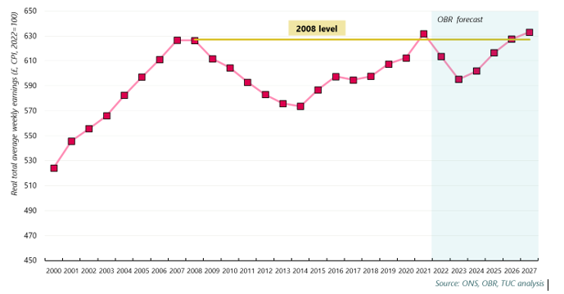
The worst real pay crisis in two centuries
(real pay: AWE, total pay, CPI, 2022=100)

Slide 4
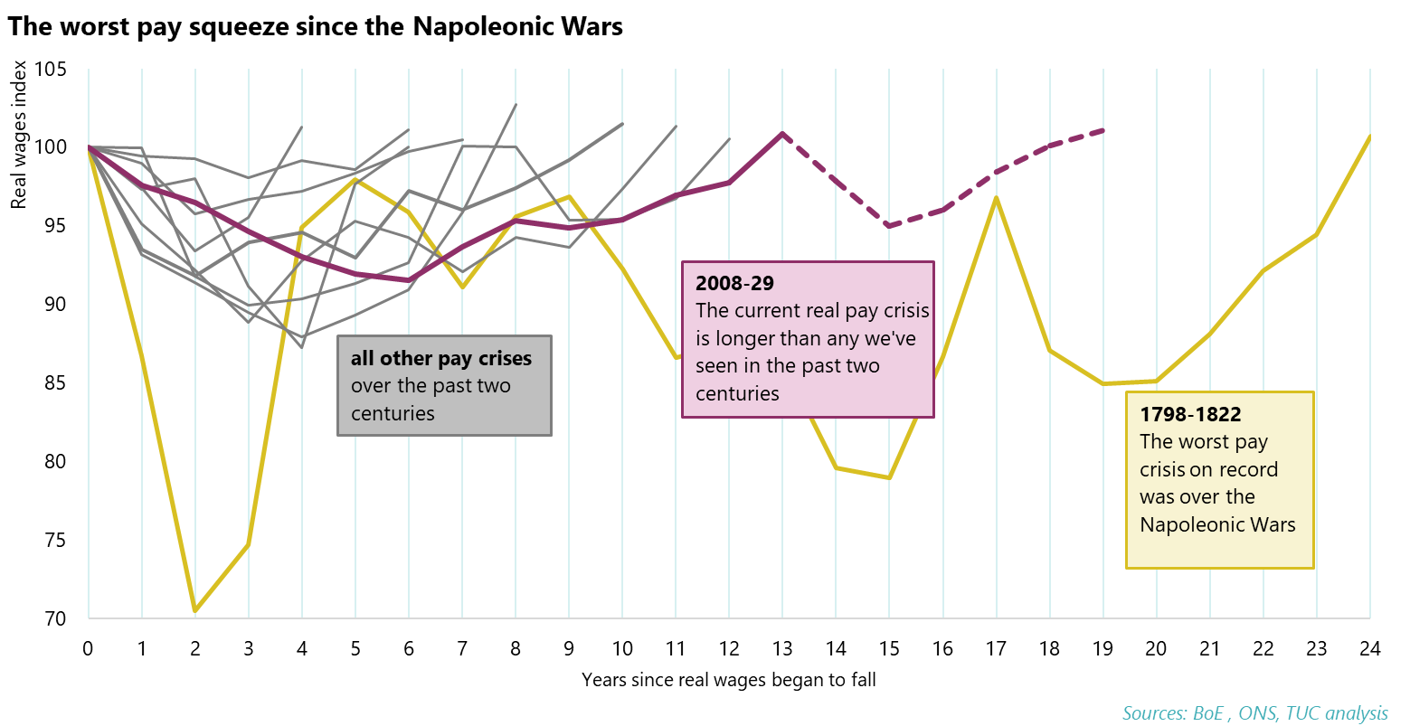
The worst real pay crisis in two centuries
(real pay, AWE, CPI, 2022=100)

Slide 5
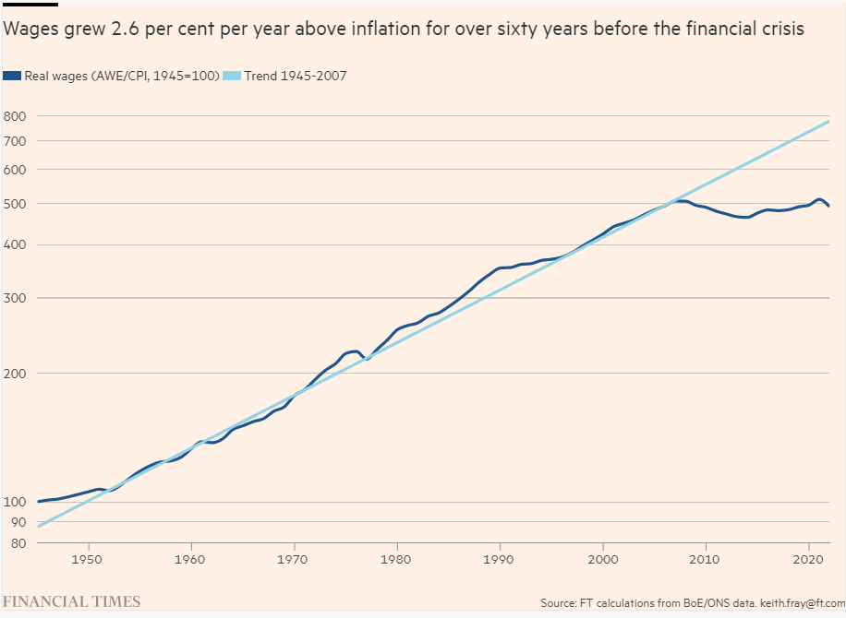
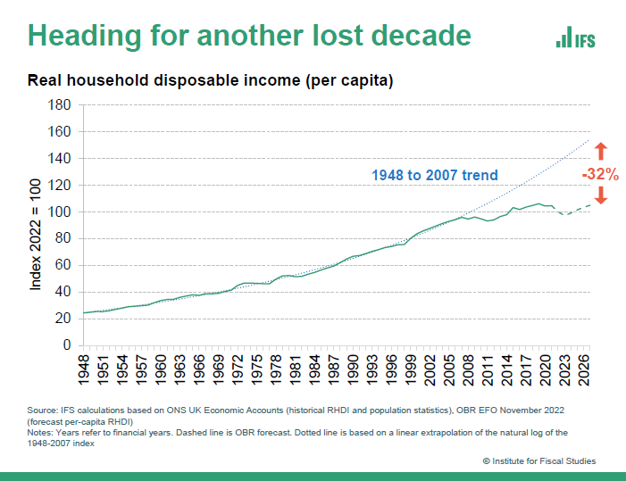
Financial Times (left) / IFS (right)

Slide 6
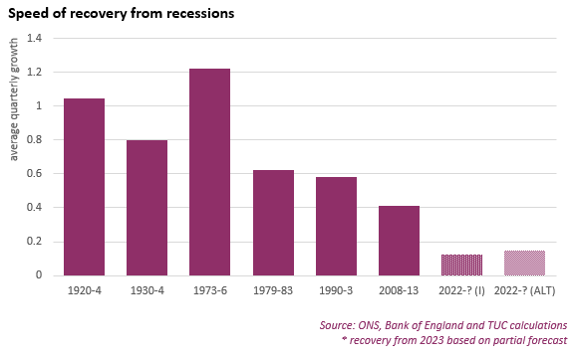
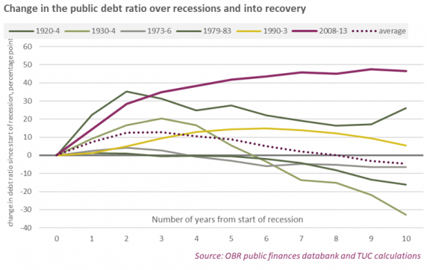
The worst recovery in a century

Slide 7
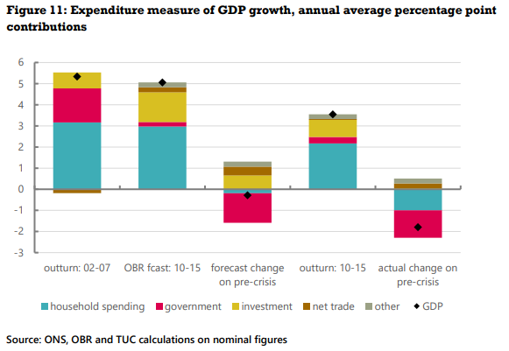

Slide 8
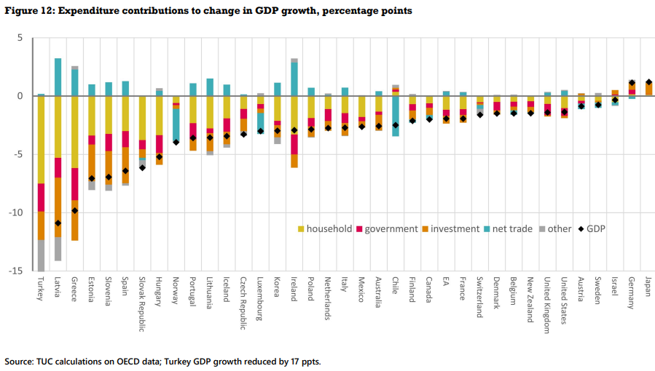

Slide 9
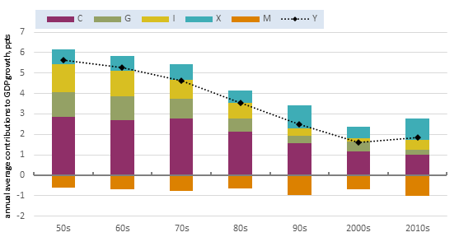
Figure 6: G7 average GDP decade growth

Slide 10
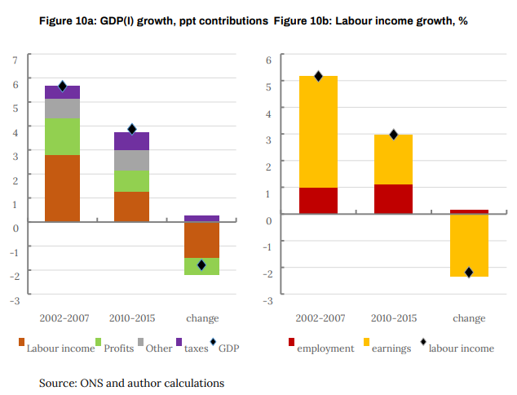

Slide 11
Productivity as an accounting relation
Supply view:
Weak pay a consequence of weak productivity
Demand view:
Weak productivity a consequence of weak pay
Since 2010 labour market adjusted to weak GDP growth through price (pay, quality of work and profit) rather than quantity (jobs)

Slide 12
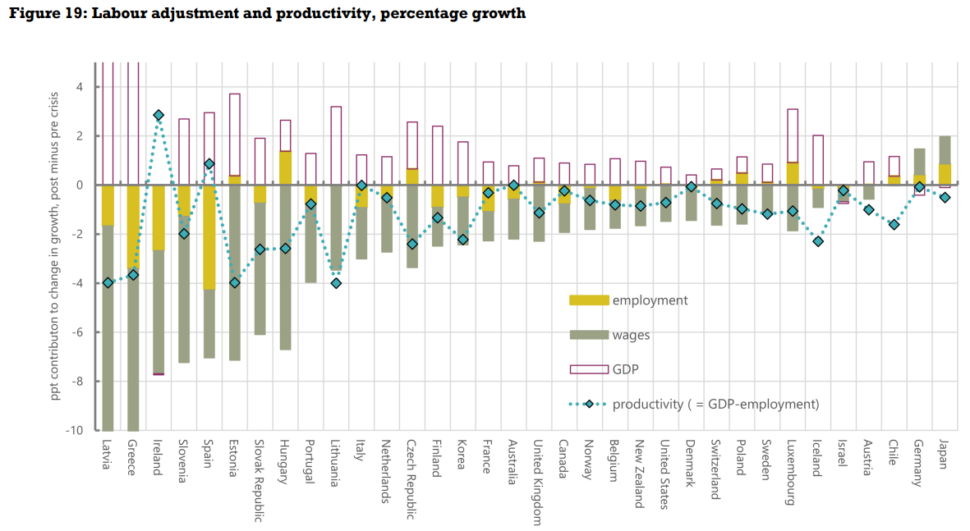

Slide 13
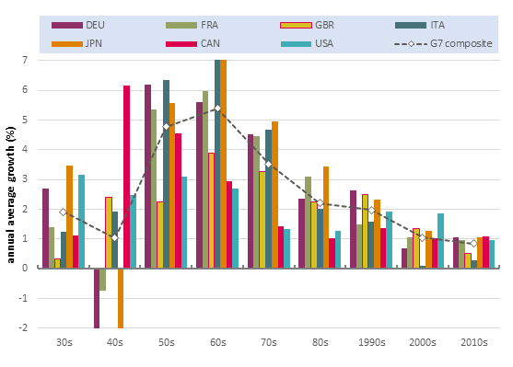
Figure 10a: Productivity growth: G7 countries, decade averages

